Slide 1
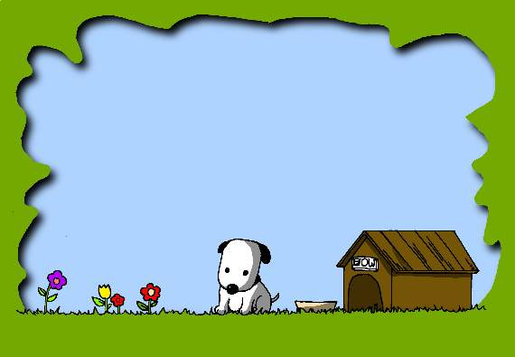
Unit2 School lifeUnit2 School life
Welcome to the Unit

Slide 2
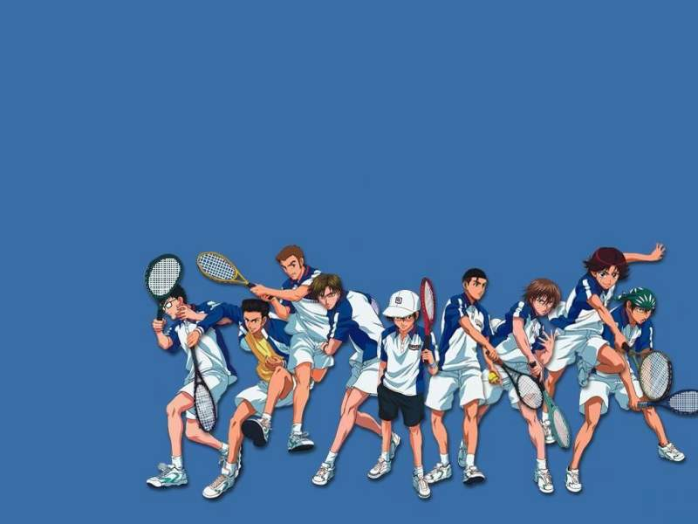
1.Do you like going to school?
2. Do you think dogs need to go to school?

Slide 3
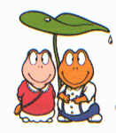
Listen and answer
What does Eddie think school is like ?
Eddie thinks that it’s like watching TV, but there are fewer advertisements.

Slide 4
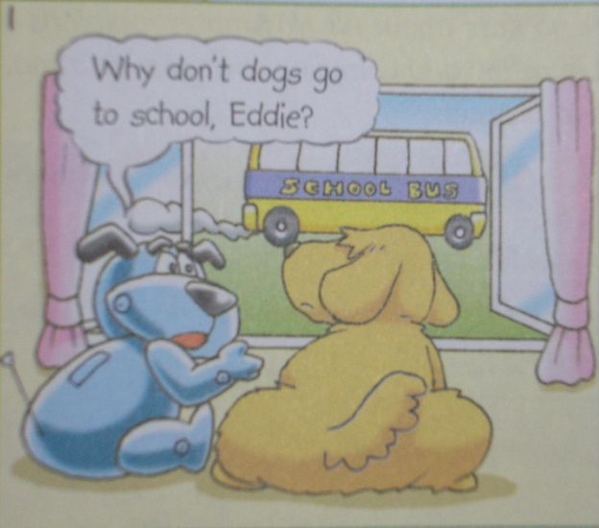
Why don’t dogs go to school,Eddie?

Slide 5
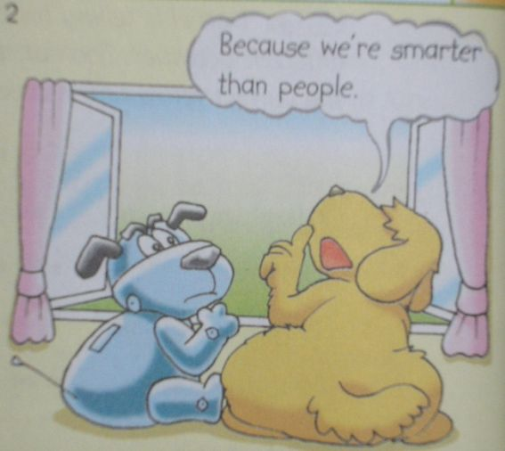
Because we are cleverer than people.They have to work harder.

Slide 6
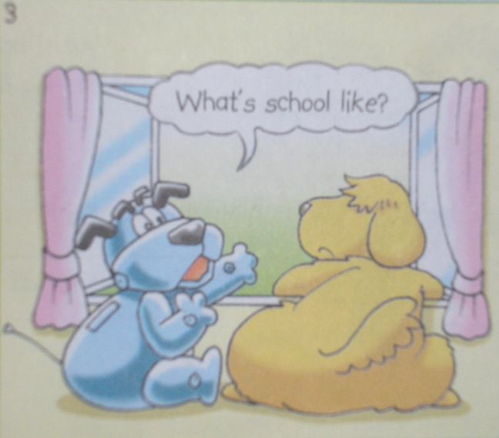
What’s school like?

Slide 7
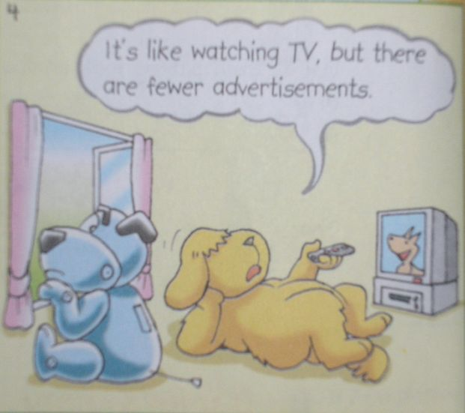
It’s like watching TV, but there are fewer advertisements.

Slide 8
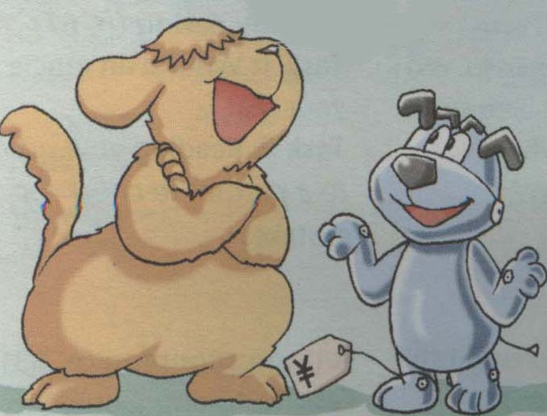
Complete the dialogue
Pair work：
ACT IT OUT!
don’t
Hobo: Why _________ dogs go to school,
Eddie?
Eddie: Because we’re ___________ than
people.
Hobo: What is school ______________?
Eddie: It’s like _______________________,
but there are
_______advertisements.
cleverer
like
watching TV
fewer

Slide 9
1. What is school like?
like: prep.像… (unlike)
eg: John looks smart, just like his father.
His hat looks like mine.
The noise sounds like crying.
What’s the weather like?
*like: v. 喜欢 （dislike）

Slide 10
2. …there are fewer advertisements.
* a few和few: 可数名词
a little和little:不可数名词
* few—fewer—fewest
little—less—least

Slide 11
Group work：Fill in the blanks.
few a few little a little
a little
1. I have ___________ money. I want to buy a pizza for lunch.
2. It is raining too hard. ______ people are in the street.
3. We often have _______ days off for National Day.
4. Hurry up !There is _____ time .
5.Don’t worry .We have _______ time .
Few
a few
little
a little
返回返回

Slide 12
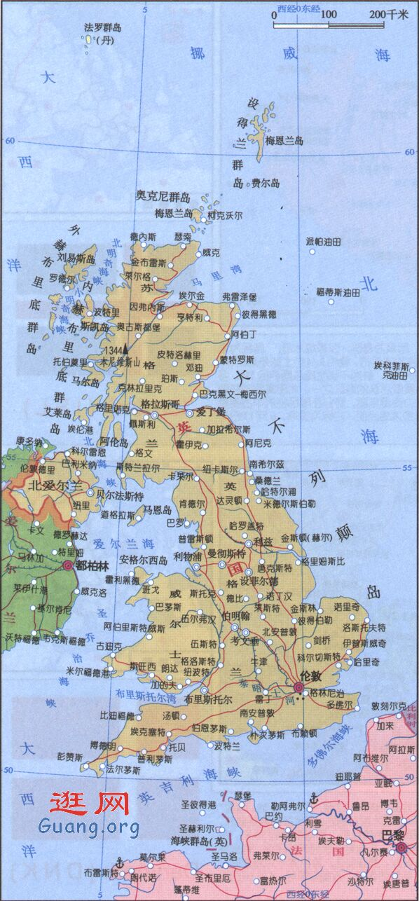
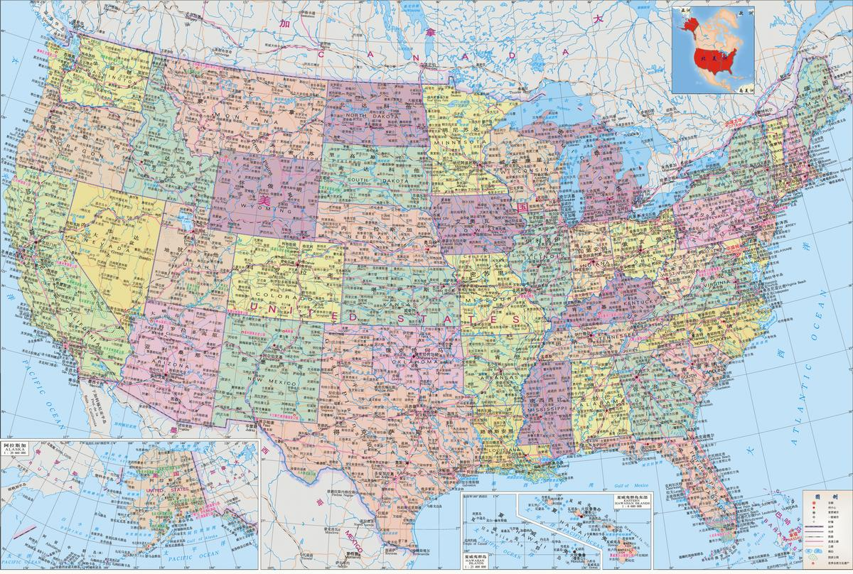
British English
American English
What countries are they?
What languages do they speak?

Slide 13
Attention:
People speak English in both Britain and the USA. However, sometimes they use different words to refer to(指代) the same thing.

Slide 14
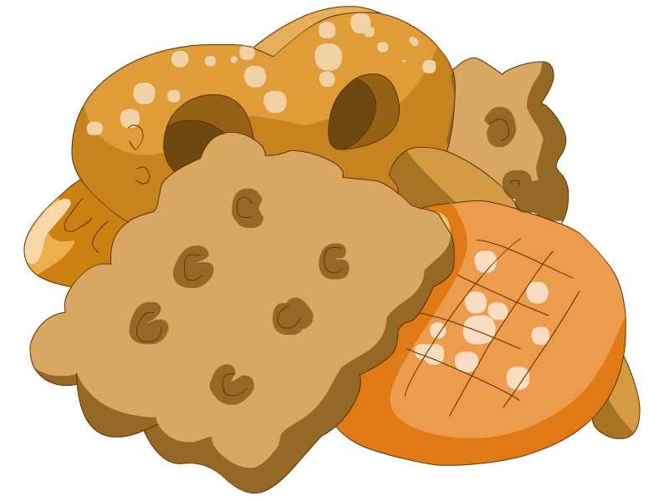
biscuit
cookie

Slide 15
autumn
fall

Slide 16
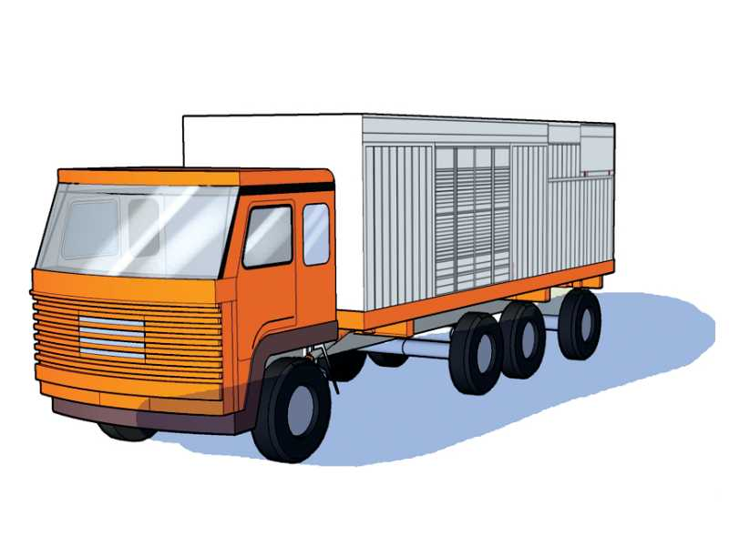
lorry
truck

Slide 17
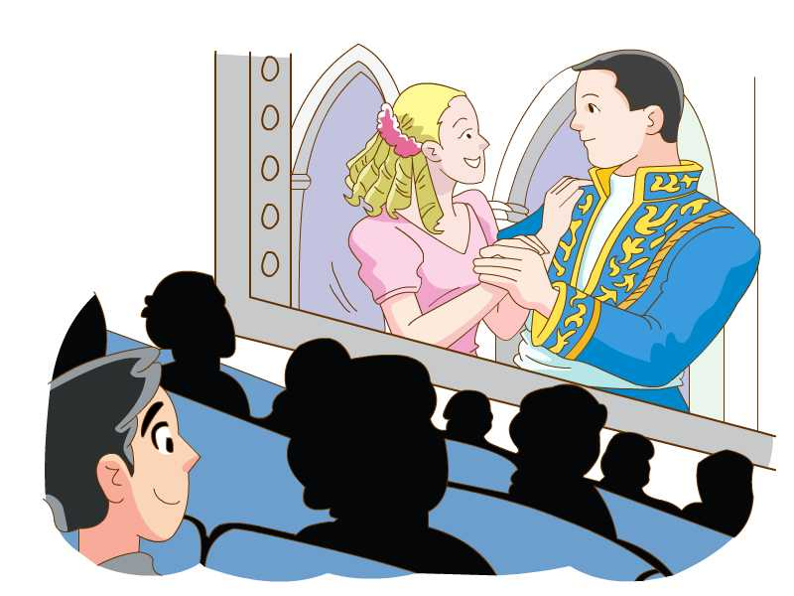
film
movie

Slide 18
football
soccer

Slide 19
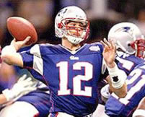
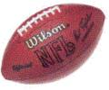
American football
football

Slide 20
holiday
vacation

Slide 21
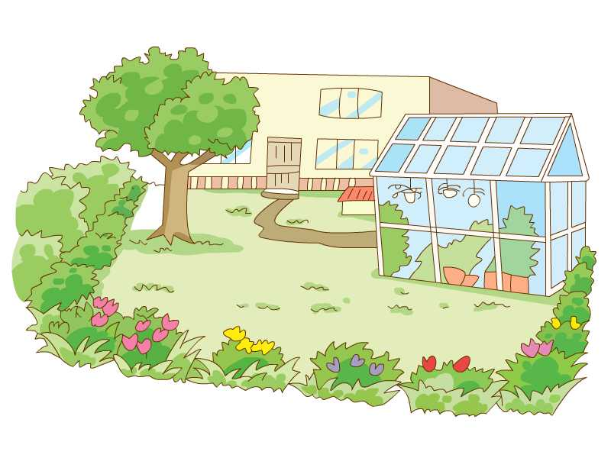
garden
yard

Slide 22
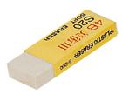
rubber
eraser

Slide 23
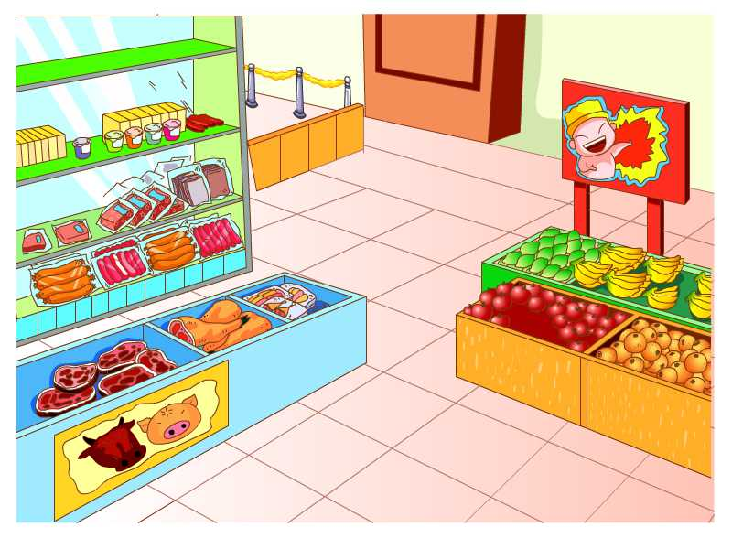
shop
store

Slide 24
British English
American English
1 biscuit
2 autumn
3 lorry
4 film
5 football
6 holiday
7 garden
8 rubber
9 shop
d
a. eraser
b. soccer
c. vacation
d. cookie
e. fall
f. store
g. truck
h. yard
i. movie
1 ___
2 ___
3 ___
4 ___
5 ___
6 ___
7 ___
8 ___
9 ___
e
g
i
b
c
h
a
f

Slide 25
Quiz！

Slide 26
film
movie

Slide 27
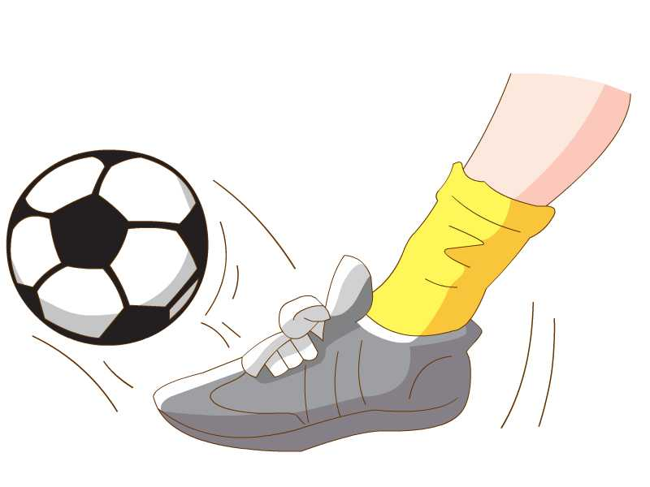
football
soccer

Slide 28
garden
yard

Slide 29
lorry
truck

Slide 30
rubber
eraser

Slide 31
It is Friday afternoon. Daniel and Simon are chatting after school. Read their conversation. Underline the British words and write the American words above them.

Slide 32
Daniel: Hi, Simon. Where are you going?
Simon: I'm going to buy a toy lorry for my
cousin in the shop near our school.
Daniel: I'll go with you. I'd like to buy some
biscuits.
Simon: Do you have any plans for the
weekend?
Daniel: I want to see a film . Shall we go
together?
Simon: I'd love to, but the school football team
will practise this Saturday. We have an
important match this autumn.
truck
store
cookie
movie
soccer
fall

Slide 33
Different words mean the same thing
British English
American English
trousers
candies
Post
secondary school
pants
sweets
Mail
high school

Slide 34
Dear Peter
Autumn is coming. I am very happy to go back to my secondary school.
I am in Grade 8 this term. My classroom is not on the ground floor. It’s on the fourth floor, so I need to go up in a lift.
I like playing with the rubber and chatting with friends when we have a break. Maths is my favourite subject and I often do well in it.
After school, I like to play football. Sometimes I can go to see a film with my classmates.
Simon
Do you know?Do you know?

Slide 35
Dear Peter
_______ is coming. I am very happy to go back to my ____________.
I am in Grade 8 this term. My classroom is not on the ________ floor. It’s on the fifth floor, so I need to go up in _______________.
I like playing with the ___________ and chatting with friends when we have a break. _________ is my favorite subject and I often do well in it.
After school, I like to play ________. Sometimes I can go to see a ________ with my classmates.
Simon
Group work！
Fall
high school
first
an elevator
eraser
Math
soccer
movie

Slide 36
Different spellings
British English
American English
maths
favourite
humour
colour
centre
practice
math
favorite
humor
color
center
practise

Slide 37
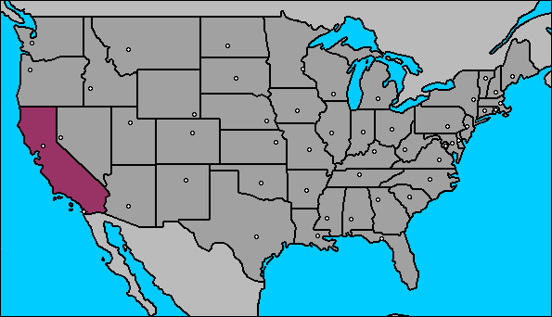
Different pronunciations
讲美式英语的人会发很清楚的卷舌音

Slide 38
Group work：Discuss the phrases and sentences.
1.得更努力
2.像看电视
3.更少的广告
4.理想学校
5.举行重要的比赛
6.学校是什么样?
7.今年秋天
8.你去哪儿？
have to work harder
be like watching TV
fewer advertisements
an ideal school
have an important match
What’s school like?
this autumn
Where are you going?

Slide 39
9.给我堂兄买卡车
10.在我们学校附近的商店
11.看电影
12.周末计划
13.在本周六练习
buy a truck for my cousin
in the shop near our school
see/watch a film/movie
the plan for the weekend
practise this Saturday

Slide 40
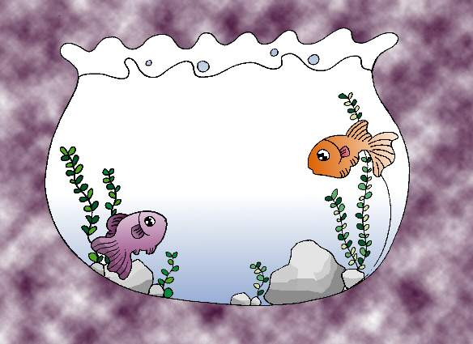
GoodbyeGoodbye

