Slide 2
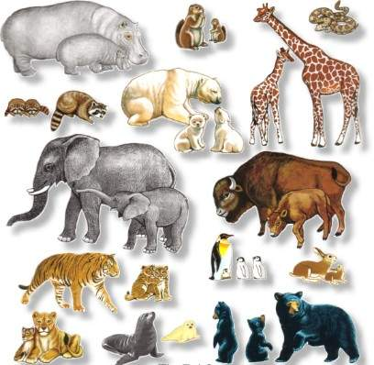
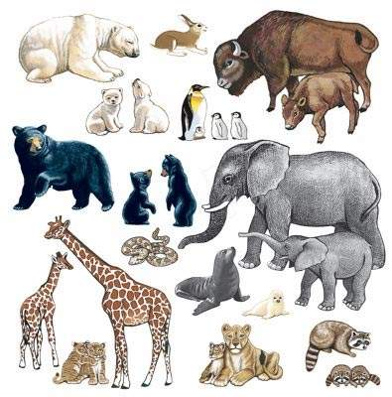
Unit 5
Wild animals
Welcome to the unit

Slide 3
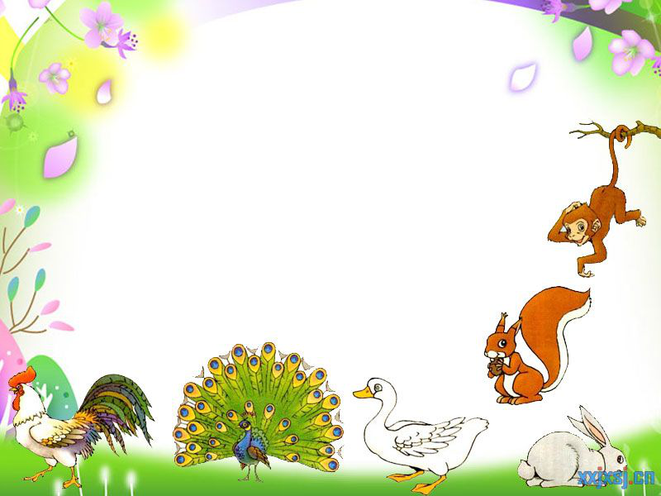
Free talk
Pairwork
What's your favourite wild animal?
Can you tell us something about it?

Slide 4
Favourite wild animals
Millie and her classmates are talking about their favourite wild animals. Listen to their conversation and answer the questions.

Slide 5
Talk about favourite wild animals
Listen and fill in the table
Wild animals
Reason
Kitty
monkeys
clever, funny
Simon
lions
strong, run fast
Peter
pandas
cute
Millie
pandas
/

Slide 6
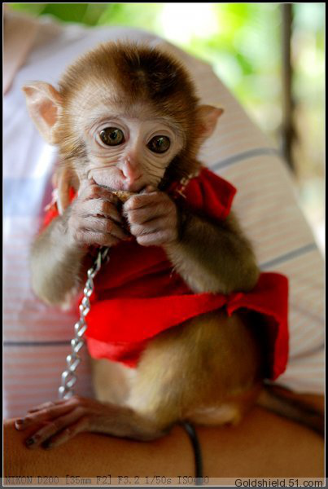
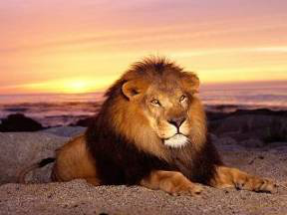
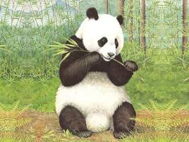
How many kinds of wild animals
did you learn just now？
lion
giant panda
monkey

Slide 7
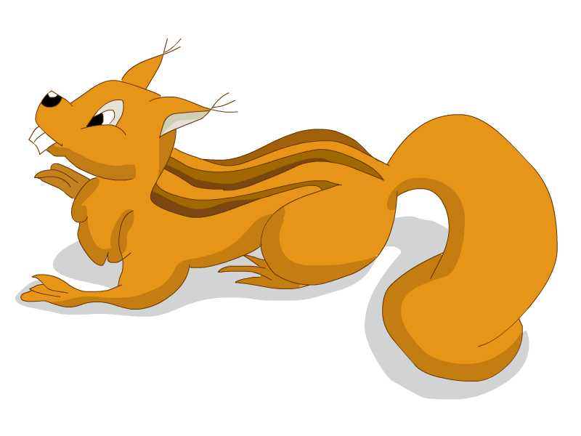
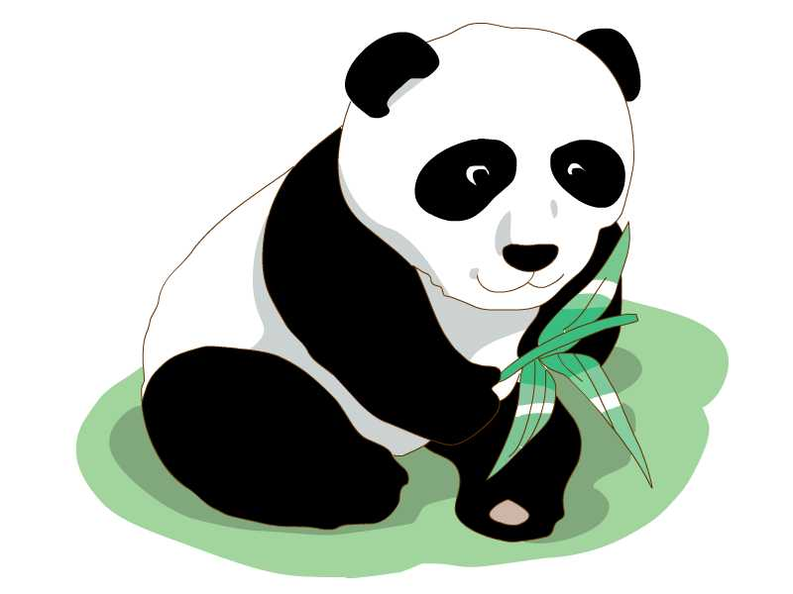
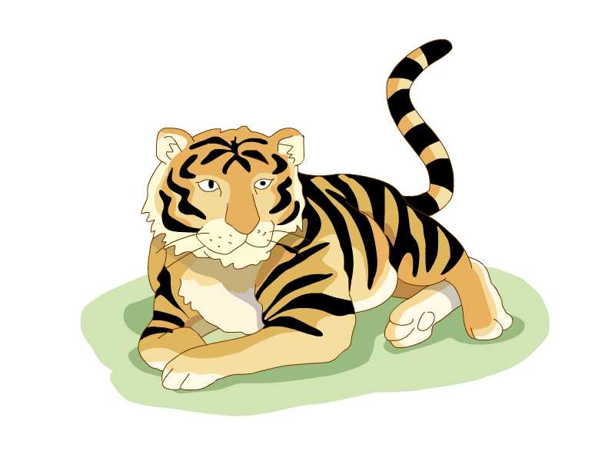
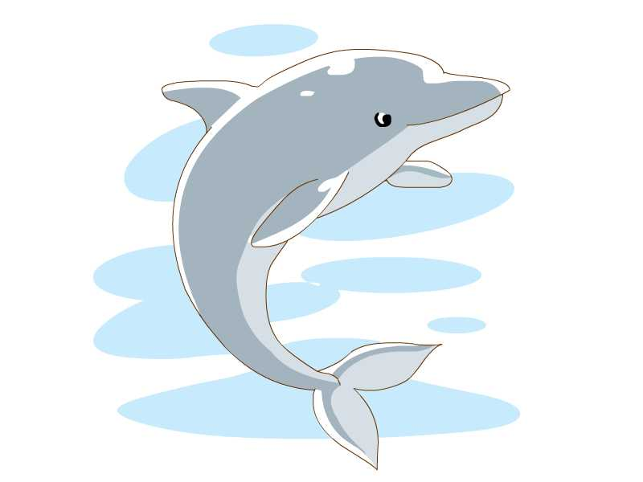
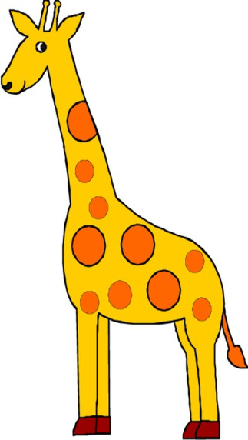
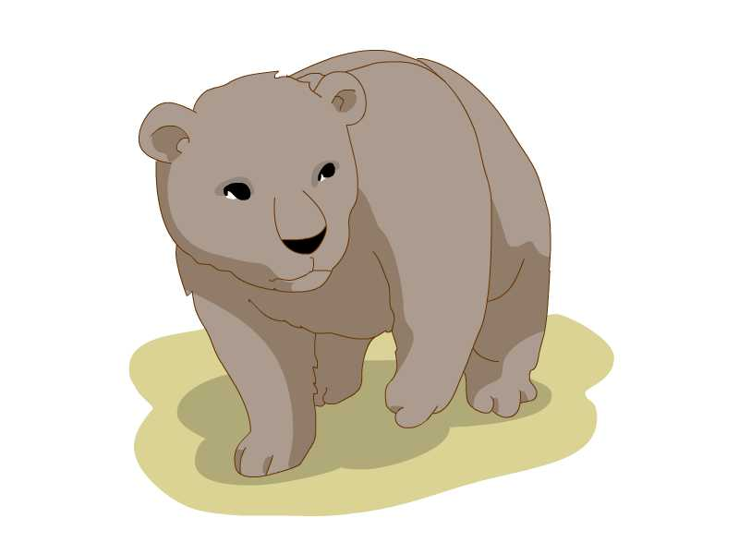
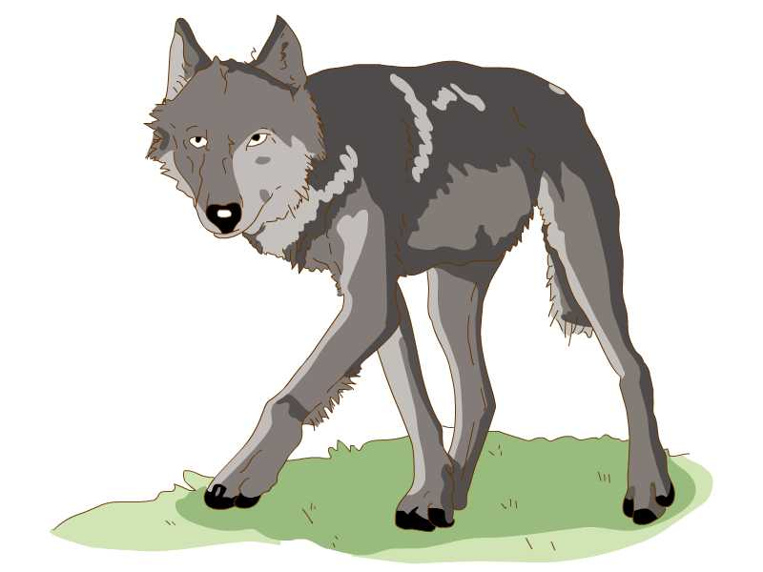
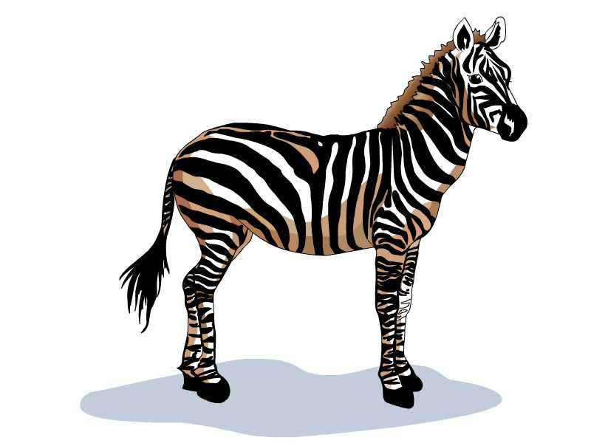
Can you list any other
wild animals?
squirrel
tiger
dolphin
giant panda
wolves
bear
giraffe
wolf
zebra

Slide 8
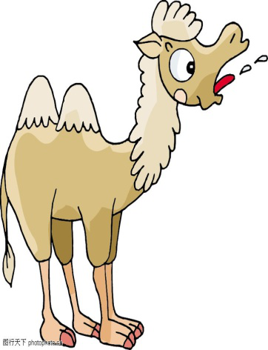
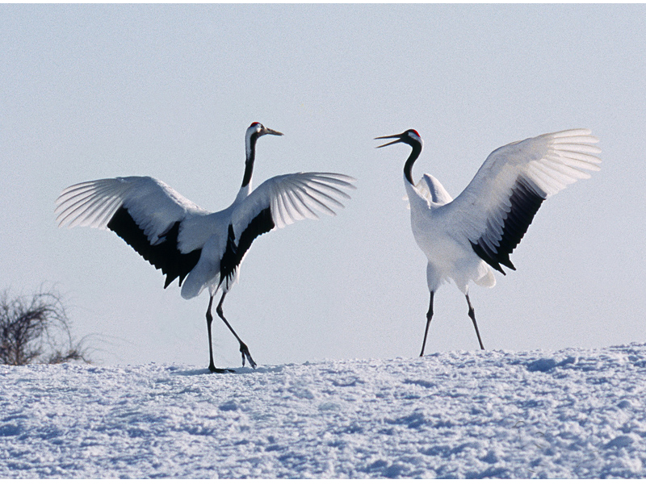
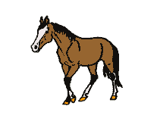
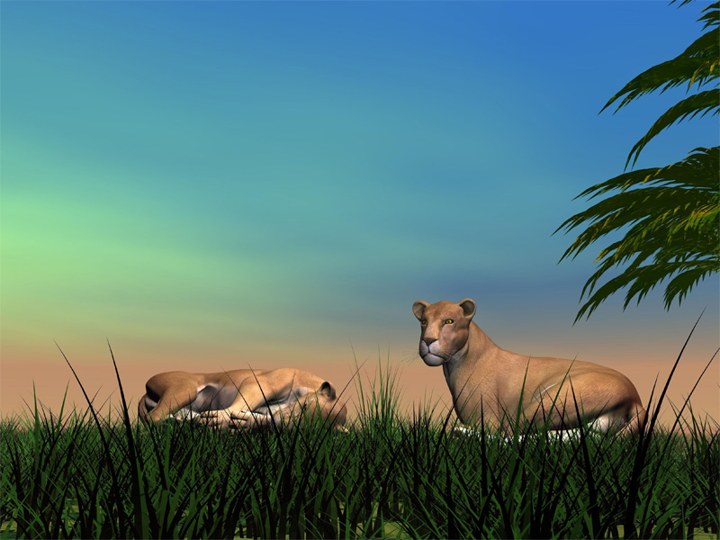
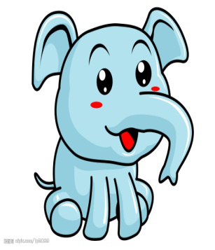
Talk about your favourite wild animal
group work
A: What wild animal do you like best, ...?
B: I like ... best. They ... . What about you, ...?
C: I like ... best. They ... .
A: They ...
C: Yes, ... . What wild animal do you like best, ...?
D: I like ... best. They ... .
A: ...
camel crane horse
snake leopard elephant

Slide 9
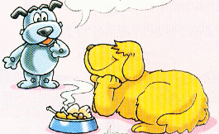
Eddie and Hobo are also talking about wild animals.
Let's join them !

Slide 10
Listen and fill in the blanks.
Would you like to ___ __ ___ ____, Eddie?
live in the wild
No.

Slide 11
1. Would you like to live in the wild, Eddie?
Would you like ...? 表示提出的建议或请求，eg:
— Would you like to go fishing with me?
你愿意和我一起去钓鱼吗？
— Yes, I’d like to.
是的，我乐意。
— Would you like to go out for a walk?
你喜欢出去散步吗？
— Yes, I'd like to.
好吧，很高兴去。

Slide 12
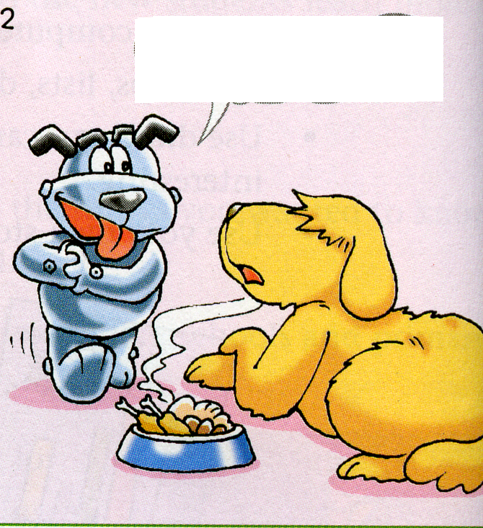
Why not? Wild animlas are _____ and ______.
free
happy
I don't think so. They may become dishes
___ ___ ____ any time.
on the table

Slide 13
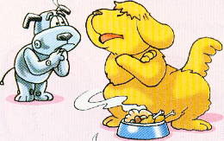
So could you please not eat them?
___ ____!
No way

Slide 14
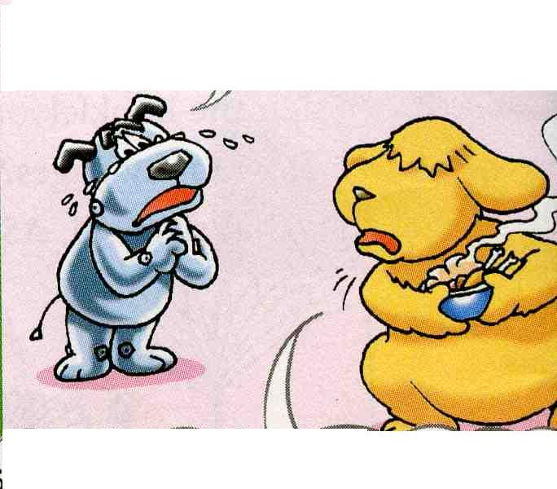
Please ____ ____ ____ them, Eddie.
have pity
on
I may die ________ them. __ ____, these are not wild animals, Hobo.
without
In
fact

Slide 15
2. Please have pity on them, Eddie.
One should have pity on the beggar(乞丐) in the street.
have pity on = take pity on 同情，怜悯
3. In fact, these are not wild animals, Hobo.
in fact 实际上，事实上
I thought that he was honest, but in fact he is a thief.
我认为他很诚实，但事实上他是个小偷。

Slide 16
Read and answer
Would Eddie like to live in the wild ?
Why or why not?
No, because wild animals may become dishes on the table any time.
2. What does Hobo beg (请求) Eddie for?
Don’t eat the wild animals.
Have pity on the wild animals.

Slide 17
Fill in the blanks.
Hobo thinks Eddie would like to live in the _______ because wild animals are _______ and happy. But Eddie doesn’t think so. He thinks they may become ________ on the table any time. Hobo asks Eddie not to eat them and he should _______ _______ _______ them. But Eddie says he may _______ without them. _______ _______, they are not wild animals.
wild
free
dishes
have pity on
die
In fact

Slide 18
Challenge time !

Slide 19
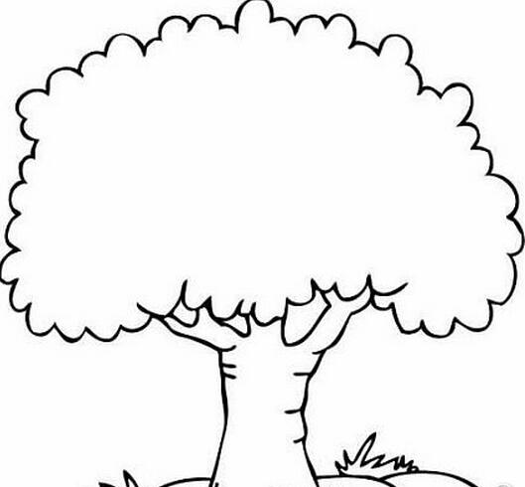
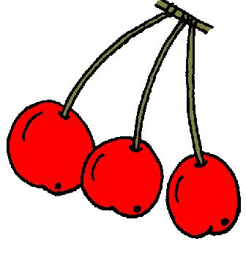
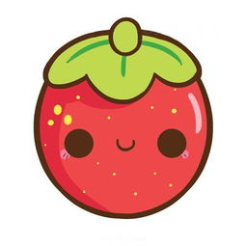
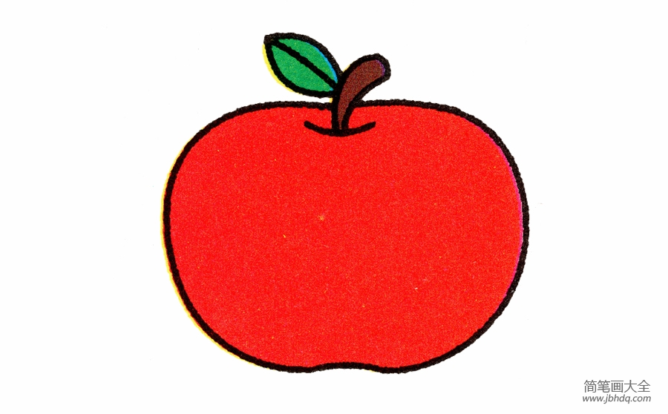
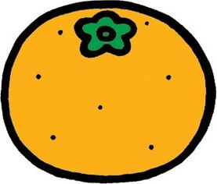
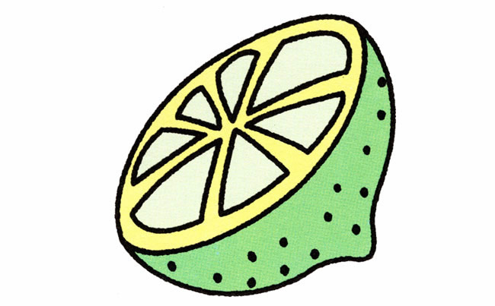
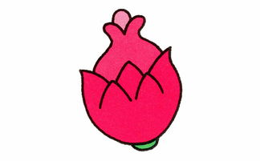
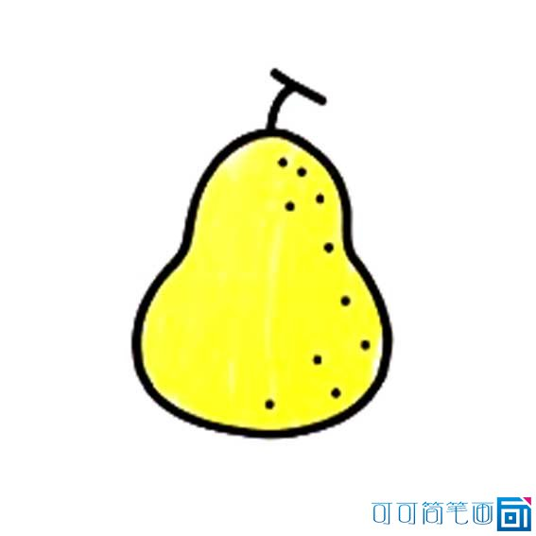
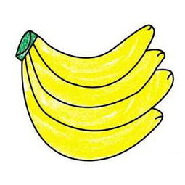
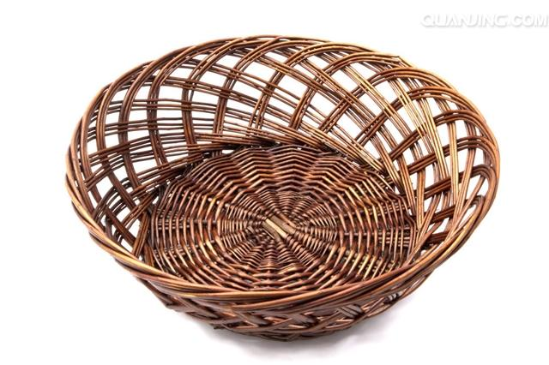
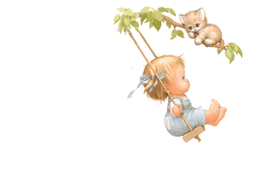
Challenge!

Slide 20
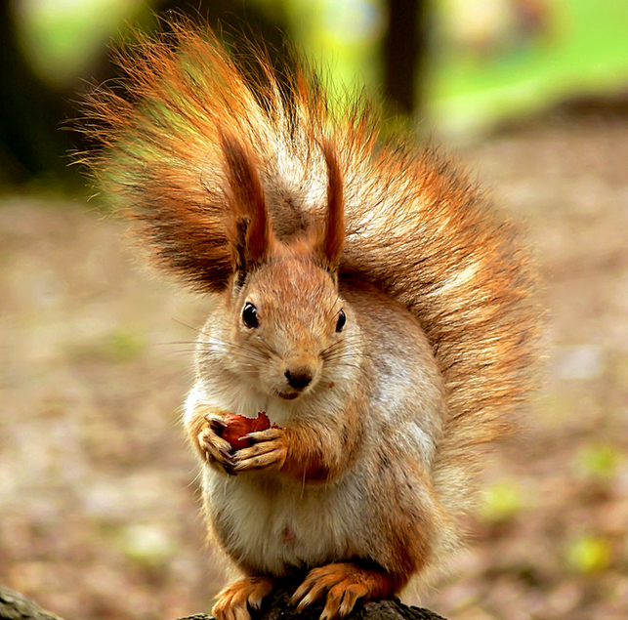
squirrel

Slide 21
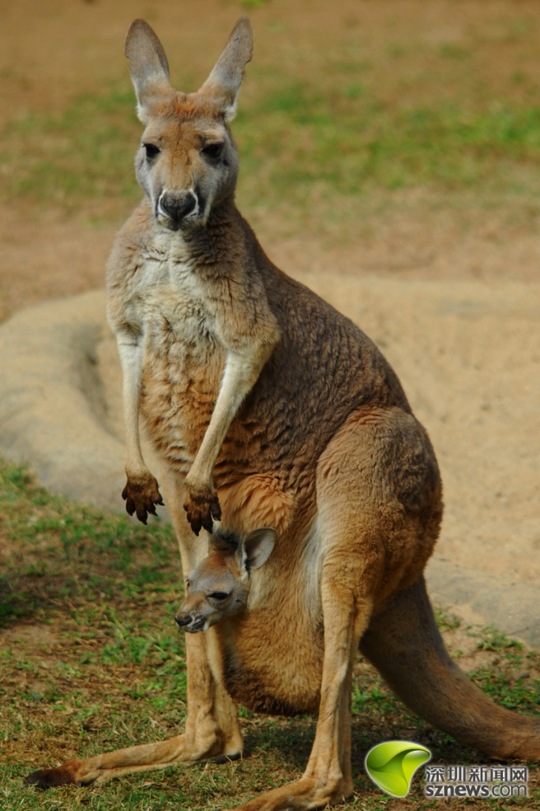
They live in Australia.
They have special pockets.
They put babies in the pockets.
They jump on their back legs.
They jump high and far.
They like eating grass and leaves.
What are they?
kangaroos

Slide 22
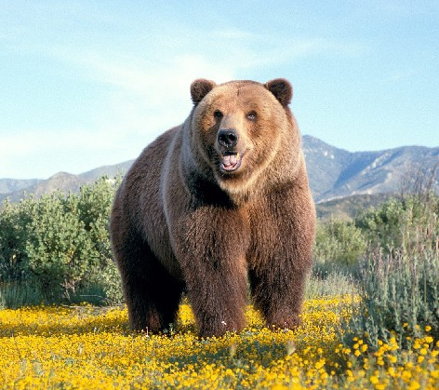
bear

Slide 23
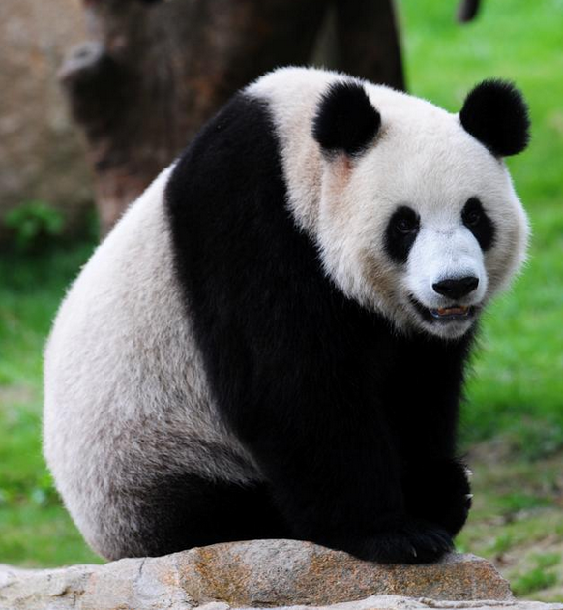
It looks very cute.
It is also fat.
It is white and black.
It likes eating bamboo.
What is it ?
giant panda

Slide 24
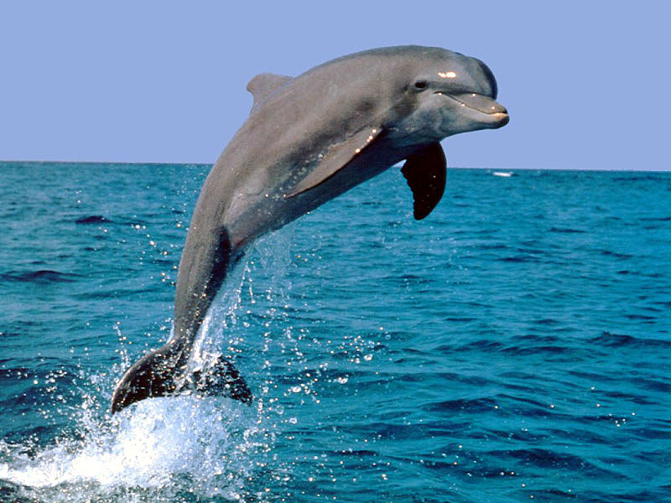
It is a good swimmer.
It is very clever and friendly.
It often gives wonderful shows.
What is it?
dolphin

Slide 25
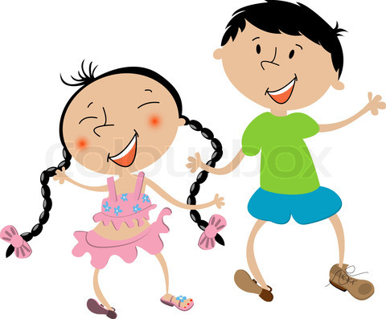
Surprise!
Each of your group member
will get a present after class !

Slide 26
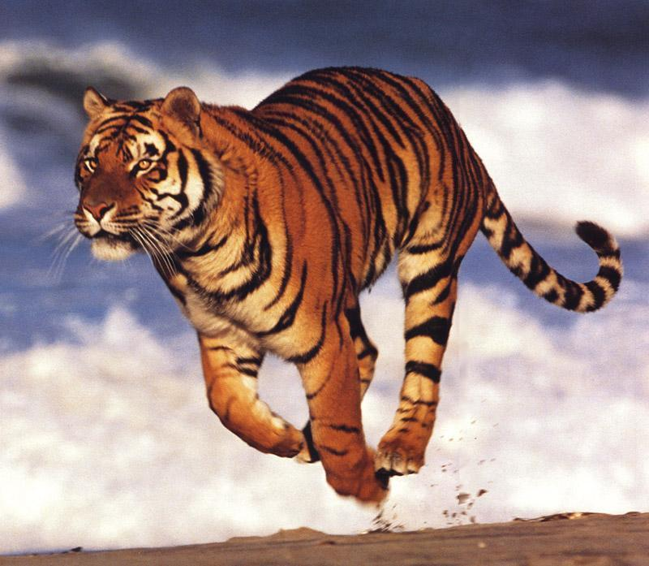
tiger

Slide 27
camel

Slide 28
Congratulations!
You are the lucky dog today!

Slide 29
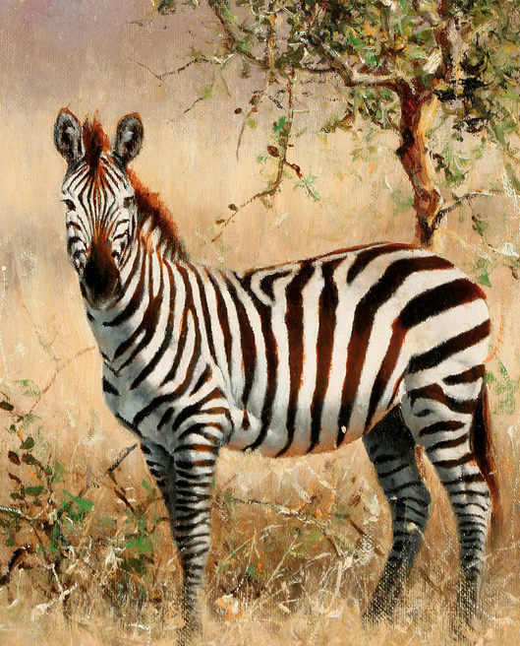
zebra

Slide 30
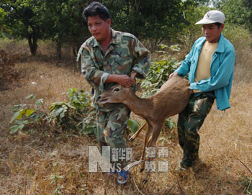
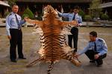
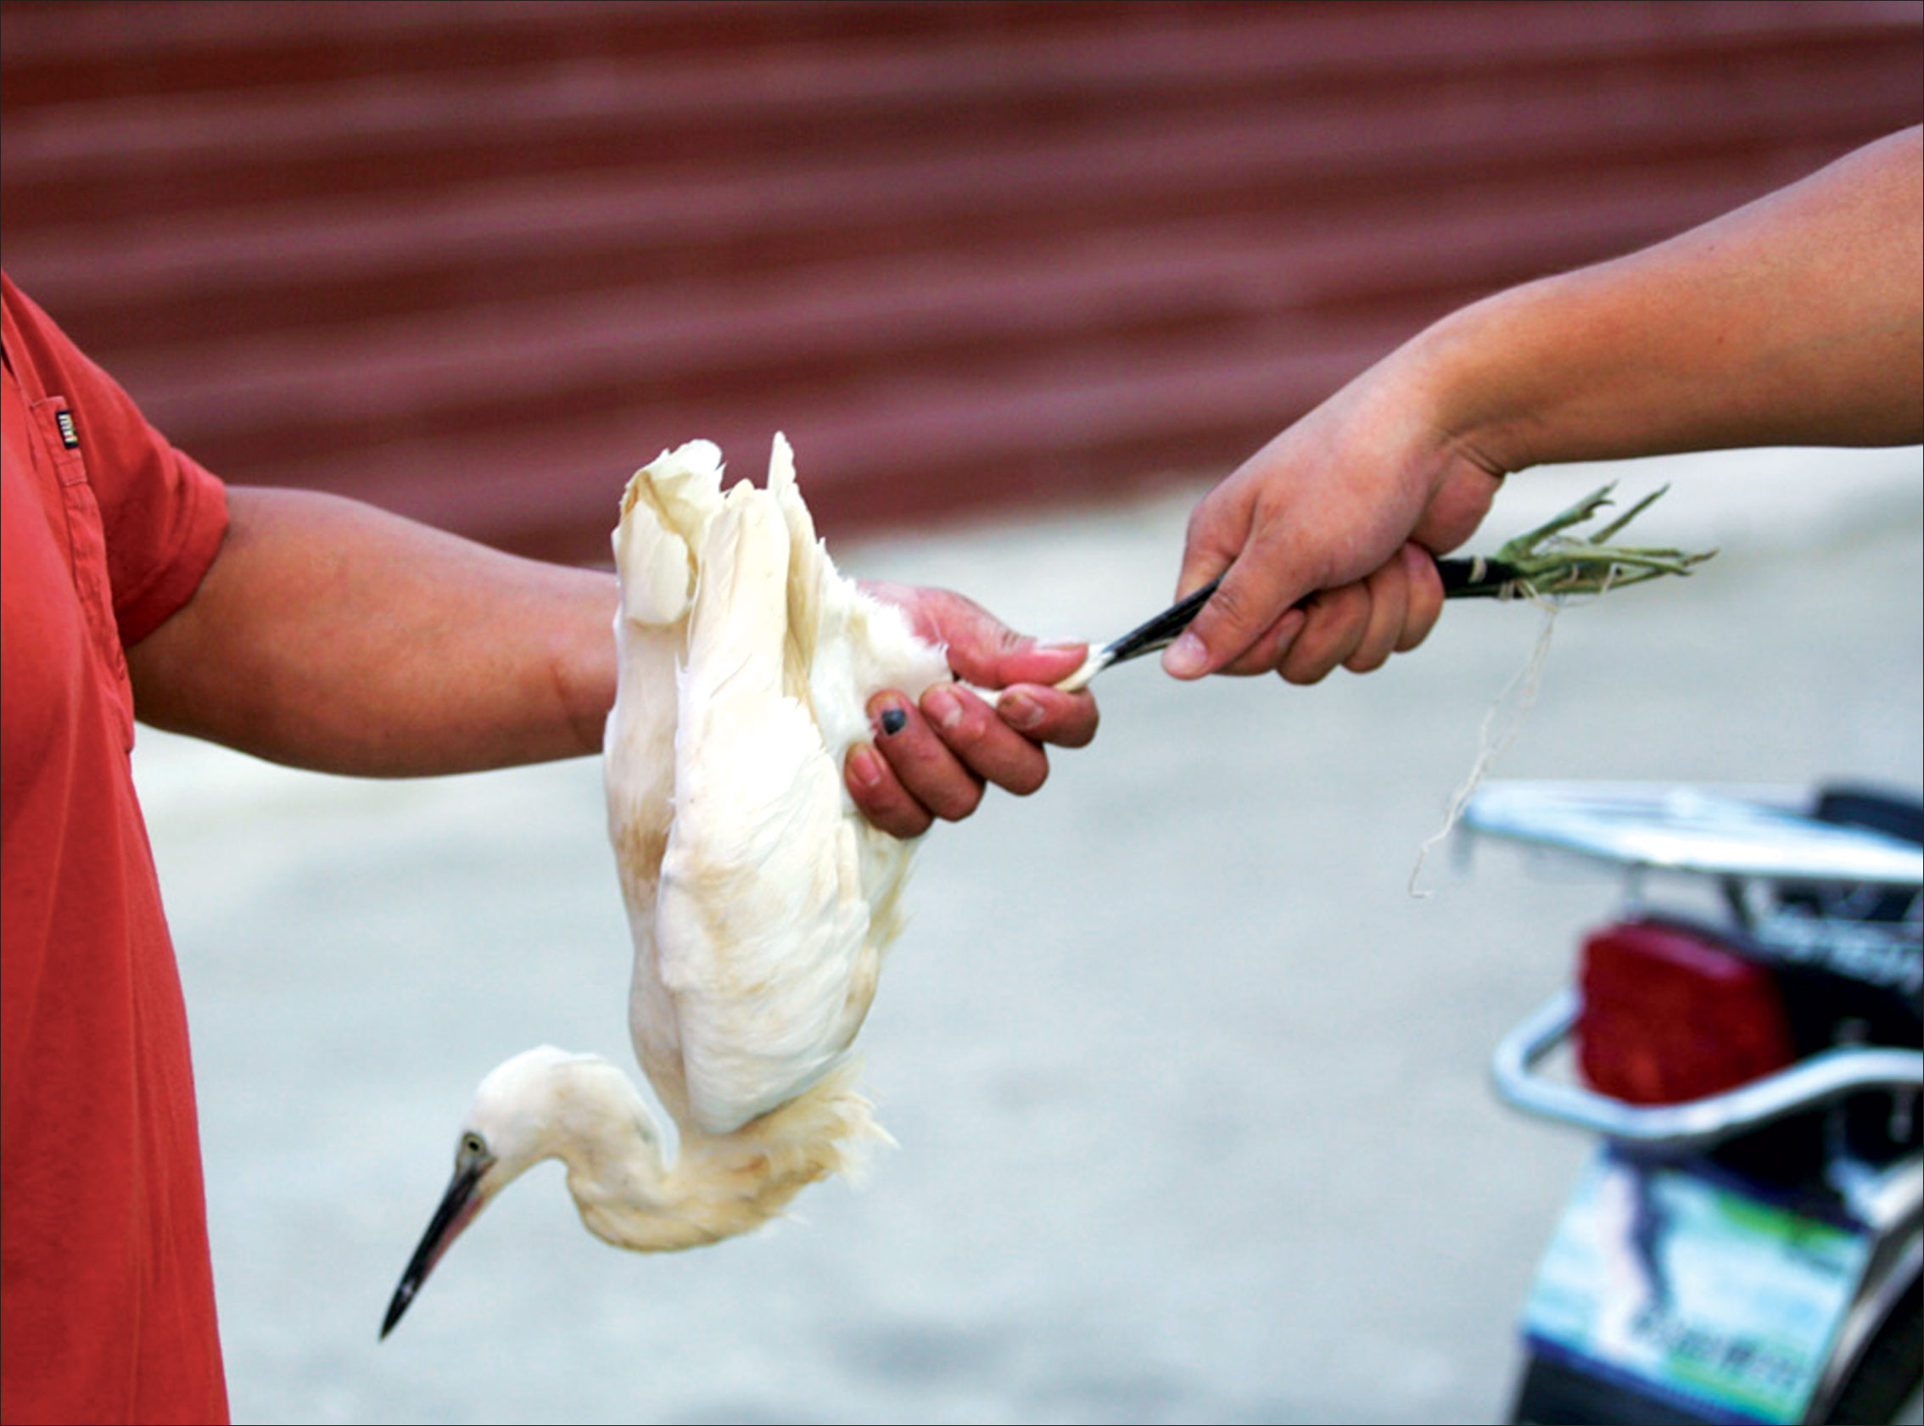
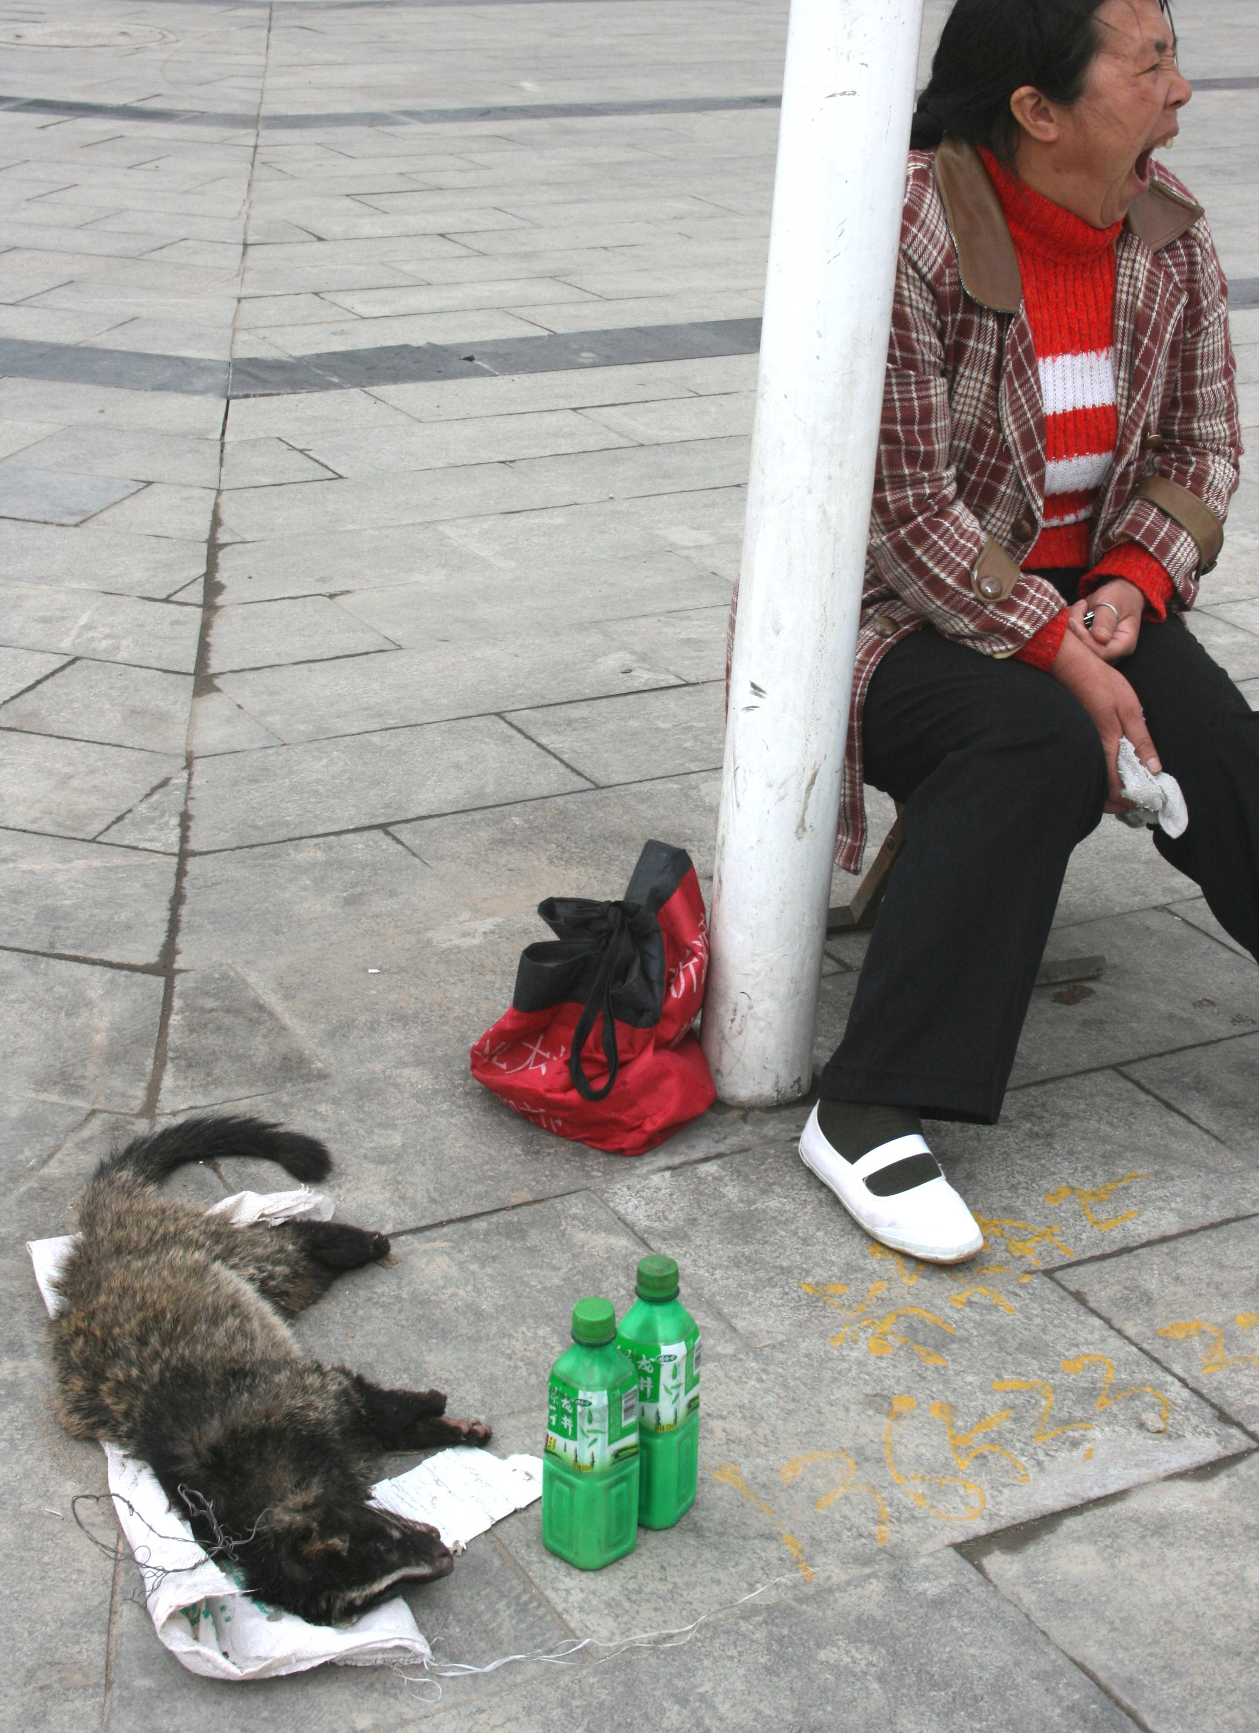
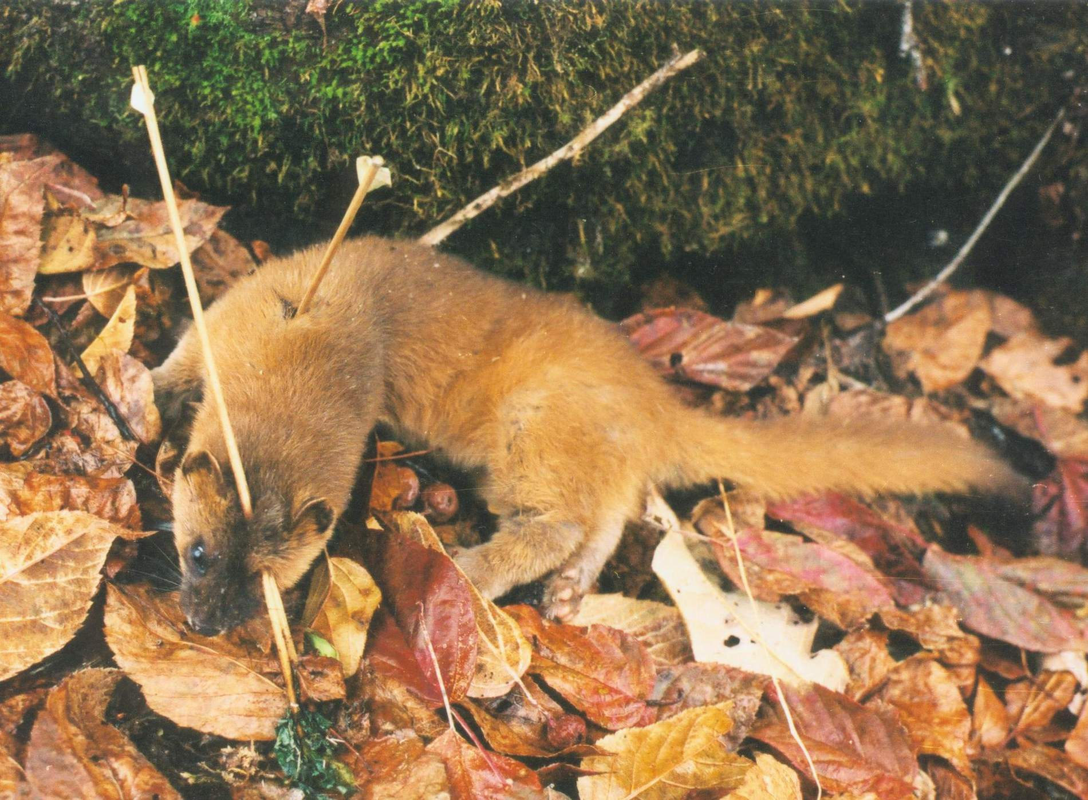
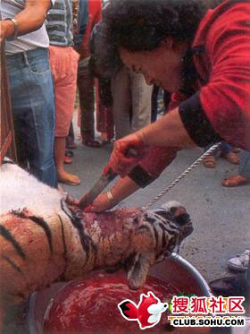
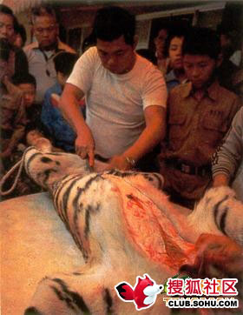
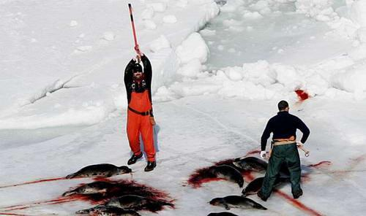
How do you feel?

Slide 31
If your favorite wild animals are in danger, what will you say to people to ask them to protect them?
Animals are our friends. Please save them.
Don't make children see wild animals only in books.
The future of wild animals is in our hands.

Slide 32
A speech on my favorite wild animals
My favorite wild animals are dolphins.
The color of their skin is grey.
They eat small fish. And they are very clever and friendly to people.
But now dolphins are in danger. We should do something to protect them.
Dolphins are our friends. Don't make children see them only in books.

Slide 33
A speech on my favourite wild animals
My favorite wild animals are (name) .
They (looks) .
They eat (food) . And they (other features) .
But now (name) are in danger. We should do something to protect them.
________________________________ .
Animals are our friends. Please save them.
Don't make children see wild animals only in books.
The future of wild animals is in our hands.

Slide 34
Homework:
1.Talk about your favourite animal with your friends after class.
2.Read and recite Comic strip ＆Welcome to the unit.
3.Finish the exercise on page 46.

