Slide 1
Enjoy a video

Slide 2
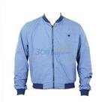
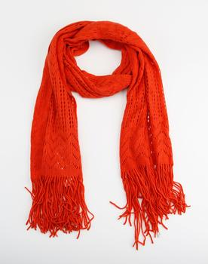
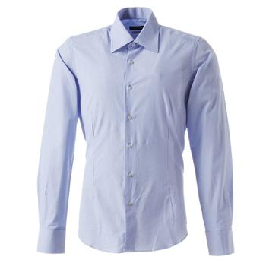
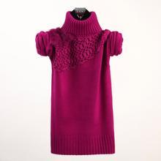
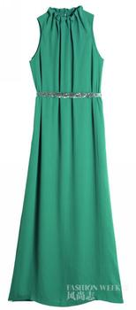
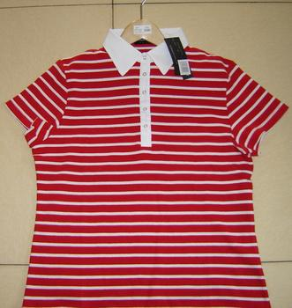
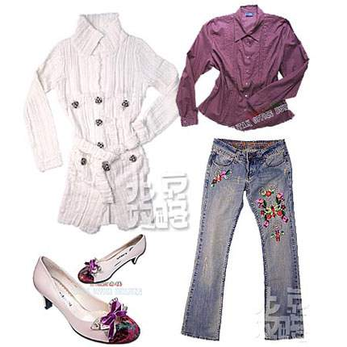
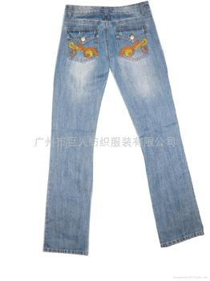
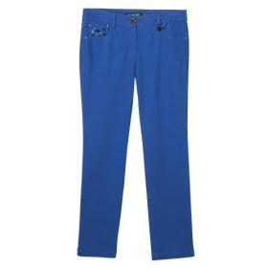
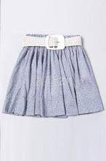
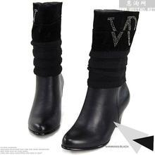
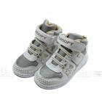
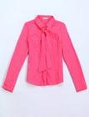
7A Unit 8 Task
Designing clothes
breakfast
reason
BY Zhang Hongyan
Liangfu Middle School
lunch
reason
supper
reason

Slide 3
a designer （设计师）

Slide 4
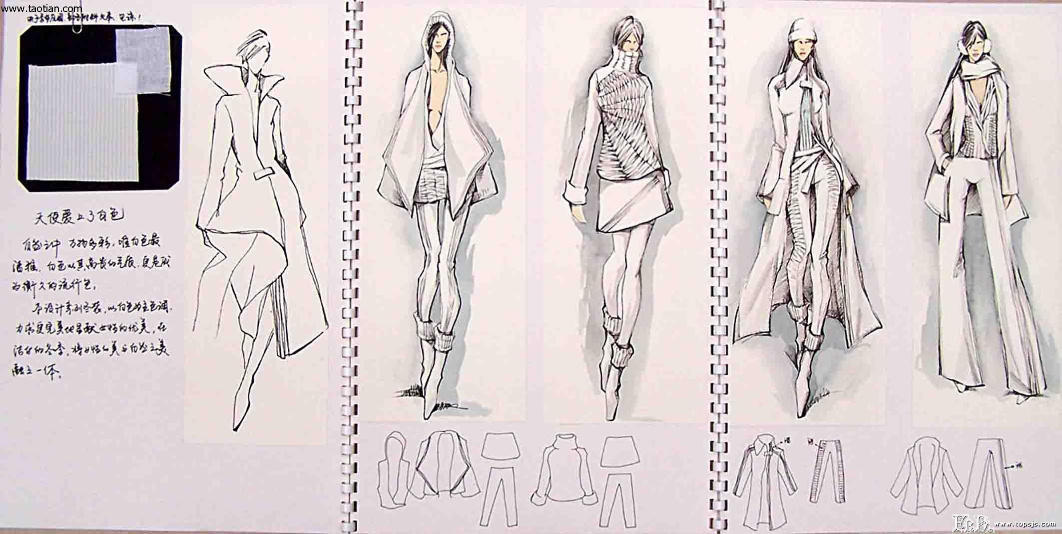
To design clothes, what should you think about？
what to design
hat, shirt, jeans, boots...
colour
dark blue, light blue , purple...
feature
[ˈfi:tʃə(r)]
smart light and comfortable....
material
wool, cotton, leather, silk..
[məˈtɪəriəl]

Slide 5
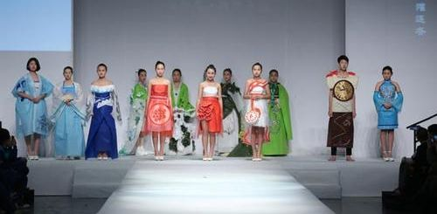
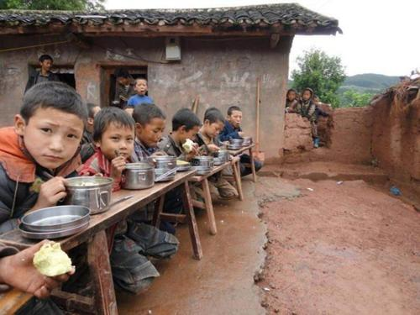
Students from Sunshine
Middle School will hold a fashion show .
They want to raise money （募集资金） for the children in poor areas.

Slide 6
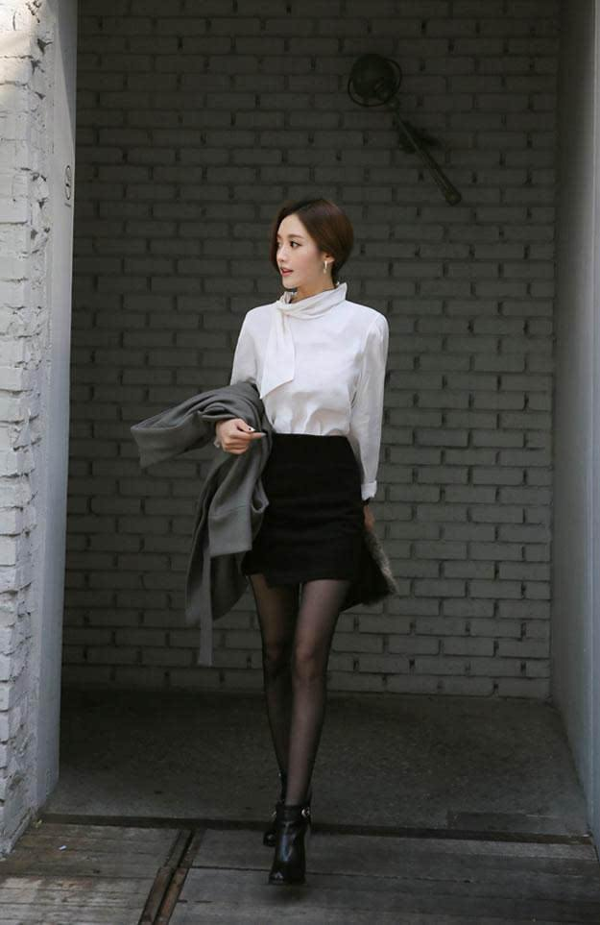
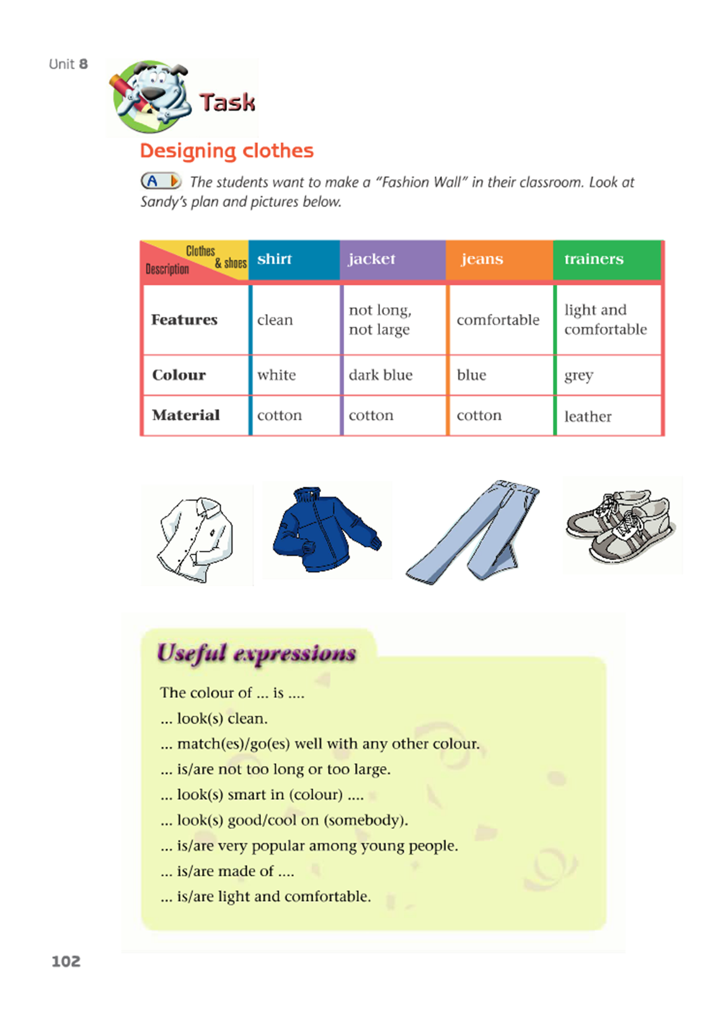
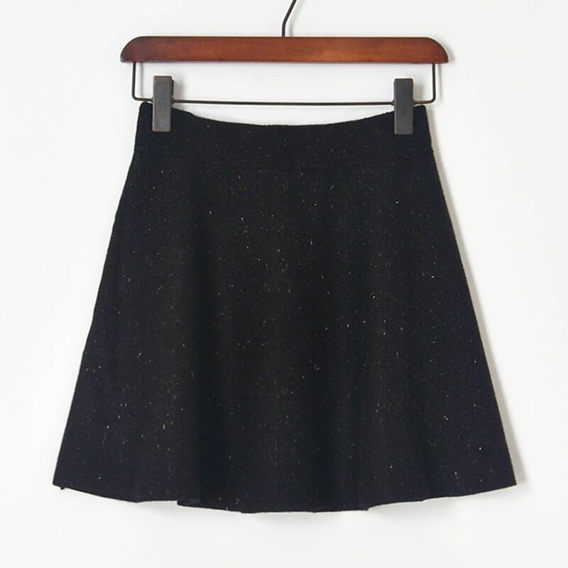
Can you describe（描述） the colour of the clothes ?
colour
The shirt is ____.
The colour of the shirt is ____.
I think ___ matches any other colour.
I think___ goes well with any other colour.
___and___ are a good match （一个好搭配）.

Slide 7

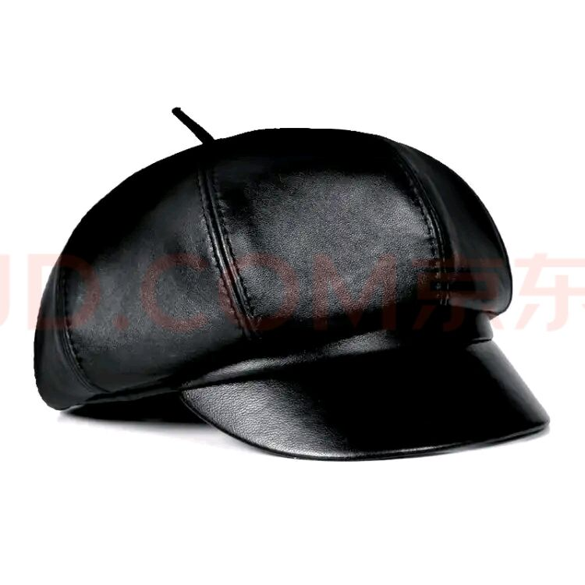
feature
Can you describe（描述） the feature of the clothes
It is not too ____or____.
I think____ looks ____
Students look ______ in _________
_______ looks ______on students .
So ____ is popular among students.

Slide 8
Can you describe （描述）the material of the clothes
material
They are made of ____
They are ____
They make us feel ____
____ are fit for ____

Slide 9



Learn about Sandy’s design
Clothes
 | shirt | jacket | jeans | trainers
Features | clean | not long, not large | comfortable | light and comfortable
Colour | white | dark blue | blue | grey
Material | cotton | cotton | cotton | leather
&shoes
Description
特征
材料

Slide 10
Tip 1: A clear structure（结构） makes a good writing.
My fashion design
Look at the model. Here is my design for _______________________
______________________
The shirt is white. I think white shirts look ________, and white _______
_________________.
The jacket is________________________, and it is dark blue. Students look ______________________.
Jeans are very ________________________,so my design _________a pair
of blue jeans.
The shirt ,the jacket and the jeans ________________ cotton and are very comfortable .
There is also a pair of trainers. They are grey. Trainers are _____ ________________________, and all the students like them.
.
a shirt , a jacket, jeans
General introduction（总体介绍）
and a pair of trainers
clean
matches
main
body
主体
the shirt
any other colour
not too long or too large
the jacket
smart in dark blue
the jeans
popular among students
includes
the material
are made of
the trainers
light and comfortable

Slide 11
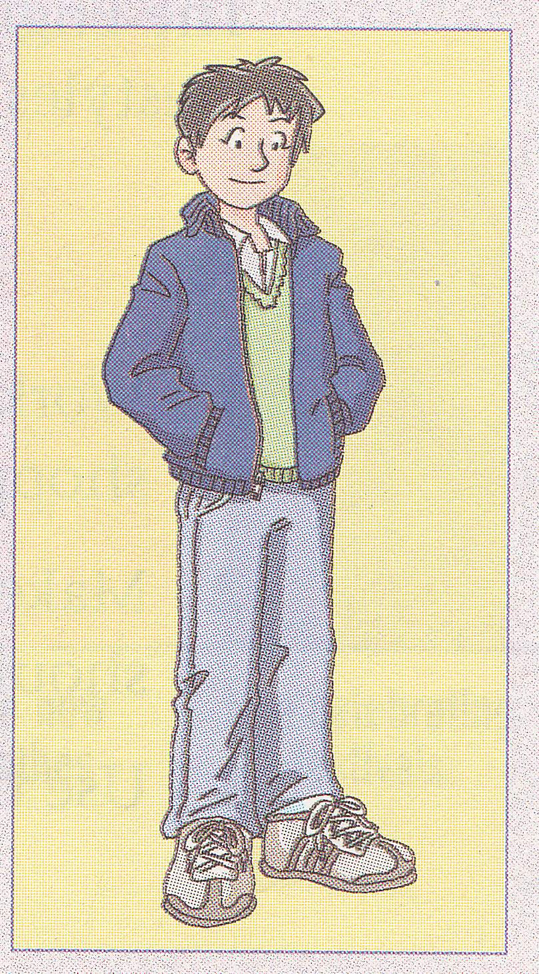
Make sentences
... the model.
Here is my design for ...
Look at the model Here is my design for a shirt, a jacket,jeans and a pair of trainers.
My fashion design includes...

Slide 12
Pair work :
The colour of the shirt is white. Because I like white best and white matches any other colour. I think white shirt look(s) clean.The jacket is dark blue. The boy looks smart in dark blue. Both of them are made of cotton . It is comfortable to wear cotton clothes.
The colour of the shirt is ...
A: What is the colour of the shirt ?
B: The colour of the shirt is ... .
A: How does the dark blue jackect look?
B: It looks ...
A: What are they made of ?
B:They are made of ...
Because I think white matches any other colour.
Dark blue looks ...
The boy looks .... in ...
Both of them are made of ...
It is comfortable to wear cotton ....

Slide 13
Tip2: Useful expressions & adjectives make your writing more beautiful.
Jeans/Trainers are .... and ...
...are fit for...
They are popular among students .

Slide 14
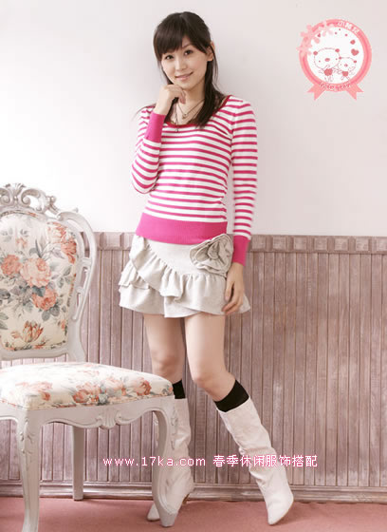
Group work
Try to talk about her clothes
The colour of ... is...
I think ... matches ...
It looks ... .The girl looks ... in ...
... be made of... It is comfortable to wear ...
It is/They are .... and ...
...are fit for...
... and... are a good match（搭配）.
Rules: 1. each student-----2 setences at least（至少）.
2. includes T-shirt 、skirt and boots.
3. choose some sentences not every sentence.

Slide 15
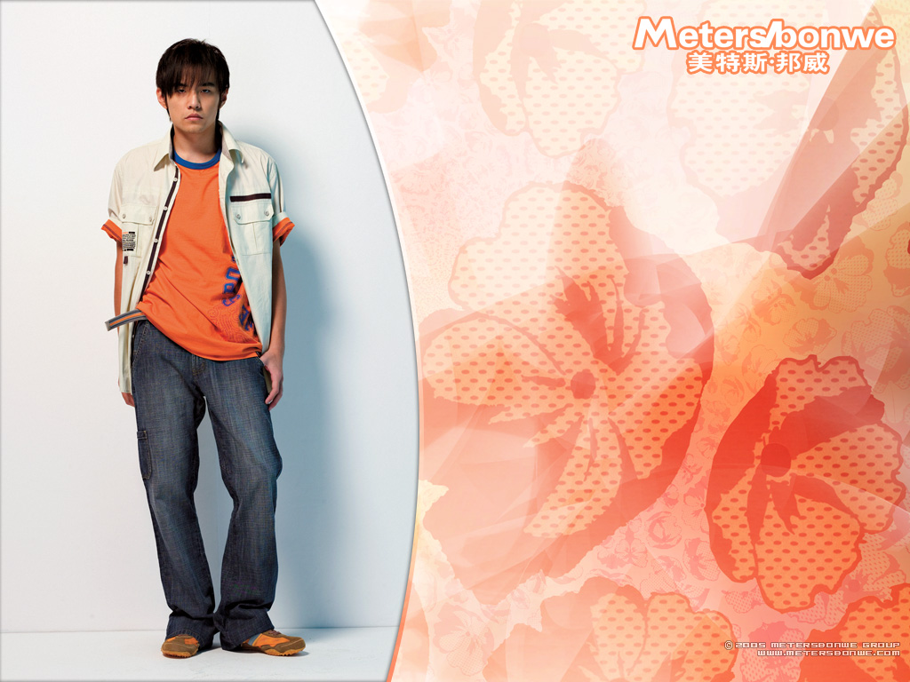
Try to talk about his clothes
The colour of ... is...
I think ... goes well with ...
It looks ... .The boy looks ... in ...
... be made of... ...
wearing ...is comfortable
It is/They are .... and ...
...are fit for...
... and... are a good match（搭配）.
Rules:
1. each student-----2 setences at least（至少）
2. includes T-shirt 、shirt、jeans and trainers.
3. choose some sentences not every sentence.

Slide 16
A good ending
Tip3: A good ending makes your writing perfect （完美）
That’s all for my design.
I think my design is very fashionable.（时尚的）
I hope you will like it .

Slide 17
Writing:
We need to wear different clothes in different occasions（场合）.
Occasion 1: Amy has to go for a party.
Occasion 2: Simon wants to go to Sunshine Park.
Please choose one occasion to design your clothes.

Slide 18
Post-writing
Do self-check（自查） and peer-check（互查）
Checklist | Self-check(Yes/No) | Peer-check(Yes/No)
1.Are there three parts in the writing? （总体介绍、主体和结尾） 5’
2.Are there three aspects（方面） in main body ?（colour、feature and material) 7’
3.Are there different sentence patterns?（变换句式） 5’
4.Are there any grammatical mistakes?（语法错误） 5’
5.Is the handwriting good?（书写工整） 3’
Your writing should follow the rules!

Slide 19
The colour of ____ is ____.
Because____ is my favourite colour.
____ matches any other colour.
____ goes well with any other colour.
____ matches____ well
____ and ____ are a good match（一个好的搭配 ）.
colour
Useful expressions!
I think white shirts look ____
Students look ____ in ____.
____ look ____ on students.
It is not too ____or____.
I think it is ____to wear .
So ____ is/are popular among students
feature
material
Both of them are made of ____
It is made of ____
It feels ____
____ is/are fit for ____

Slide 20
Show time

Slide 21
Homework:
Polish（完善） the writing according to the checklist.

