Slide 1

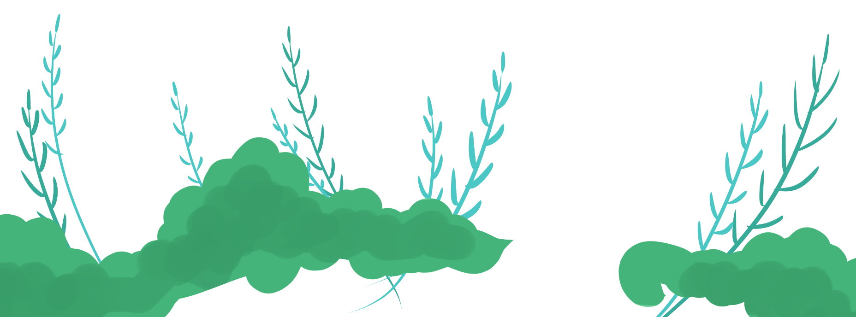
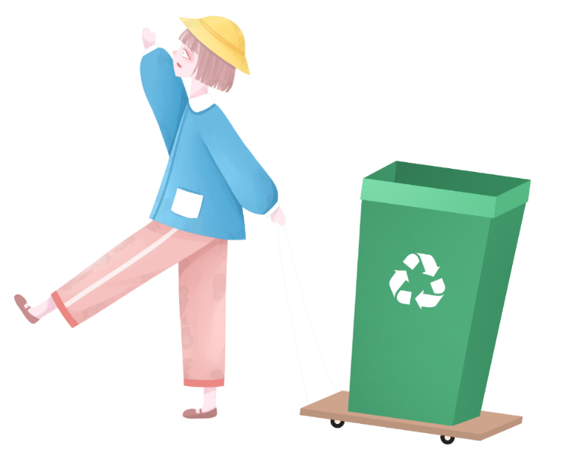
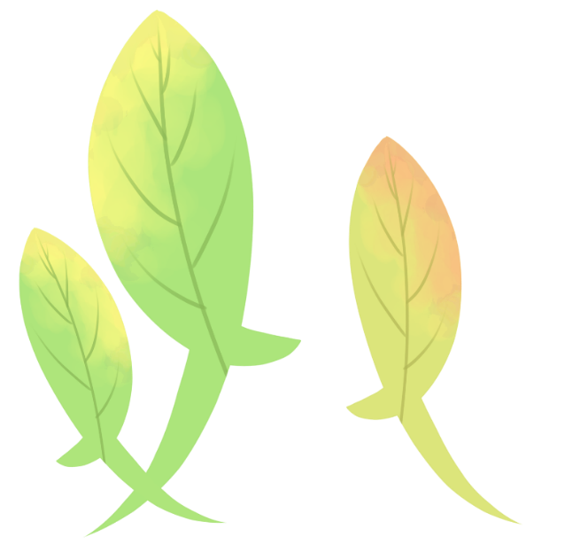
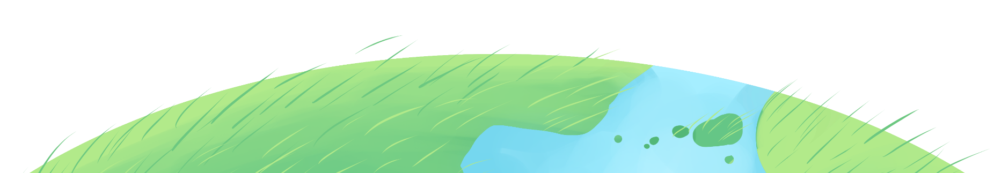

8B Unit 8 A green world
垃圾分类 全民行动
Task
By Zoe-Chan
From Mingde Middle School

Slide 2
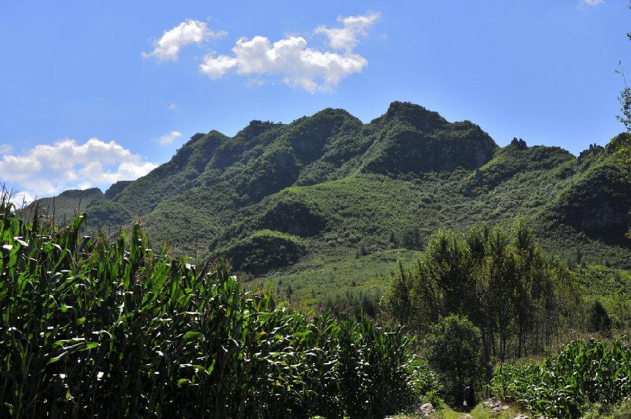
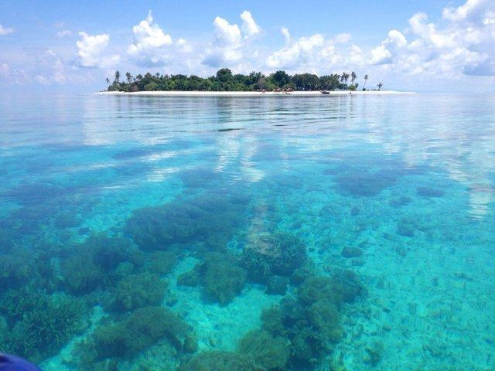
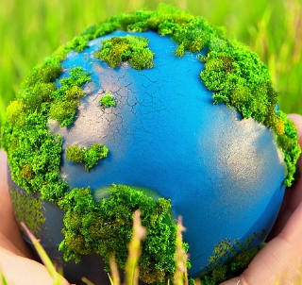
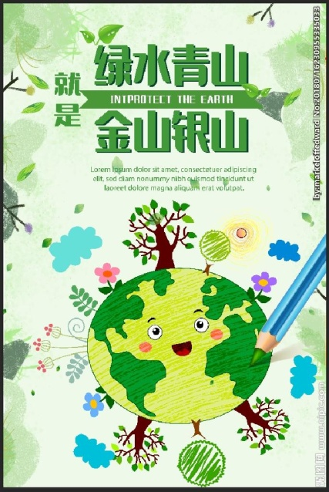
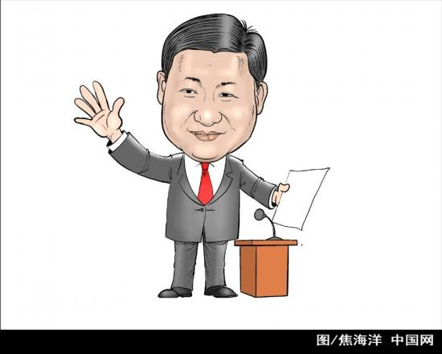
Q1: What’s a green world like in your mind?
Free talk:
clean blue lakes
Green hills
“ Green hills and clear water are as good as mountains of gold and silver.”

Slide 3

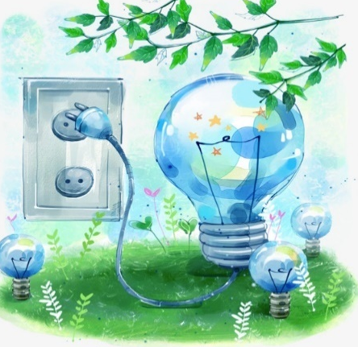

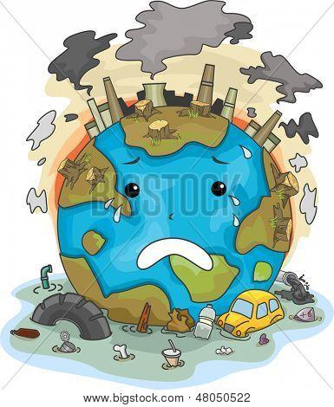
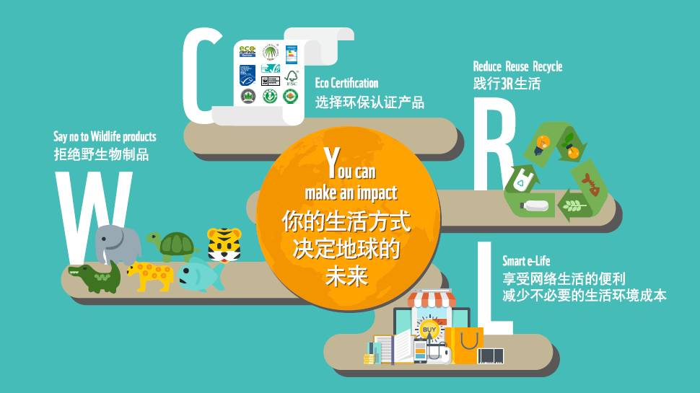
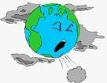
Q2: What should we do to go green ?
save water
save power
Develop a green lifestyle
reduce pollution

Slide 4



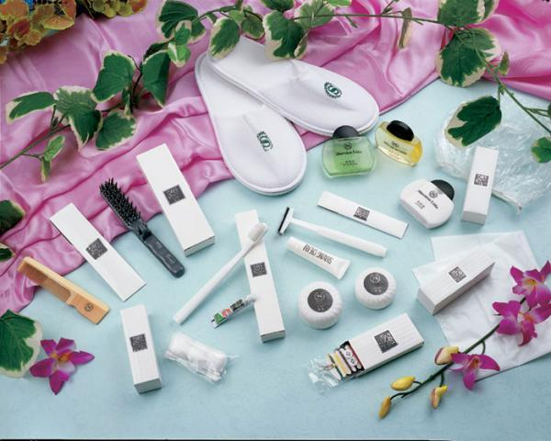

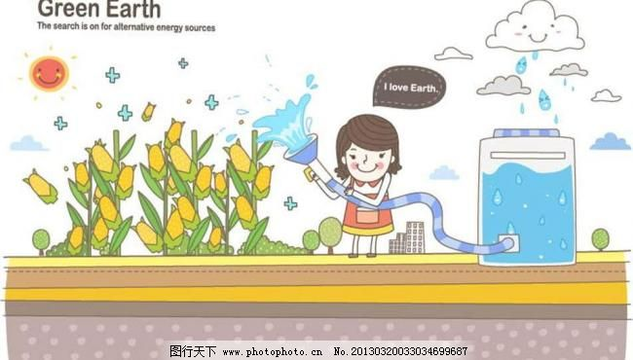

Go green in daily life
Collecting rain water is a good way to save water.
We can save power by using energy-saving lamps
We had better not use one-off products.
It is wise of us to choose environment-friendly products.
Doing sth. is a good way to do sth.
We can do sth. by doing sth.
We had better (not) do sth.
It is adj. of/ for sb. to do sth.

Slide 5
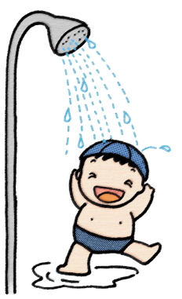
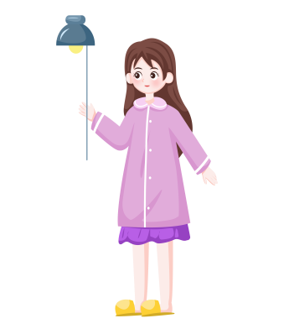

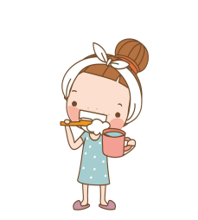

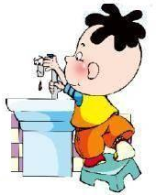

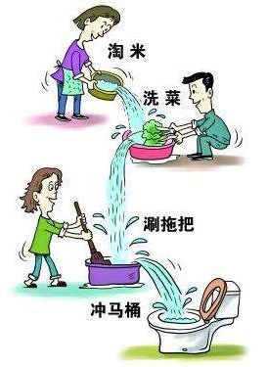

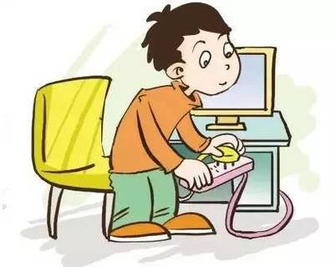

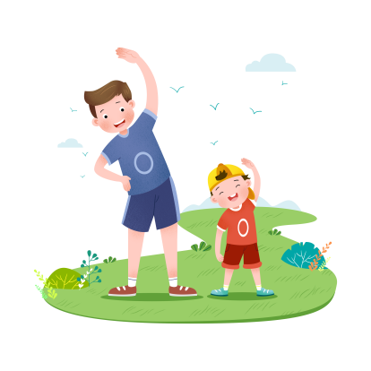
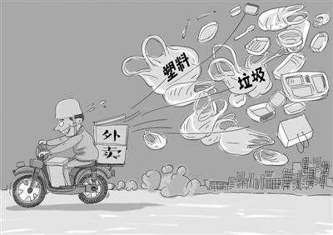
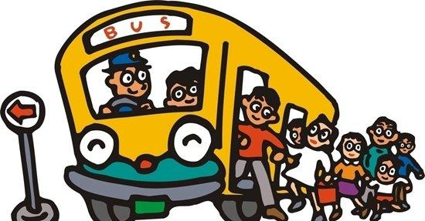
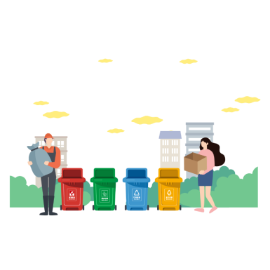
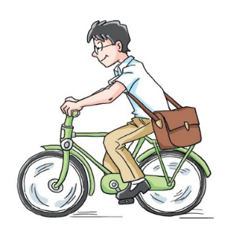
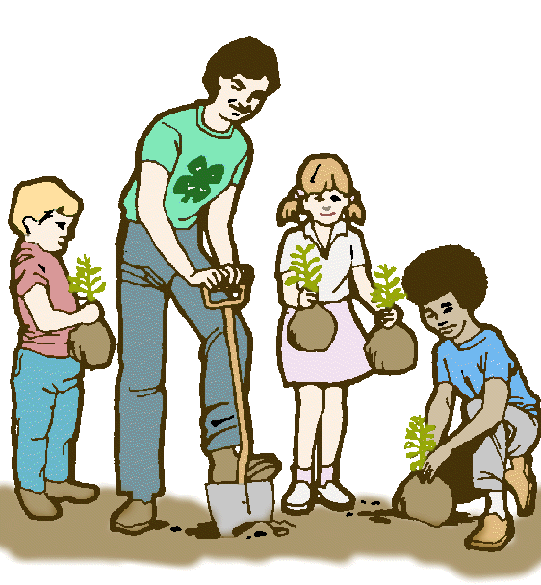
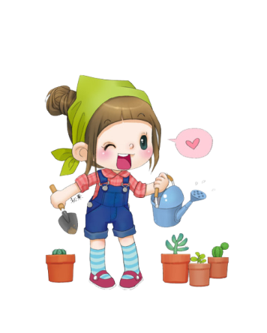

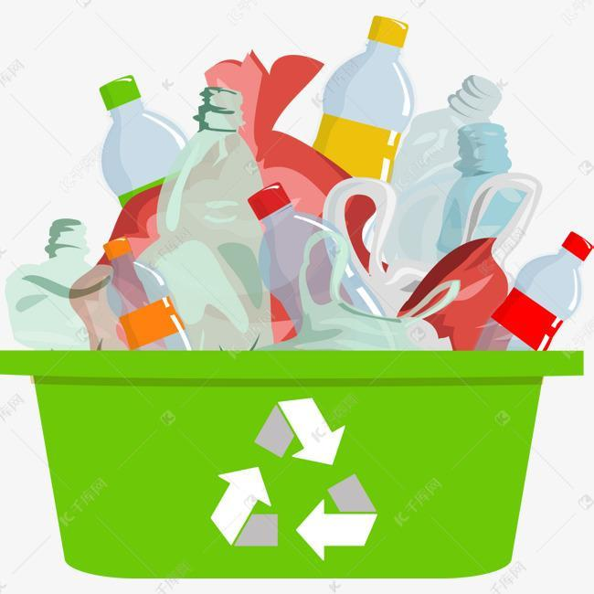
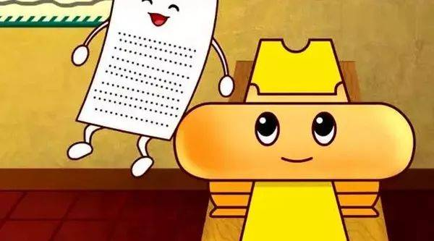
How to go green in daily life?
save water
save power
develop a green lifestyle
reduce pollution

Slide 6
Go green in daily life
Group work: Discuss how to reduce pollution and develop a green lifestyle in groups of five. Each member uses different sentence pattens to talk about one way . (Please avoid making the same sentence)
S1: What should we do to reduce pollution/develop a green lifestyle ,***?
S2: We can_______________ by _________________. It’s our duty to do something for our environment.
S3: I agree. _______________ is a good way to _______________.
S4: I think it’s ___________ for/ of us to _____________________.
S5: And we had better (not) _____________________.
S1: Protecting the Earth is protecting ourselves. A little support goes a long way.

Slide 7
How to go green in daily life?
To save water:
To save power:
Turn off the tap when brushing teeth.
Turn off the tap tightly after it is used
Take shorter showers
Reuse water if possible
Use energy-saving lamps
Turn off the lights when leaving
Turn off the power when the TV or computer is not in use
To reduce pollution
Tip1: Before writing, draw a chart, mind map or take notes to organize your ideas. (8B Unit 6 Study skills)
Develop a green lifestyle
Take your own bags when shopping
Separate waste then recycle and reuse
Recycle empty bottles
Plant more trees
Use both sides of the paper
Choose public transport
Do not use plastic bags
Choose environment-friendly products
Do not order take-away food too often
Do more exercise and play fewer computer games
Plant some flowers at home

Slide 8
Organize your ideas orally
Our environment is changing for the worse, so it’s time for us to go green.
(Group 1-2 )
We can save water by____________________________________________
____________________________________________________________________.
(Group 3-4)
We can save power by ____________________________________________
_____________________________________________________________________.
(Group 5-6)
We should (not) _________________________________________________to
reduce pollution.
(Group 7-8)
We’d better ______________________________________________________to
develop a green lifestyle.
Remember that everyone can do something to make a difference.

Slide 9

Complete Millie’s script
Our environment is changing for the worse, so it is time for us to _________________. Here are some simple steps to take.
We can save water by taking ________________________________ and turning off ____________________when we brush our teeth. We should also ______________________if possible. In order to save power, we should ______________________________ when we leave a room. We should also turn off the power when our TV or computer is ______________________.
go green
short showers
the tap
reuse water
turn off the lights
not in use

Slide 10
Complete Millie’s script
Some other good habits can help reduce pollution too. We should not use _____________________. Instead, we should take _________________________ when shopping. Recycling is also a good way to help reduce pollution. We should separate_________________ into different groups so that it can be recycled.
Moreover, it is important for us to develop a green lifestyle. We should______________________________ and watch less TV and it is good to ___________________________________at home.
Follow these small steps, and you can make a big difference to the Earth!
plastic bags
our own bags
waste
do more exercise
plant some flowers

Slide 11
How to organize ideas
Our environment is changing for the worse, so it is time for us to go green. Here are some simple steps to take.
We can save water by taking shorter showers and turning off the tap when we brush our teeth. We should also reuse water if possible. In order to save power, we should turn off the lights when we leave a room. We should also turn off the power when our TV or computer is not in use.
Some other good habits can help reduce pollution too. We should not use plastic bags. Instead, we should take our own bags when shopping. Recycling is also a good way to help reduce pollution. We should separate waste into different groups so that it can be recycled.
Moreover, it is important for us to develop a green lifestyle. We should do more exercise and watch less TV and it is good to plant some flowers at home.
Follow these small steps, and you can make a difference to the Earth!
Introduction
The purpose of the presentation
1
2
To save water
To save power
To reduce pollution
A green lifestyle
Main body
The simple steps to go green
3
4
Conclusion
5
The hope of the presentation

Slide 12
How to connect ideas
topic sentence
Our environment is changing for the worse, so it is time for us to go green. Here are some simple steps to take.
We can save water by taking shorter showers and turning off the tap when we brush our teeth. We should also reuse water if possible. In order to save power, we should turn off the lights when we leave a room. We should also turn off the power when our TV or computer is not in use.
Some other good habits can help reduce pollution too. We should not use plastic bags. Instead, we should take our own bags when shopping. Recycling is also a good way to help reduce pollution. We should separate waste into different groups so that it can be recycled.
Moreover, it is important for us to develop a green lifestyle. We should do more exercise and watch less TV and it is good to plant some flowers at home.
Follow these small steps, and you can make a big difference to the Earth!
topic phrase
topic phrase
topic sentence
Tip 2 :Write topic sentences and supporting details to make rich content
topic sentence
supporting details
Read and find out the topic sentence and phrases

Slide 13


Use topic sentence and supporting details
Add at least two supporting sentences to make rich content.
Our environment will be better if we plant as many trees as can.
______________________________________________________________________________________
______________________________________________________________________________________
__________________________________________________________________________________________________________________________________________________________________________
Trees not only make our city beautiful but also reduce dust and keep the air clean. Trees also keep soil in place during storms. What’s more, trees provide home for animals too.
Group work: 1. write the sentence then share them in groups
2. Group leader organize the ideas and report in class

Slide 14
How to connect ideas
Our environment is changing for the worse, so it is time for us to go green. Here are some simple steps to take.
We can save water by taking shorter showers and turning off the tap when we brush our teeth. We should also reuse water if possible. In order to save power, we should turn off the lights when we leave a room. We should also turn off the power when our TV or computer is not in use.
Some other good habits can help reduce pollution too. We should not use plastic bags. Instead, we should take our own bags when shopping. Recycling is also a good way to help reduce pollution. We should separate waste into different groups so that it can be recycled.
Moreover, it is important for us to develop a green lifestyle. We should do more exercise and watch less TV and it is good to plant some flowers at home.
Follow these small steps, and you can make a big difference to the Earth!
Tip 3: Use transitional words to connect ideas. (8B Unit 4 Study Skills Ss’book P59)

Slide 15
How to connect ideas
First,
______________we can save water by taking shorter showers and turning off the tap when we brush our teeth. We should also reuse water if possible. _____________in order to save power, we should turn off the lights when we leave a room. We should also turn off the power when our TV or computer is not in use.
_______________some other good habits can help reduce pollution too. We should not use plastic bags. Instead, we should take our own bags when shopping. Recycling is also a good way to help reduce pollution. We should separate waste into different groups so that it can be recycled.
_______________, it is important for us to develop a green lifestyle. We should do more exercise and watch less TV and it is good to plant some flowers at home.
Second,
Use transitional words to make your writing coherent （连贯的，有条理的）
Third,
What’s more/ Finally / Last but not the least,

Slide 16
How to express ideas
Our environment is changing for the worse, so it is time for us to go green. Here are some simple steps to take.
We can save water by taking shorter showers and turning off the tap when we brush our teeth. We should also reuse water if possible. In order to save power, we should turn off the lights when we leave a room. We should also turn off the power when our TV or computer is not in use.
Some other good habits can help reduce pollution too. We should not use plastic bags. Instead, we should take our own bags when shopping. Recycling is also a good way to help reduce pollution. We should separate waste into different groups so that it can be recycled.
Moreover, it is important for us to develop a green lifestyle. We should do more exercise and watch less TV and it is good to plant some flowers at home.
Follow these small steps, and you can make a big difference to the Earth!
It’s time for us to…
We can save water by…
Tip 4:Use varied sentence structures and rich phrases to express ideas
We should use / take…
… is a good way to …
It is important for us to …
It is good to …

Slide 17
How to express ideas
We can save water by taking shorter showers and turning off the tap when we brush our teeth. We should also reuse water if possible. In order to save power, we should turn off the lights when we leave a room. We should also turn off the power when our TV or computer is not in use.
Some other good habits can help reduce pollution too. We should not use plastic bags. Instead, we should take our own bags when shopping. Recycling is also a good way to help reduce pollution. We should separate waste into different groups so that it can be recycled.

Slide 18
Use varied sentence structures
Use different sentence structures to make your writing more creative.
1. In order to save power, we should turn off the lights when we leave a room.
In order to save power, _________ __________ ___________ __________ turned off when we leave a room.(改成被动句）
2. We should not use plastic bags. Instead , we should take our own bags when shopping.（合并成一句）
We ________ _________ take our own bags when shopping __________ ________ using plastic bags.
the lights should be
had better
instead
of

Slide 19
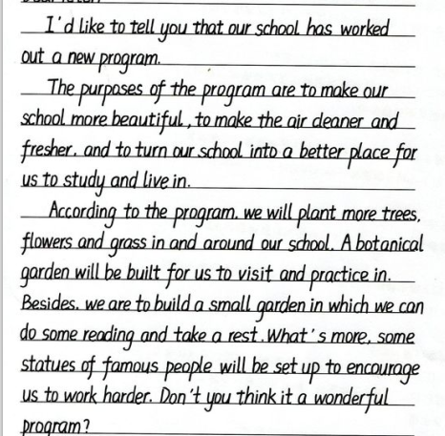
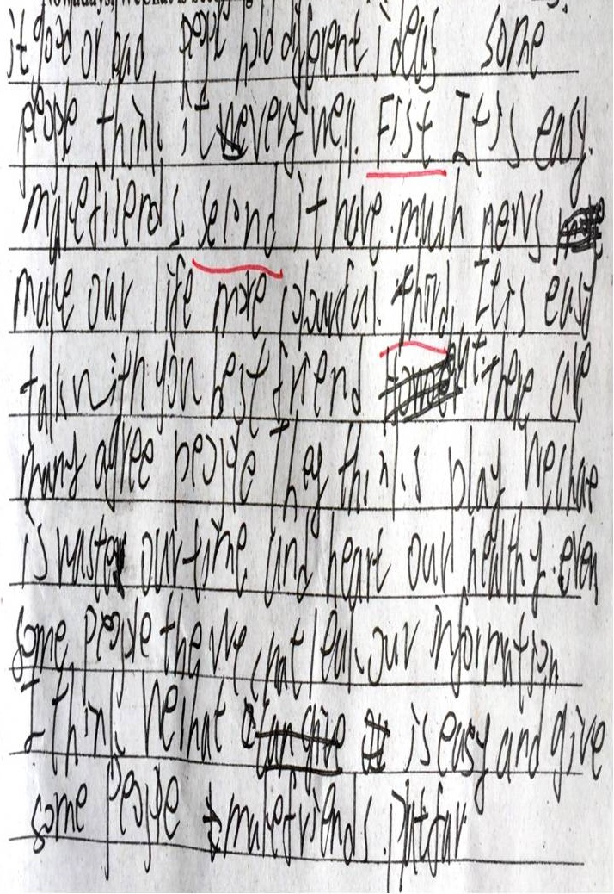
Comparison
Tip 5 : Pay attention to grammar and handwriting. (8B Unit 7 study skills)
  capital letters
  punctuation
  spelling
  singular or plural (单复数)
  parts of speech (词性)
  verb tenses (时态)
  subjects and verbs that agree (主谓一致)
  …

Slide 20
Writing task
太仓在2020年被评为全国文明城市。请你写一份英文的演讲稿，号召中小学生从“衣食住行”四个方面, 养成绿色环保的生活方式，共建绿色文明城市。
Discuss in groups:
Draw a spider gram to organize ideas.
Share your spider gram in class.

Slide 21
Draw a spider gram to organize ideas
What to eat
What to wear
How to live a green life
How to live
How to travel

Slide 22



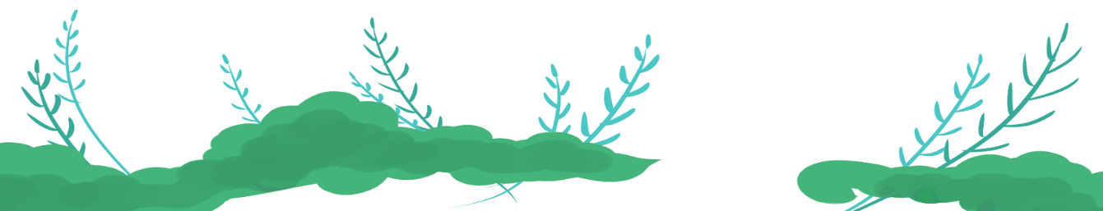



The Standard For Evaluation
Clear structure
Aspect | Criteria | Score
Clear structure | Organize ideas according to the type of writing | 3
Good language | Use proper transitional words to make the writing coherent | 3
 | Use varied sentence structures and rich phrases | 5
 | Use topic sentences and supporting details to make rich content | 4
Correct and neat | Correct grammar | 1
 | Neat handwriting | 4
Good language
Rich content
Neat handwriting

Slide 23
Proofreading
Connect ideas with transitional words
Use varied sentence structures
Write topic sentence and supporting details
Pay attention to grammar and handwriting
Form a presentation logically
Self-assessment
Peer
Assessment
Teacher
Assessment

Slide 24

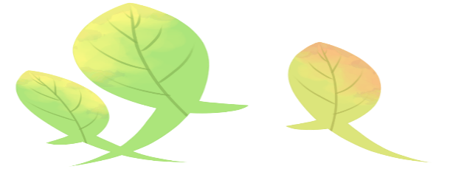

Homework:
1. Check more writings.
2. Polish(润色) your writing.
Good writing is clear thinking made visible.
A good method gets twice the result with half the effort.
Practice makes perfect.

Slide 26
Use varied sentence structures
1. Natural resources are important. We should use them wisely.
Natural resources are _____ important ________ we should use them
wisely.
2. We must take proper actions to reduce pollution and protect the environment.
_____________ ___________ _________ _________taken to reduce pollution and protect
the environment.
3. Tibet is a beautiful place. It has high mountains and blue lakes.
Tibet is a beautiful place ________ high mountains and blue lakes.
4. Recycling waste is necessary. Our country makes rules to recycle waste in big cities.
It is __________________ for our country ________________________________to recycle
waste in big cities.
so
that
so …that 句型
Proper actions must be
sth. be done 被动句
with 结构
with
necessary
to make rules
It is +adj.+ for / of sb. to do sth. 句型

Slide 27

Read Millie’s notes
According to Millie’s notes, why is it time to go green?
2. What are Millie’s tips for a green lifestyle?
Because our environment is changing for the worse.
We should not only do more exercise and watch less TV but also plant some flowers at home.

Slide 28
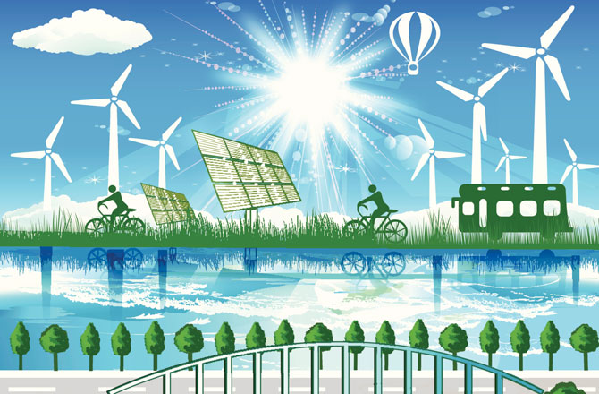
Use topic sentence and supporting details
Add a topic sentence
Some possible answers:
Renewable energy is good for our environment.
Renewable energy has many advantages.
In order to reduce pollution, people start to use renewable energy.
___________________________________________________________________________.
We use renewable energy like wind power, solar power and water power. We can use them to produce electricity without causing pollution. They cost very little and will never run out.

Slide 29
Use transitional words
We can save water by taking shorter showers and turning off the tap when we brush our teeth.
We can save water _________ __________ by taking shorter showers ___________ __________ by turning off the tap when we brush our teeth.
not only
but also

Slide 30
Use transitional words
For example
Never
not only
but also
And
Use transitional words to make your writing coherent （连贯的，有条理的）
Moreover
On the one hand
On the other hand
We students should ____________have good manners in public _____________be helpful to others.__________________________, we should behave properly and politely.____________________, we should always obey traffic rules and queue for our turn. ______________ drop litter everywhere or pick flowers in the park.______________, keeping our voice down in a public place is necessary.
__________________________________, we must do something to help people in need. It’s right to give our seats to the elderly on the bus. ____________ we can do volunteer work to make our city a better place to live in.

Slide 31
Writing task
太仓在2020年被评为全国文明城市， 这是每一位太仓人不懈努力的成果。文明城市倡导“绿色环保，文明和谐”的新时尚。文明城市的建设需要呼吁所有中小学生，养成一种文明互助，绿色环保的生活方式，为文明城市建设贡献力量。请你根据表格中的内容，写一份英文演讲稿，号召全体同学行动起来，共建绿色文明城市。

