Slide 1
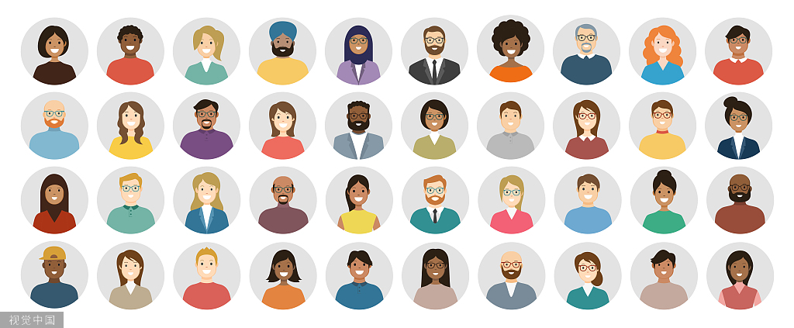
九上 Unit1 Know yourself
单元导入课
Shaxi Experimental Middle School
Gu Chunyan

Slide 2
Watch and think
Do different people have different personalities?
Do people with different personalities behave in different ways?
3. If you get a job, do you think your personality should be suitable for the job?

Slide 3
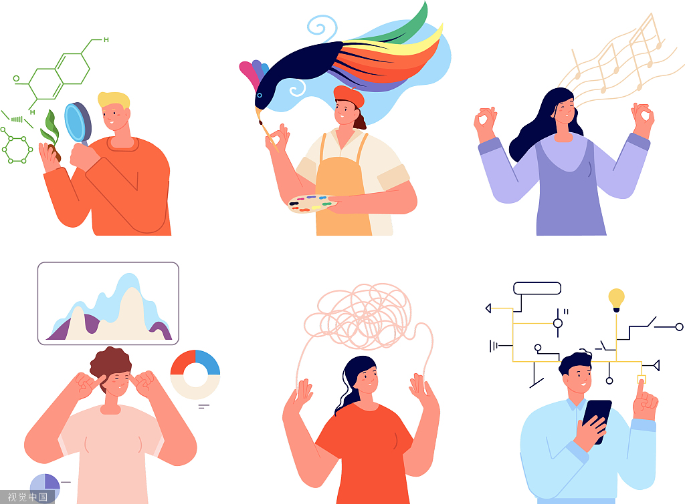
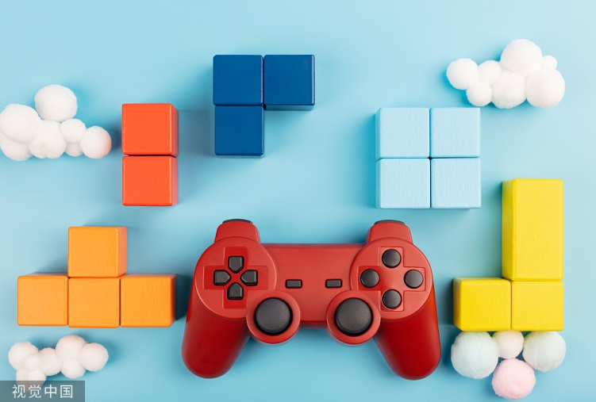
Which words can describe personalities?
Play a game

Slide 4
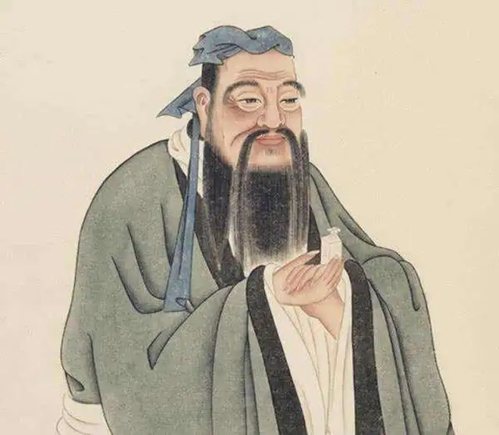
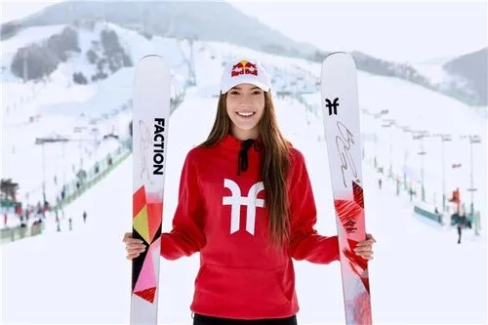
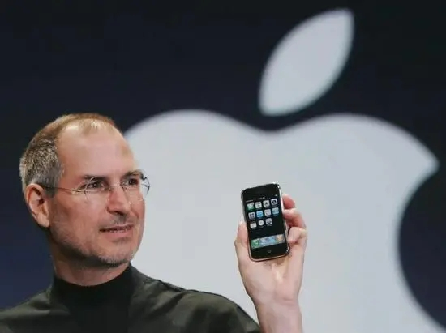
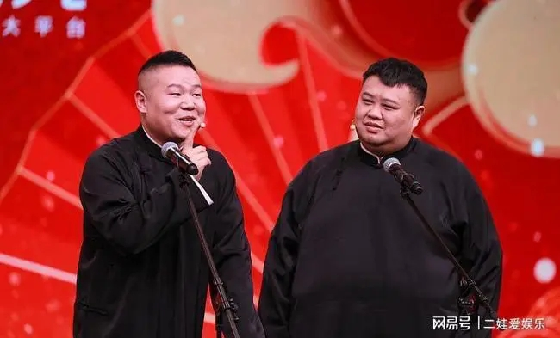
Different jobs & Different personalities
teacher/educator
athlete
modest
energetic
/'mɒdɪst/
/ˌenə'dʒetɪk/
do not talk much about his/her abilities
have a lot of energy
engineer
comedian
creative
humorous
/kriː'eɪtɪv/
/ˈhjuːmərəs/
come up with new ideas
active
/ˈæktɪv/
enjoy taking part in different activities

Slide 5
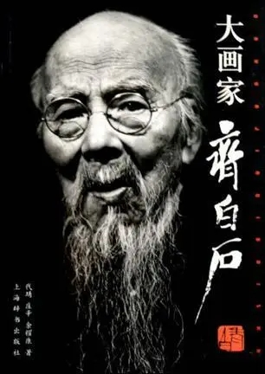
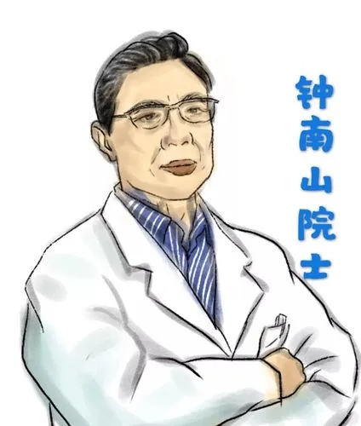
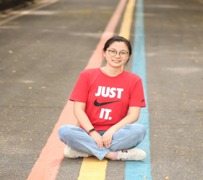
Different jobs & Different personalities
artist
creative
curious /ˈkjʊəriəs/
have a strong desire to know about sth.
doctor
patient
kind
careful
helpful
brave
accountant
serious
organized
/ˈɔːɡənaɪzd/
keep things in good order
teacher
clever
hard-working
honest
confident
practical
/ˈpræktɪkl/

Slide 6
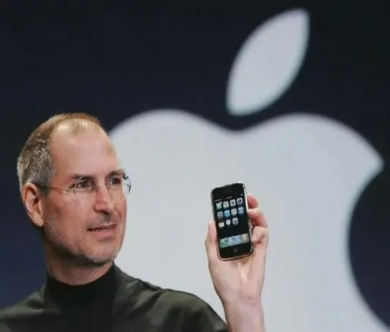
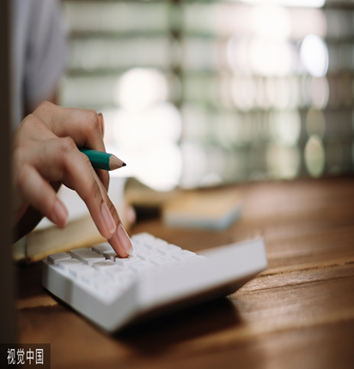
Personalities
curious
modest
patient
kind
careful
helpful
brave
energetic
clever
hard-working
honest
confident
practical
creative
serious
organized
humorous

Slide 7
Use some adjectives to describe people’s personalities.
Confucius has a lot of knowledge, but he is m and never shows off.
Gu Ailing is very e . She always practices skiing for hours.
Jobs was so c that he invented a lot of things.
Yue Yunpeng is a famous comedian. Many people think he is very h .
Qi Baishi is good at painting because he is c about new things.
Zhong Nanshan is p enough to take care of the sick people.
The accountant is well o . She keeps all her things in good order.
Miss Gu is such a h teacher that she always stays up late to prepare for the English classes.
modest
energetic
creative
humorous
curious
patient
organized
hard-working

Slide 8
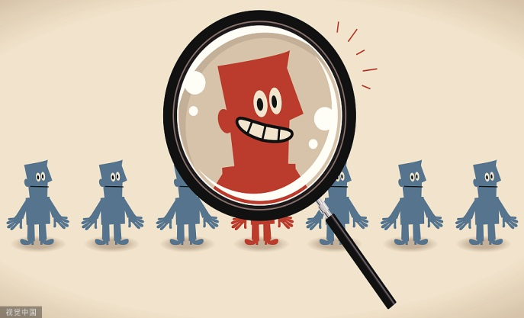
Are there any relationships (关系）between personalities and jobs?
Personality | Job
patient
creative
energetic
organized
curious
teacher/ doctor/dentist
artist/ designer/writer
coach/ athlete/cook
accountant/ policeman
scientist

Slide 9
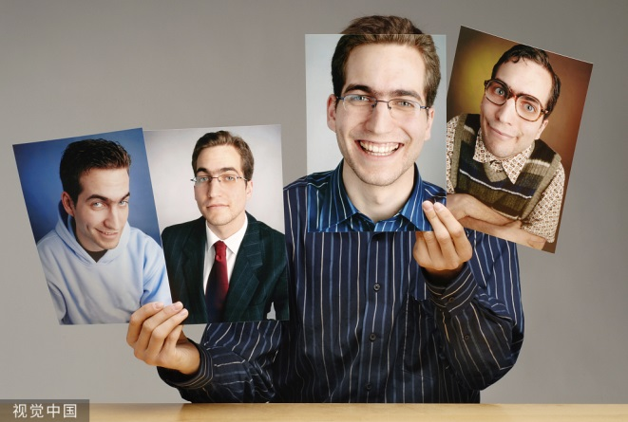
Work in pairs
A:—Can you use some adjectives to describe yourself?
B: —Yes. I am .
A:—What is your dream job?
B: —I want to be a .
A:—Do you think your personality is suitable for the job? Why?
B:—Yes./ No. Because .
A:—In order to get the job, what should you do?
B:—I should .

Slide 10
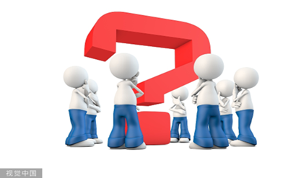
Group work
Collect the information of the group members and complete the information card.
Names | Personalities | Dream jobs | Suitable(Yes/No)

Slide 11
Each group member says at least one sentence. Replace A/B/C/D… with your group members’ names.
Group report
There are people in our group.
A is and . His/Her dream job is .
He is/ isn’t suitable for the job because .
B is and . His/Her dream job is .
He is/ isn’t suitable for the job because .
C is and . His/Her dream job is .
He is/ isn’t suitable for the job because .
…
That’s all for our group report. Thanks for listening.

Slide 12
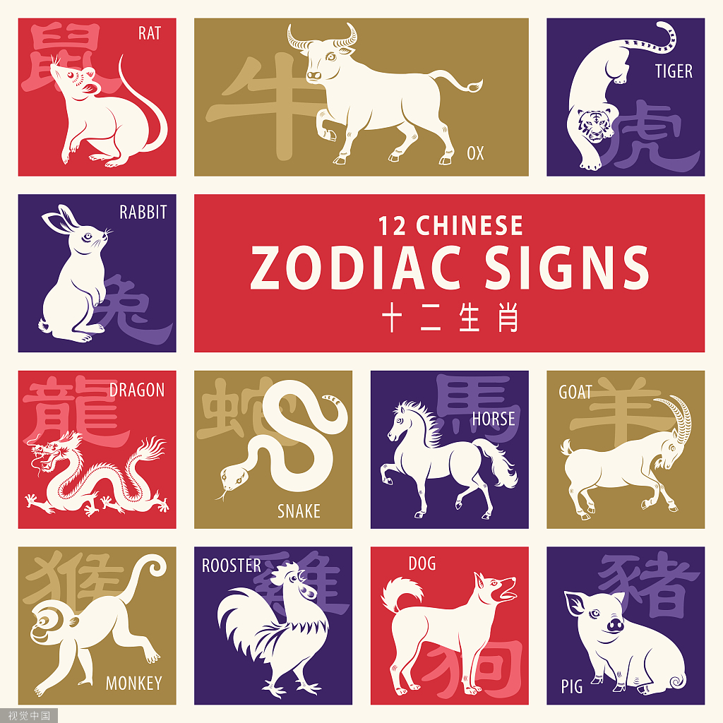
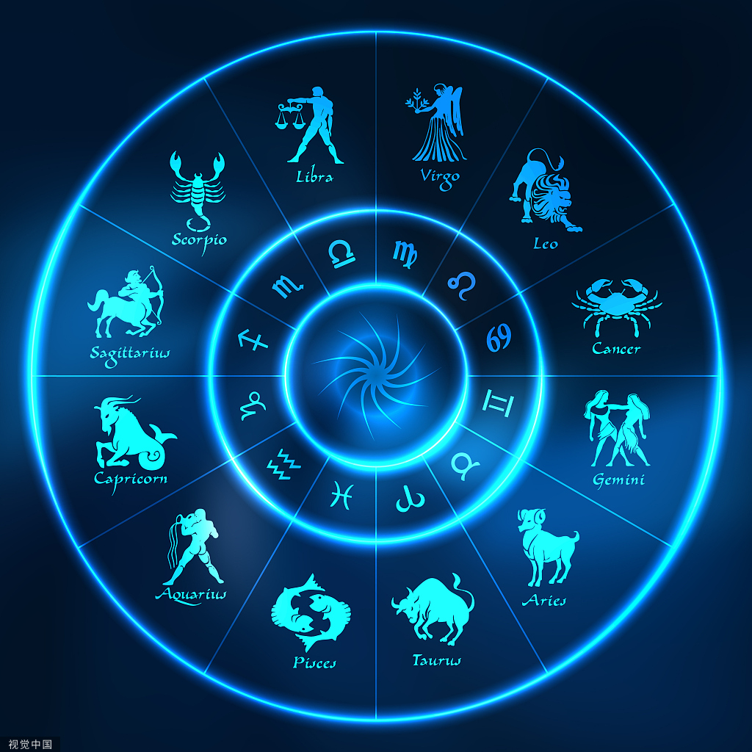
Further thinking
What decides your personality?
Chinese animal signs
Western star signs

Slide 13
Chinese animal signs
Fill in the blanks
Rat, Ox, ,
Rabbit, ,
, Horse,
, Monkey,
Rooster, Dog and .
Tiger
Dragon
Snake
Goat
Pig

Slide 14
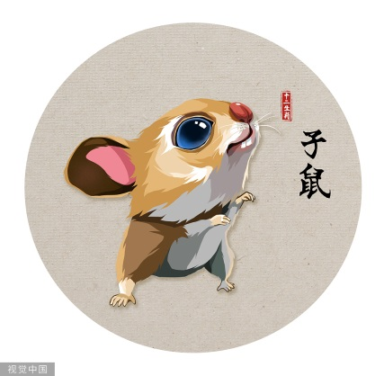
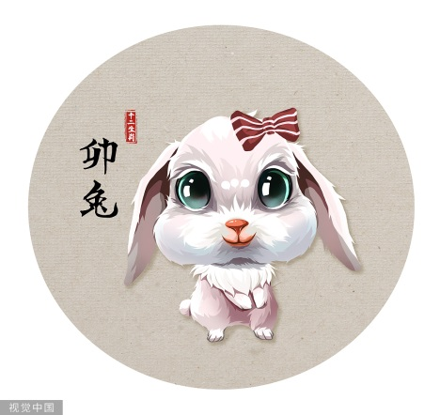
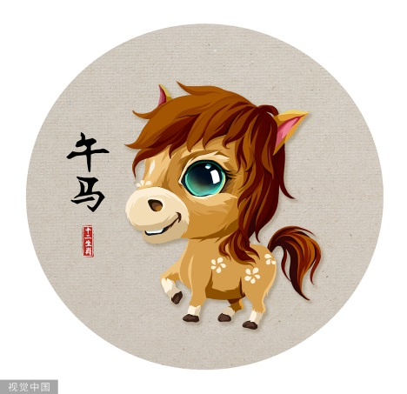
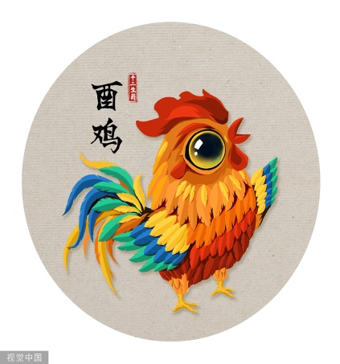
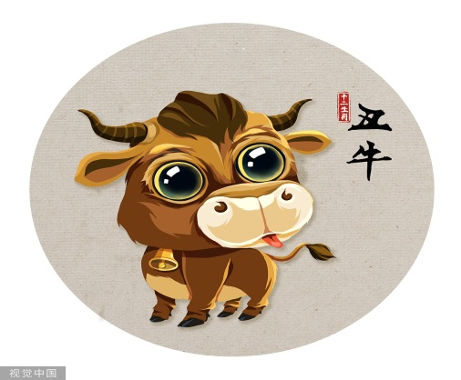
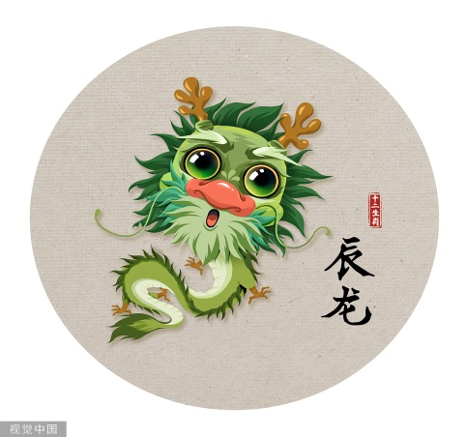
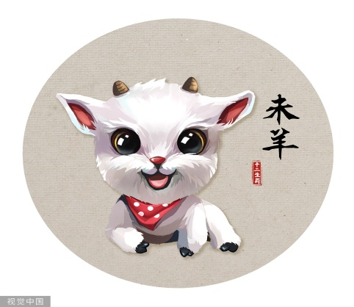
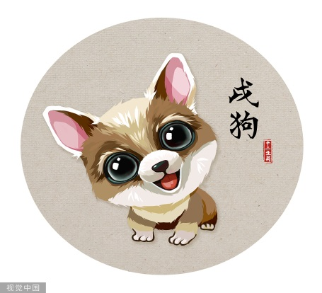
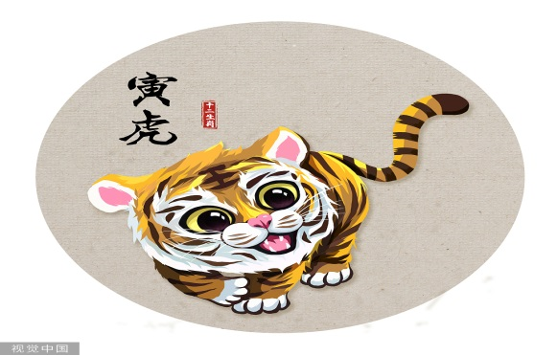
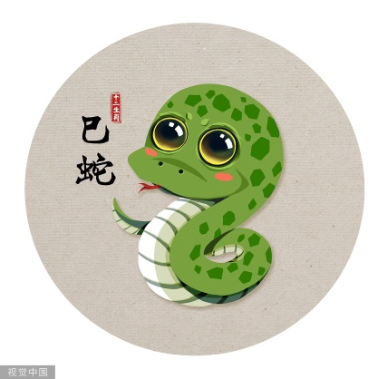
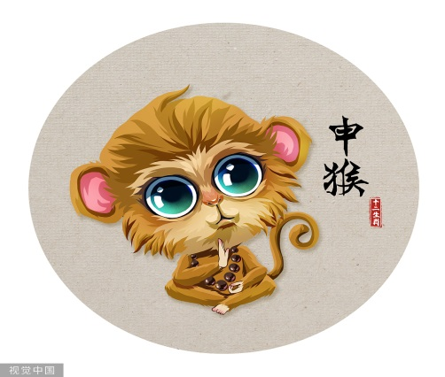
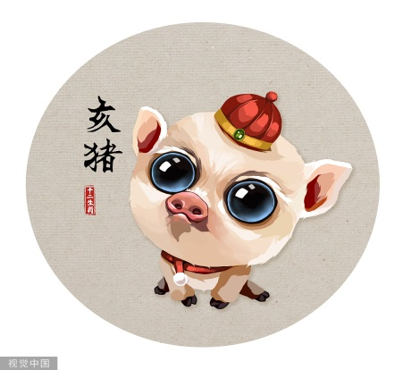
Animal signs & Personalities
Careful; lively; practical; lively;
Brave; wise; gentle; powerful;
Loyal; clever; brave; hard-working
Rat
Rabbit
Horse
Rooster
Smart
Careful
Lively
Practical
What’s your animal sign?
Do you think what the animal says about you is true?
Why?
Ox
Dragon
Sheep
Dog
Powerful
Gentle
Loyal
Hard-working
Tiger
Snake
Monkey
Pig
Brave
Wise
Clever
Honest

Slide 15
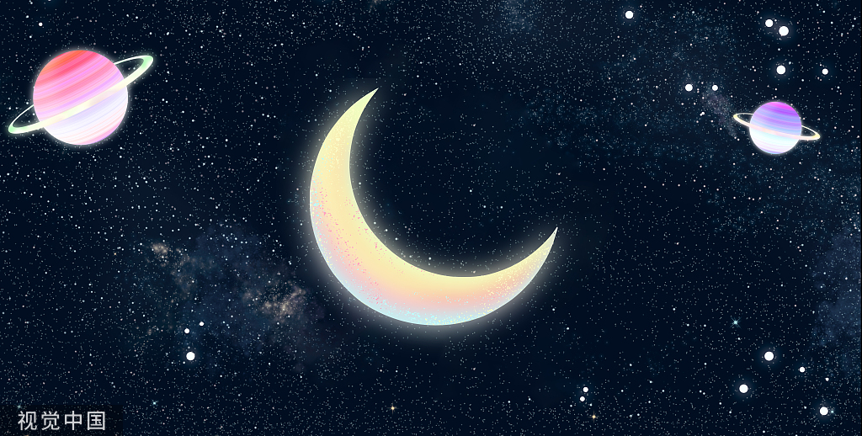
Western star signs
12
Star signs: a cycle of star signs.
Your star sign: depends on your ,
Some people believe that your star sign may
decide your personality.
date of birth

Slide 16
Do animal signs or star signs really decide your personality?
Not really.
If you are interested in either animal signs or star signs, read about them just for fun.
It is you who shape your life and your future.

Slide 17
How to be a good monitor
You can come up with new ideas.
example
1.creative
2.
5.
A good monitor
3.
6.
4.
Word Bank:
modest; energetic; creative; humorous; serious; organized;
confident; helpful ; hard-working
Choose the words from the word bank and give at least one example about each personality

Slide 18
modest
1. .
Example:
.
2. .
Example:
.
3. .
Example:
.
4. .
Example:
.
5. .
Example:
.
…
You are good at many things, but you never show off.
organized
You are so well organized that you keep everything in order
confident
You are confident enough to make a speech.
helpful
It is helpful of you to give a helping hand to others in need.
hard-working
You are hard-working. If you have plenty of time, you’ll read books

Slide 19
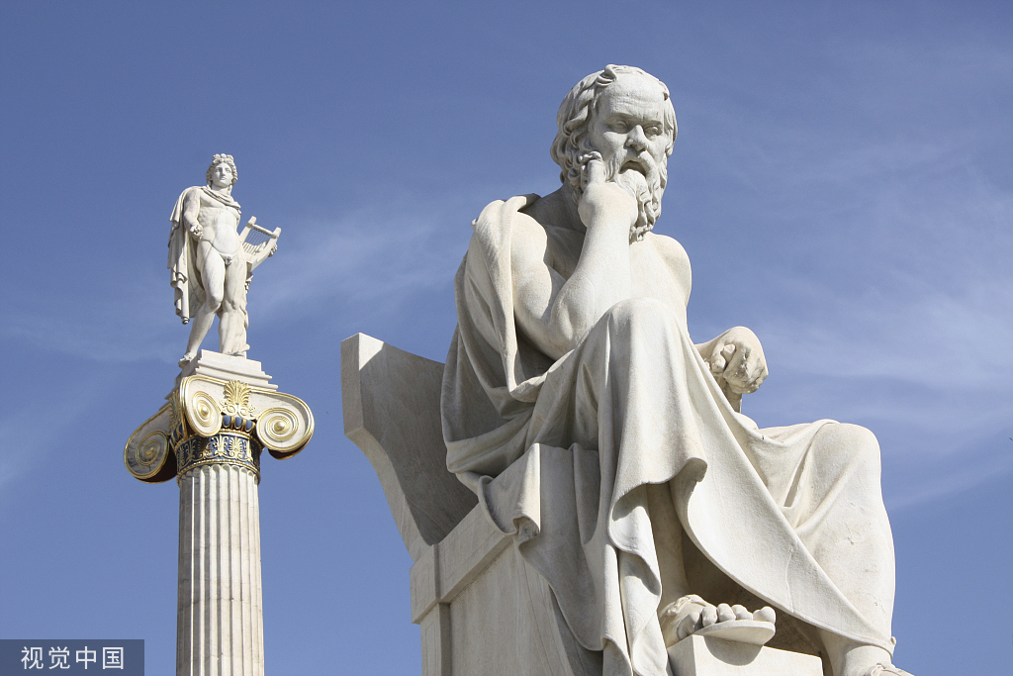
Socrates ['sɔkrəti:z] 苏格拉底
a Greek philosopher [fɪ'lɒsəfə]
古希腊哲学家
1.It is important to know yourself.
2.Knowing yourself is the height
of wisdom.
了解自己是智慧的最高点。
3.Goals determine what you are going
to be.
目标决定你将成为什么样的人。

Slide 20
Develop good personalities.
Be happy every day.
Be kind to others.
Believe in yourself.

