Slide 1
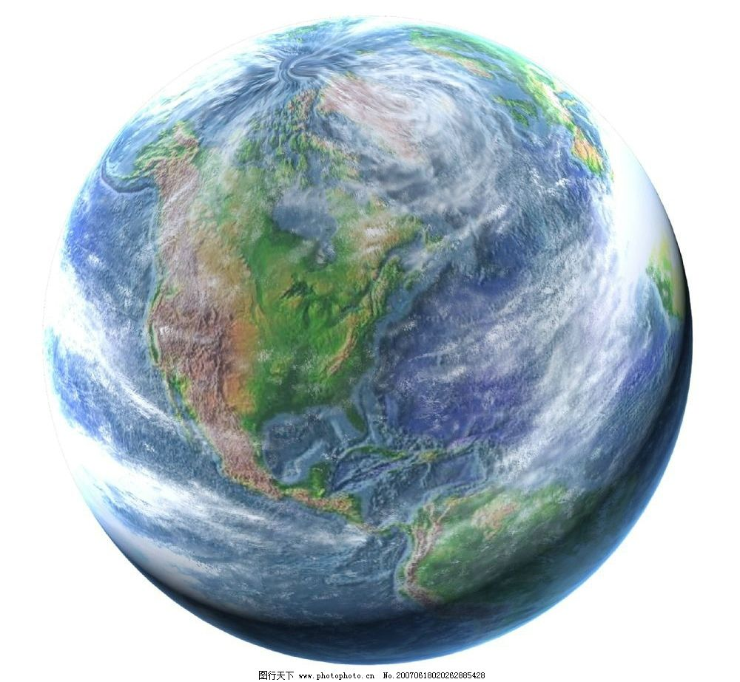
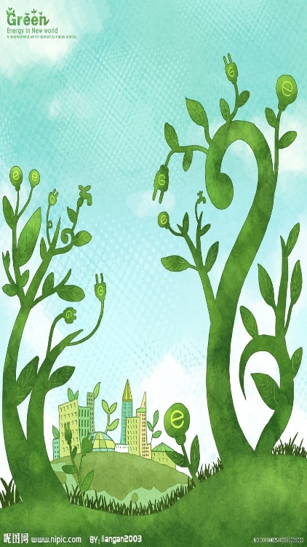
Unit 8
A green world
Task
王子佳 太仓市浮桥中学

Slide 2
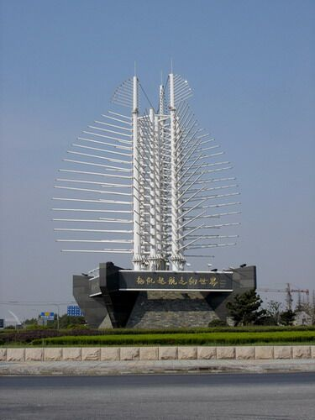
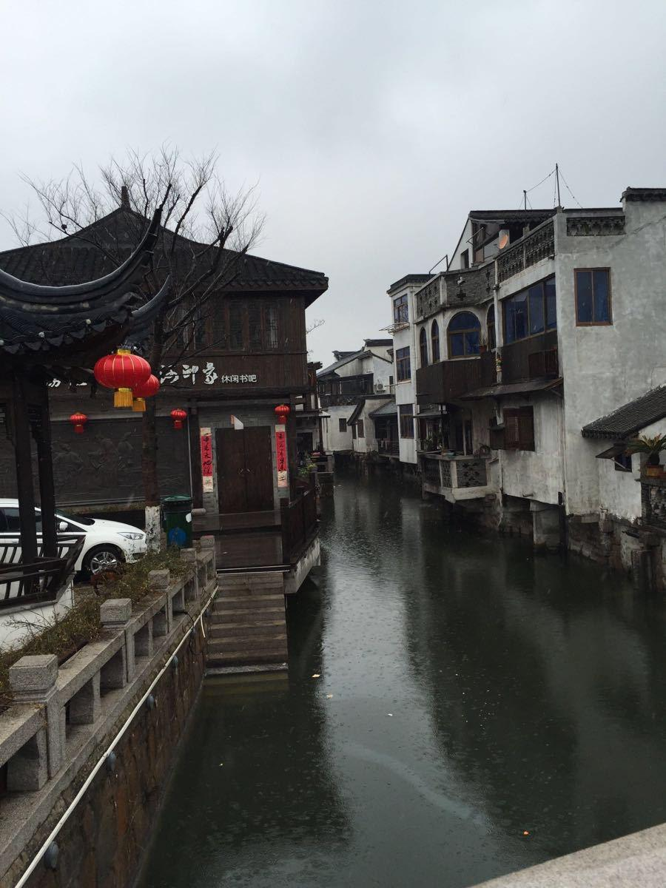
Liuhe

Slide 3
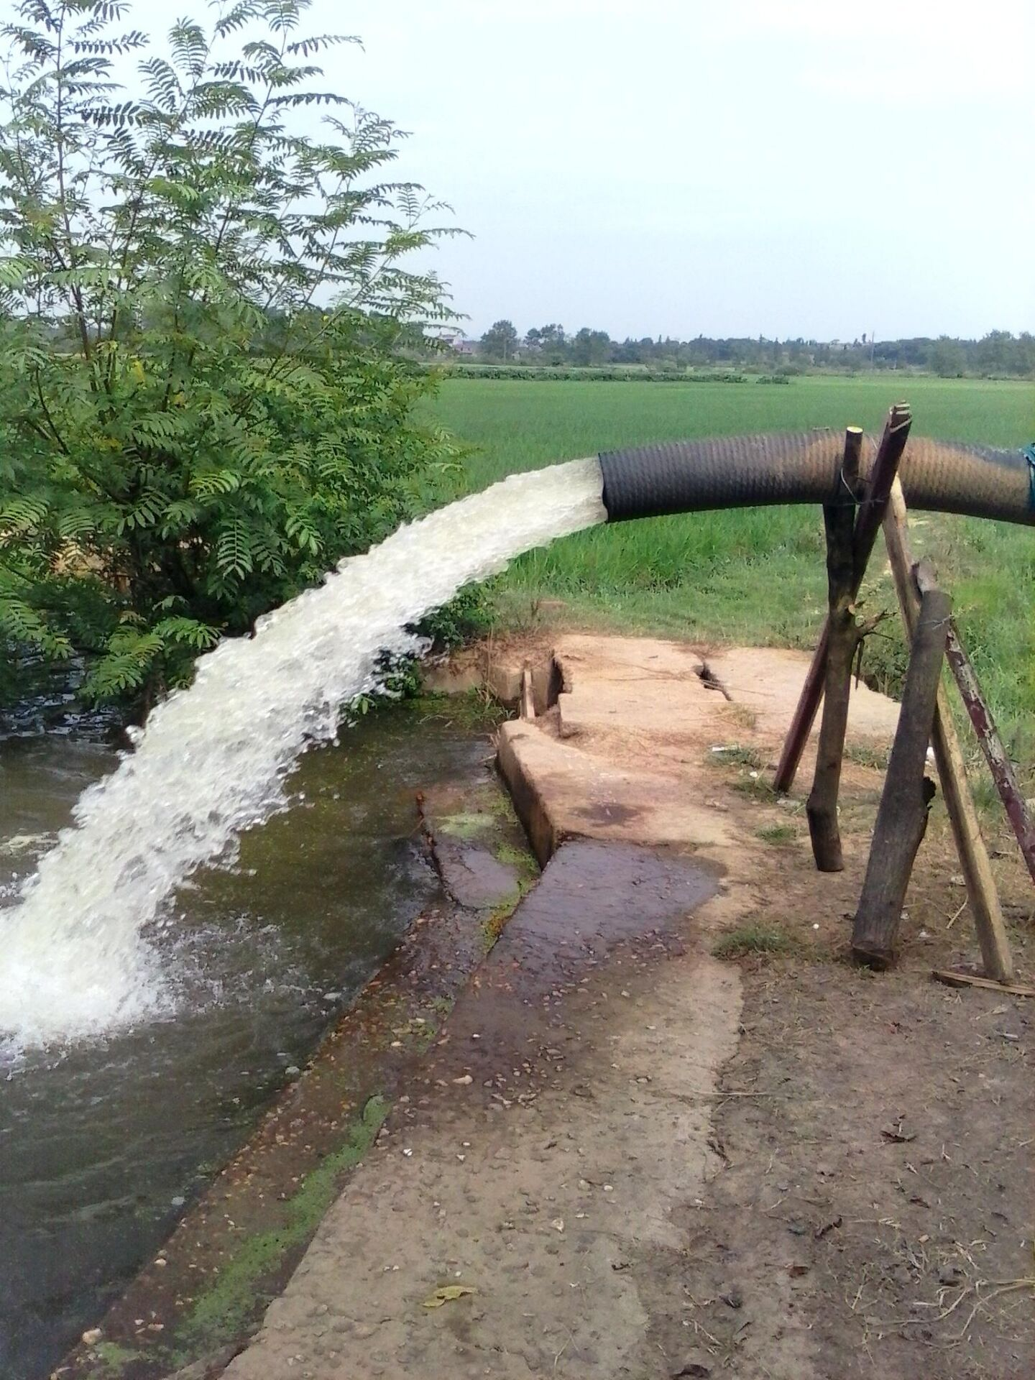
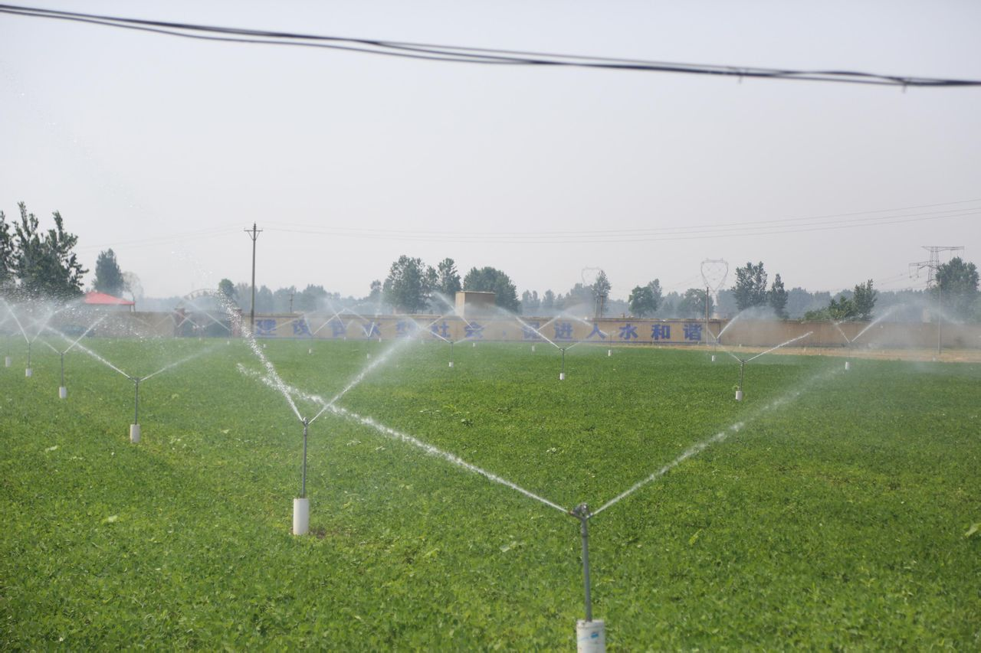
Which way is better? Why?

Slide 4
Mind map
To save water

Slide 5
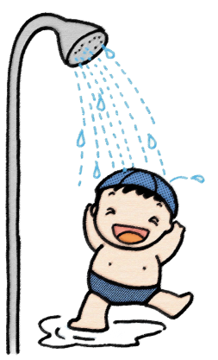
Brainstorm
What can we do to save water?
We can save water by________
1.Take shorter showers
2.Turn off the tap when we brush our teeth
3.Reuse water if possible
4. ………

Slide 6
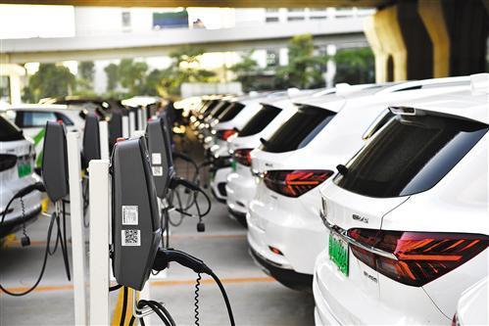
Why do more and more people drive New Energy cars?

Slide 7
Mind map
To save water
To reduce pollution
To save power

Slide 8
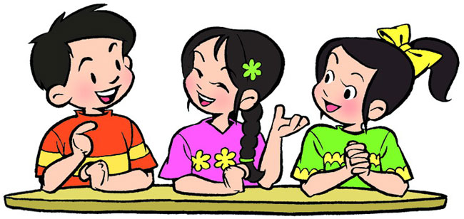
Pair work
What can we do to save power?
(to reduce pollution)
Make an interview with your partner
A:What can we do save power?
B: It is a good way to .....
A: Anything else?
B: It is important for us to..........
A:What can we do to reduce pollution?
B: We should ......

Slide 9
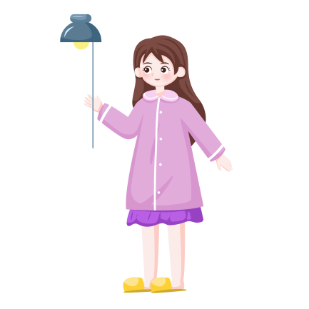
Summary
What can we do to save power?
It is important for us to ________
1. Turn off the lights when we leave a room.
2.Turn off the power when our TV or computer
is not in use.
3. .......

Slide 10
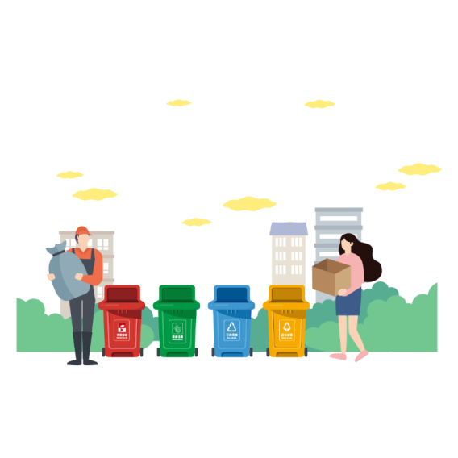
Summary
What can we do to reduce pollution?
We should use/take ....
1. Do not use plastic bags. Take our own bags when shopping.
2.Separate waste into different groups.
3. .......

Slide 11
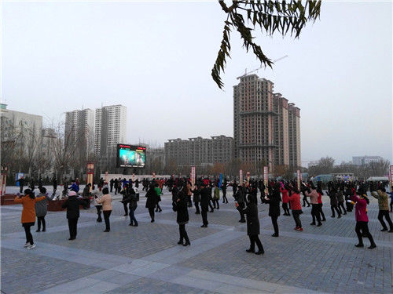
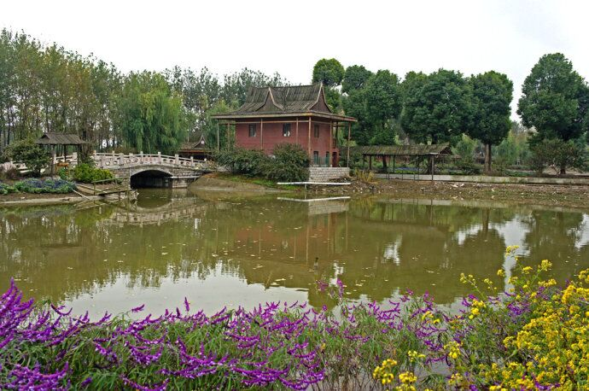
what else can we do to develop a green lifestyle?
exercise more
plant more flowers

Slide 12
Mind map
To save water
To reduce pollution
Go green
To save power
To develop a green lifestyle

Slide 13
Complete Millie's script
Our environment is changing for the worse, so it is time for us to (1) _________. Here are some simple steps to take.
We can save water by taking (2) _______________ and turning off (3) __________ when we brush our teeth. We should also (4) ___________ if possible. In order to save power, we should (5)_________________ when we leave a room. We should also turn off the power when our TV or computer is (6)_________.
go green
shorter showers
the tap
reuse water
turn off the lights
not in use

Slide 14
Complete Millie's script
Some other good habits can help reduce pollution too. We should not use (7)___________. Instead, we should take (8) _____________ when shopping.
Recycling is also a good way to help reduce pollution. We should separate (9)_______ into different groups so that it can be recycled.
Moreover, it is important for us to develop a green lifestyle. We should (10)_______________ and watch less TV and it is good to (11) _________________ at home.
Follow these small steps, and you can make a big difference to the Earth!
plastic bags
our own bags
waste
do more exercise
plant some flowers

Slide 15
Analyze (分析）the structure
Our environment is changing for the worse, so it is time for us to go green.
Here are some simple steps to take.
We can save water by taking shorter showers and turning off the tap when we brush our teeth. We should also reuse water if possible. In order to
save power, we should turn off the lights when we leave a room. We should also turn off the power when our TV or computer is not in use.
Some other good habits can help reduce pollution too. We should not use plastic bags. Instead, we should take our own bags when shopping. Recycling is also a good way to help reduce pollution. We should separate waste into different groups so that it can be recycled.
Moreover, it is important for us to develop a green lifestyle. We should do more exercise and watch less TV and it is good to plant some flowers at home.
Follow these small steps, and you can make a big difference to the Earth!
save water
save power
have a clear structure
reduce pollution
develop a green lifestyle

Slide 16
Learn to write
A.
Our environment is changing for the worse.
It is time for us to go green.
B.
Our environment is changing for the worse,
so it is time for us to go green.
Transitions can make our writing coherent(连贯的）
Transitional word(过渡词）

Slide 17
Our environment is changing for the worse, so it is time for us to go green. Here are some simple steps to take.
We can save water by taking shorter showers and turning off the tap when we brush our teeth. We should also reuse water if possible. In order to save power, we should turn off the lights when we leave a room. We should also turn off the power when our TV or computer is not in use.
Some other good habits can help reduce pollution too. We should not use plastic bags. Instead, we should take our own bags when shopping.
Recycling is also a good way to help reduce pollution. We should separate waste into different groups so that it can be recycled.
Moreover, it is important for us to develop a green lifestyle. We should do more exercise and watch less TV and it is good to plant more flowers at home.
Follow these small steps, and you can make a big difference to the Earth!
Try to circle the transitional words or phrases

Slide 18
Make the speech better by using transitional words (You can do it in different ways)
Hello, everyone. I’m Amy. It’s nice to speak about what we can do for the environment.
____________, we can use cloth bags instead of plastic bags when we go shopping. It helps to protect the environment. _________, don’t forget to turn off the lights before we leave the classrooms in order to save energy. _____________ , it will be better if we walk or ride a bike to school. We should try our best to reduce pollution and waste.
____________ , even the simplest everyday activities can make a real difference to the environment. I believe we can make the world a better place to live .
Thank you for your listening!
Firstly
Secondly
What’s more/moreover
In a word/At last

Slide 19
Learn to appreciate
Try to find out some good sentences
Our environment is changing for the worse, so it is time for us to (1) _________. Here are some simple steps to take.
We can save water by taking (2) _______________ and turning off (3) __________ when we brush our teeth. We should also (4) ___________ if possible. In order to save power, we should (5)_________________ when we leave a room. We should also turn off the power when our TV or computer is (6)_________.
go green
shorter showers
the tap
reuse water
turn off the lights
not in use

Slide 20
Learn to appreciate
Try to find out some good sentences
Some other good habits can help reduce pollution too. We should not use (7)___________. Instead, we should take (8) _____________ when shopping.
Recycling is also a good way to help reduce pollution. We should separate (9)_______ into different groups so that it can be recycled.
Moreover, it is important for us to develop a green lifestyle. We should (10)_______________ and watch less TV and it is good to (11) _________________ at home.
Follow these small steps, and you can make a big difference to the Earth!
plastic bags
our own bags
waste
do more exercise
plant some flowers

Slide 21
——play a solitaire game 接龙
plastic
word
phrase
do not use plastic bags
sentence
We should not use plastic bags. We should use our own bags.
Instead of
We should use our own bags instead of using plastic ones when shopping.
Polish(美化)
Imperative sentence (祈使句）
Remember to use your own bags instead of plastic ones when shopping.

Slide 22
——play a solitaire game 接龙
use various
（各种各样的） expressions
trees
word
phrase
plant more trees
sentence
We should plant more trees to protect our environment.
Passive voice
More trees should be planted in order to protect our environment.
Polish(美化）
动词+ing 充当主语
Planting more trees is a good way to protect our environment.

Slide 23
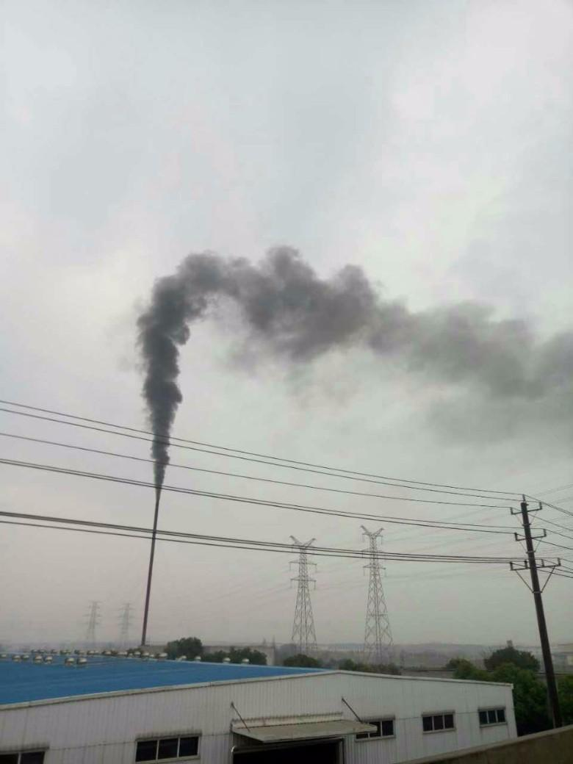
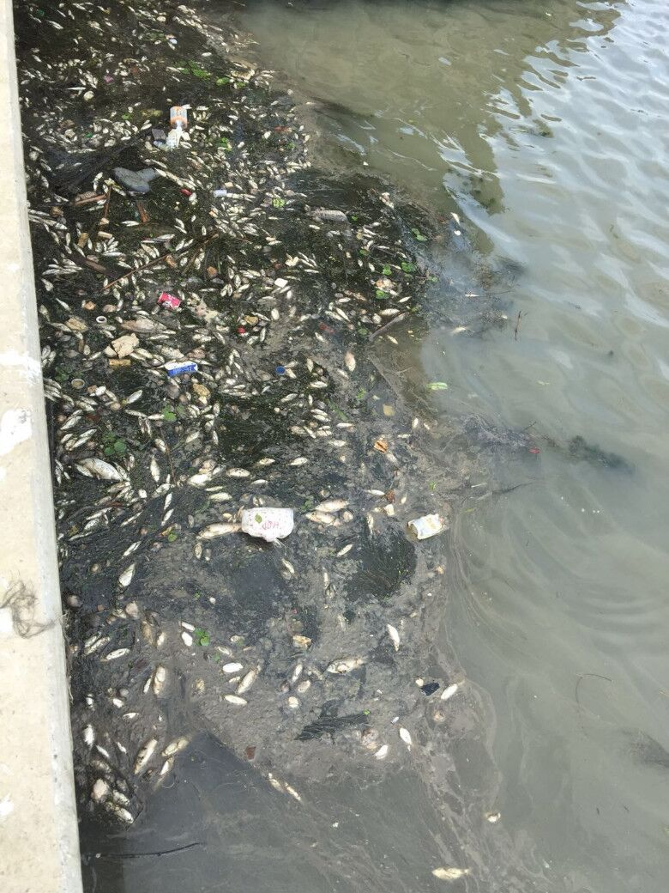
air pollution
water pollution

Slide 24
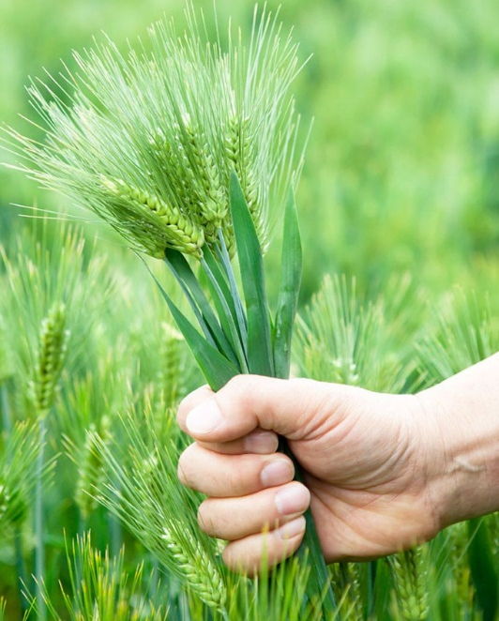
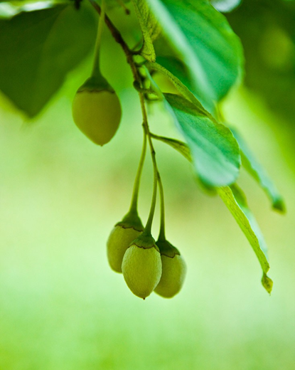
Let's write
As the environment is changing for the worse, the mayor(镇长）of Liuhe calls on people to live a low-carbon life( 低碳生活 ）. Can you help him make a speech?
请插入图片
（见教程）
请插入图片
（见教程）
请插入图片
（见教程）
请插入图片
（见教程）

Slide 25
Mind map
How can we live a low-carbon life?
Save energy
how to live a low-carbon life
Choose green travel
Reduce pollution
Have a green lifestyle

Slide 26
Group work
How can we live a low-carbon life?
1.Write down your ideas from 4 aspects(方面）by yourself.
2. Each aspect should have at least 2 ideas.
3. Share your ideas in groups .
4. Group leader chooses one best idea from your group and then writes it down on the blackboard.

Slide 27
Summary
How can we live a low-carbon life?
Save energy
We can save energy by...
1. turn off the lights when we leave the room
2. reuse water if possible
3. use both sides of paper
4 .…
Reduce pollution
We had better ......
1. plant more trees
2. use our own bags instead of plastic ones
3. not drop litter everywhere
4. …

Slide 28
Summary
How can we live a low-carbon life?
Have a green lifestyle
We should ...
1. spend less time watching TV or surfing the Internet
2. eat less meat
3. do more exercise
4. …
Choose green travel
It is important for us to ...
1. walk or ride to school
2. choose public transports to go out
3. drive new energy cars
4. …

Slide 29
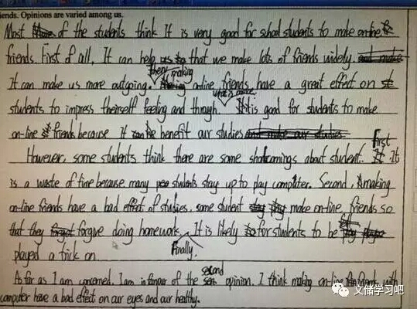
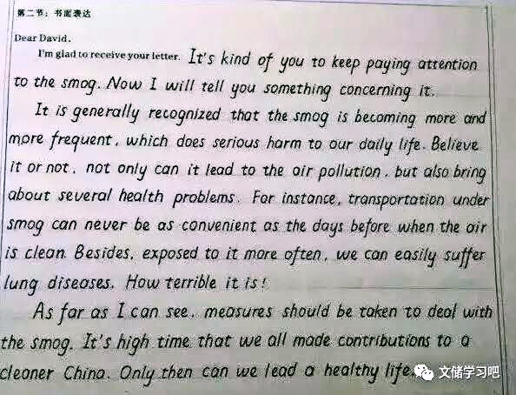
Attention:
Make your handwriting clean and tidy

Slide 30
Let’s write
Dear citizens,
Nowadays, the environment is changing for the worse. It's time for us to do something to protect our hometown. I call on more people to live a low-carbon life in order to protect the environment. Here are some simple steps we can take.
.
.
Tips:
Use your ideas from task 1 logically(有逻辑地）.
Use various(多样的） expressions to better your sentences.
Use transitions（过渡词） wisely.
4. Make your handwriting clean and tidy.
5. Finish the writing in 6 minutes.

Slide 31
Peer-editing
exchange your writing in your group (A-B; C-D)
use red pens
You should:
1. Find out the good expressions in the writing.
Use
2. Help correct the mistakes.

Slide 32
Have an evaluation
Grading standards
nice handwriting (2 points)
nice sentences (6 points)
transitions between ideas (4 points)
article structure (3 points)
grammatical use (5 points) Fewer mistakes
Your marks:____________

Slide 33
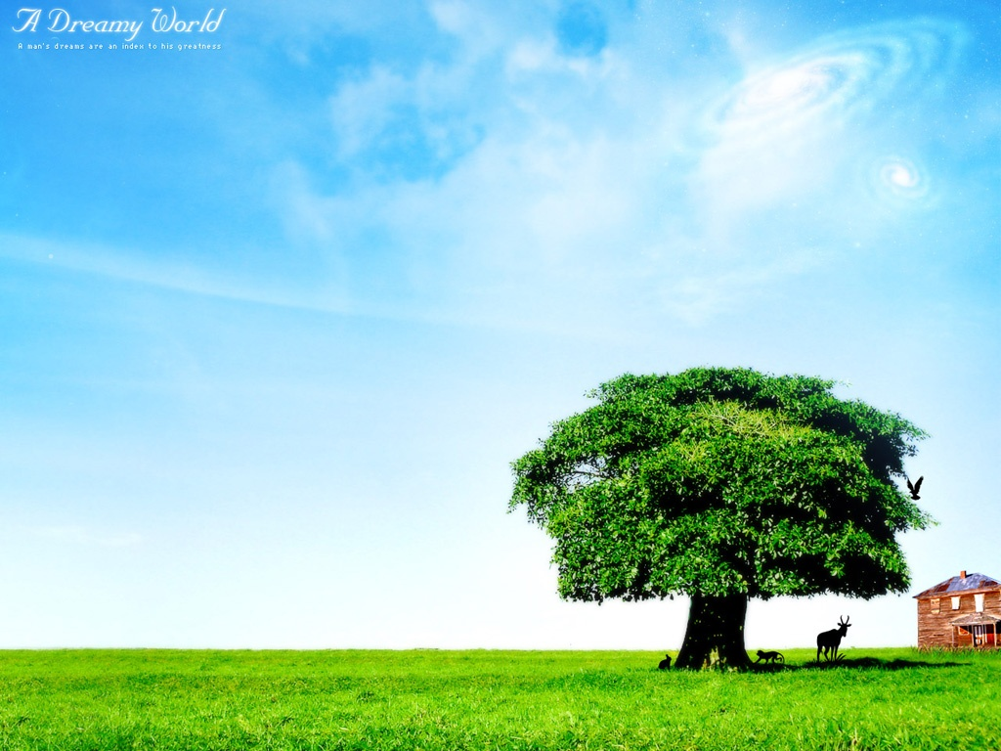
Show time

Slide 34
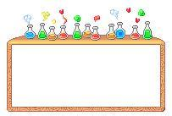
Thank you
1.It's everyone's duty to protect the environment.
2. Cherish life, safety first.

Slide 35
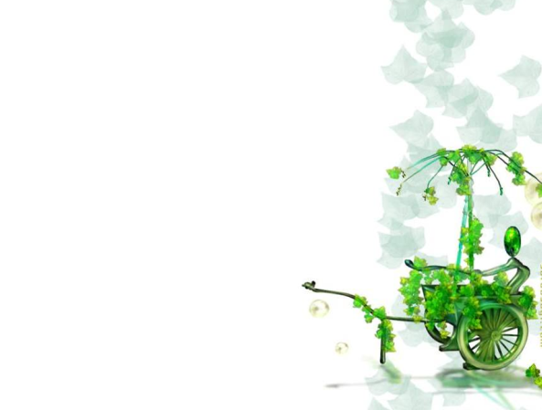
Homework:
1.Read your writing again and revise(修改） it if necessary.
2.Tell more people around you about how to go green.

