Slide 1
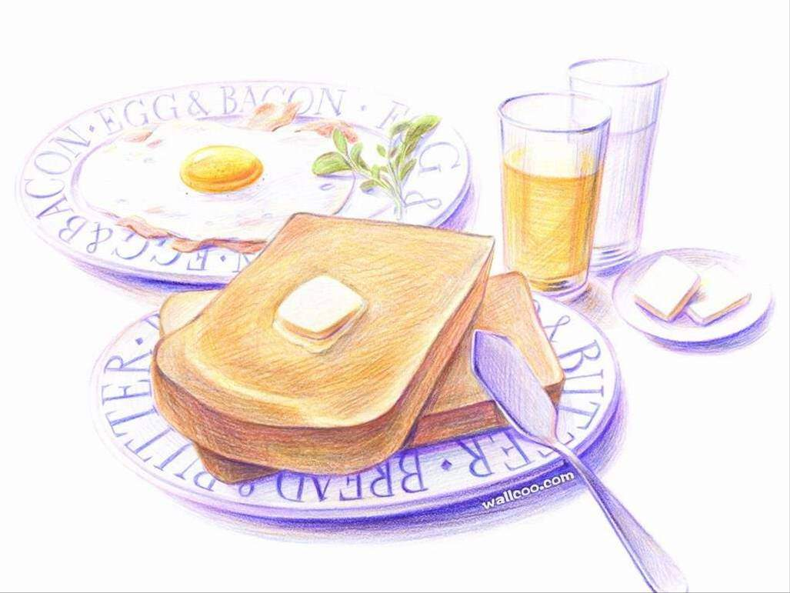
Unit 6 Food and Lifestyle
Integrated skills
How to keep fit
Fuqiao Middle School
Wang Zijia

Slide 2
Dear Mr Wang:
I’m glad to receive your letter. But now I am not very happy. I’m in trouble(麻烦) now。
I always feel hungry, so I eat a lot of snacks every day. I like eating chocolate, hamburgers, meat, cakes and I also like drinking cola. I seldom eat fruit and vegetables. I am 100 kilos now. I am too fat.
I hate exercise. I like playing computer games at night. I go to bed very late. So in daytime(白天)， I feel very tired and don’t want to do anything.
I know I am not healthy now, but I don’t know how to do, can you help me? Waiting for your letter. Please write back soon.
Suzy

Slide 3
Questions:
1、What are Suzy’s problems?
2、Why is her lifestyle not healthy?

Slide 4
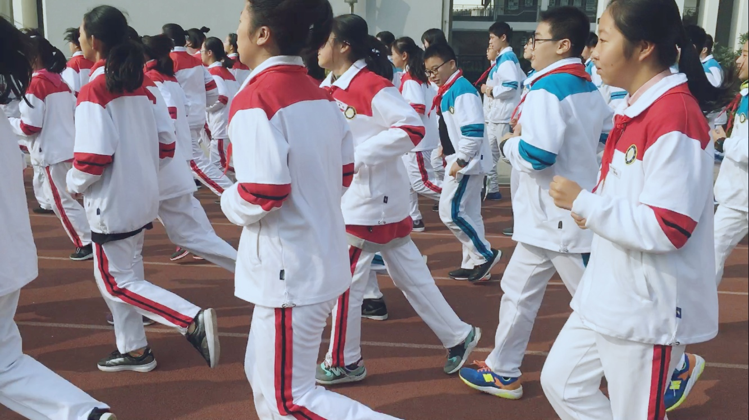
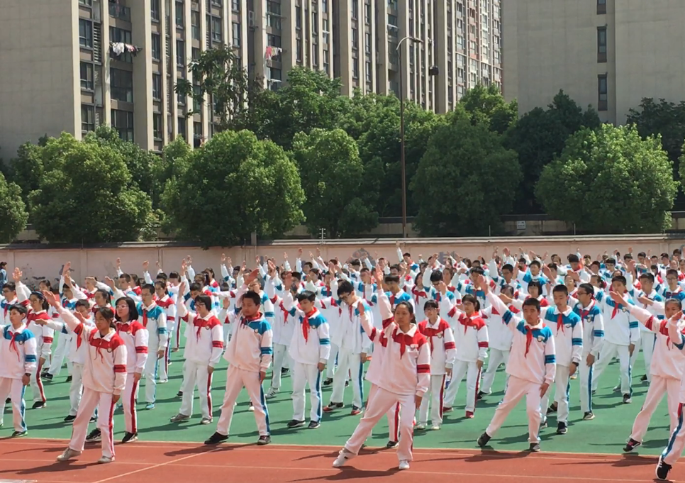
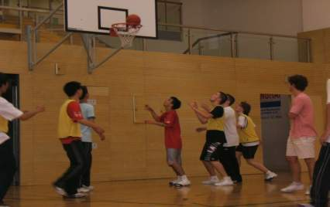
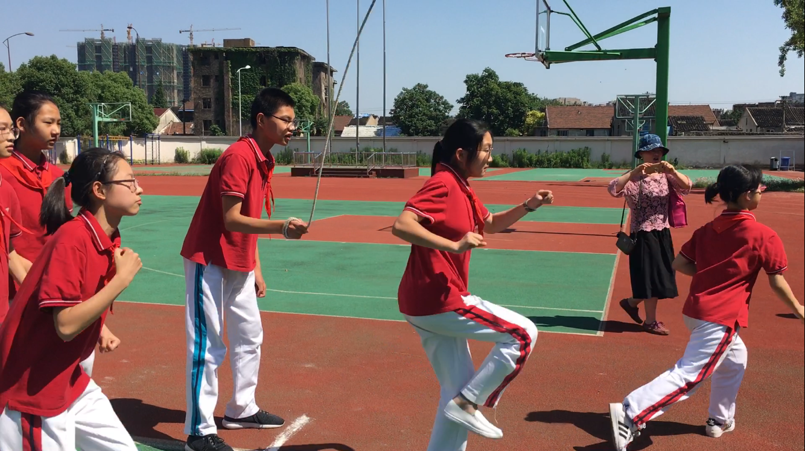
How often do you exercise?

Slide 5
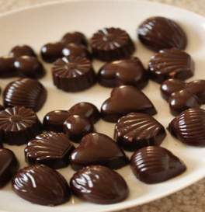
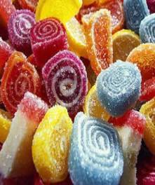
cakes
chocolate
sweets
How often do you eat cakes ,chocolate or sweets?

Slide 6
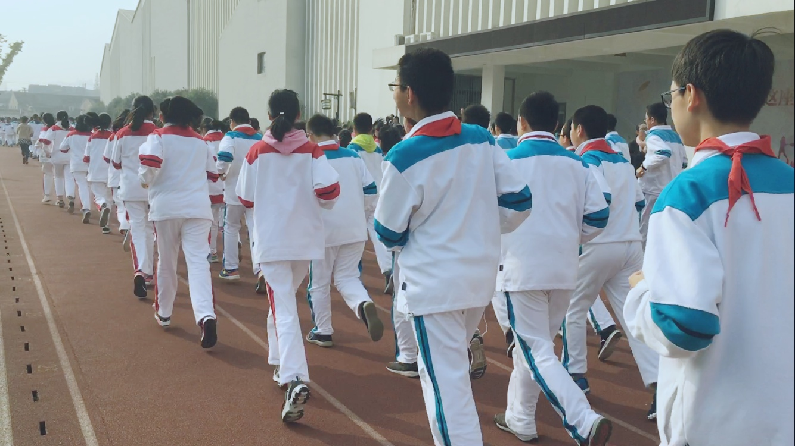
How often do you take a walk?

Slide 7
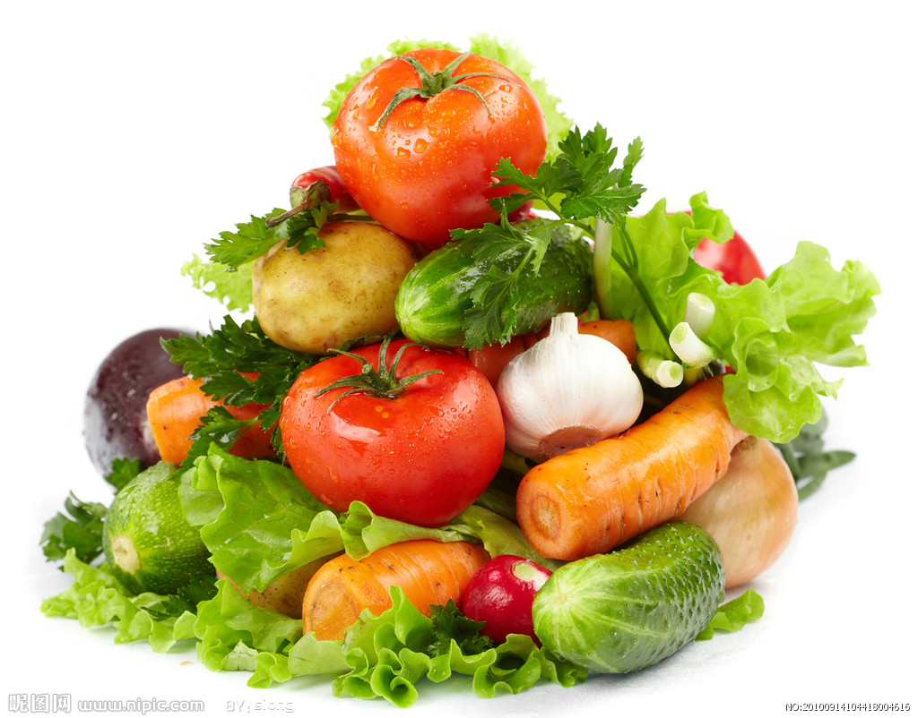
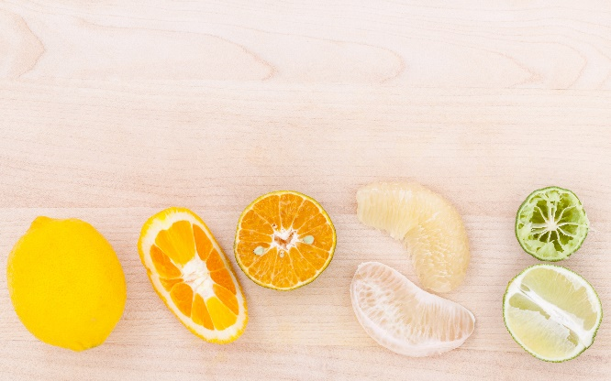
How often do you eat fruit and vegetables?

Slide 8
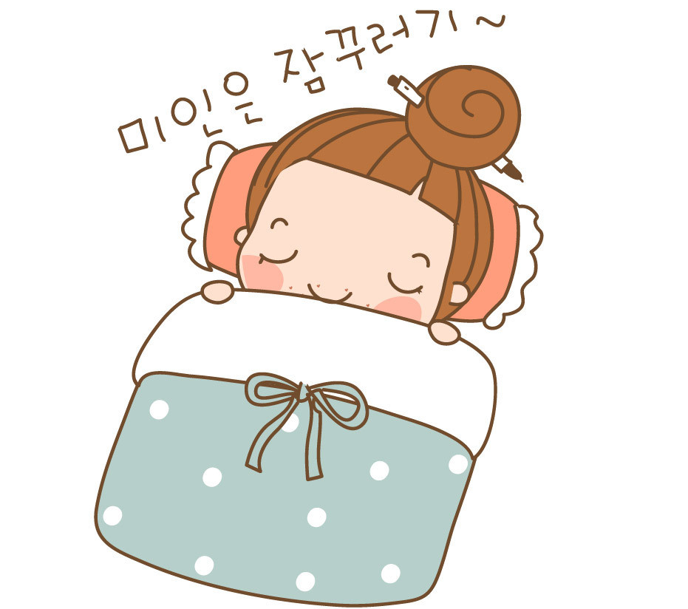
How long do you sleep every night ?

Slide 9
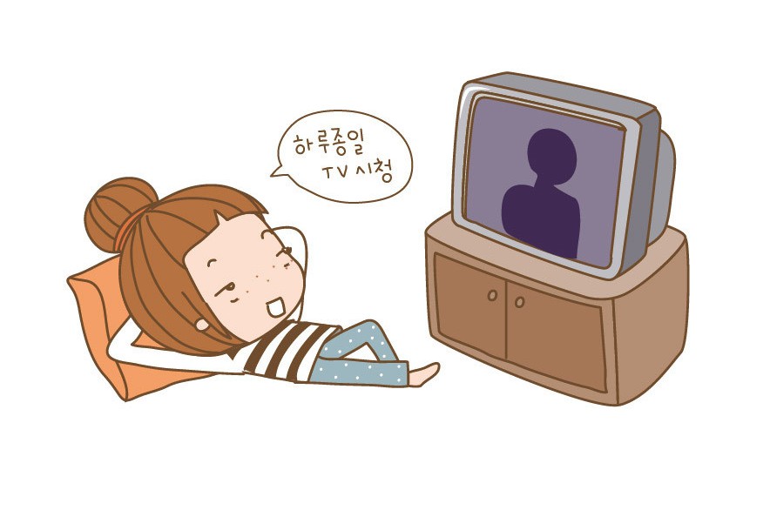
How long do you watchTV every day?

Slide 10
How healthy are you?
Please finish the questionnaire to show your lifestyle.

Slide 11
1.How often do you exercise?
A less than three times a week
B three to six times a week
C every day
You
LIFESTYLE
Questionnaire
2.How long do you sleep every night?
A. less than 7 hours
B. more than 9 hours
C. about 8 hours
问卷调查
3.How long do you watch TV every day?
A more than 2 hours
B 1-2 hours
C less than 1 hour
4.How often do you eat cake, chocolate or sweets?
A. every day B. often C. seldom
5.How often do you eat fruit and vegetables?
A. never B. seldom C. often
6.How often do you take a walk?
A. never B. sometimes C. every day

Slide 12
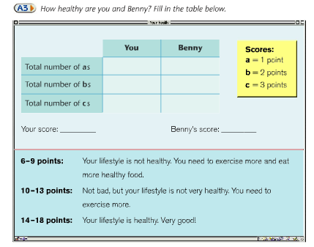
Your score: ______

Slide 13
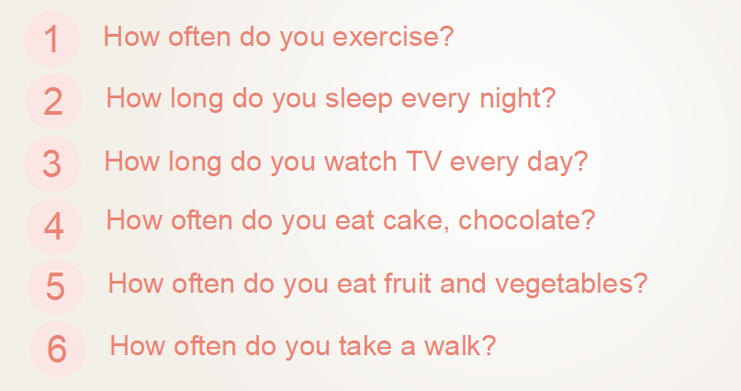

Slide 14
Report(报告)
I would like to tell you about my partner
____’s lifestyle.
My partner exercises _____. He/She sleeps for ____ hours every night. In his/her free time, he/she watches____ hours of TV every day. He/She ____eats cakes, chocolate and sweets and ____ eats fruit and vegetables.And he/she ____ takes a walk.
He/She gets ____ points. So I think his/her
lifestyle is ____(healthy/not healthy). I hope
he/she________________________________.

Slide 15
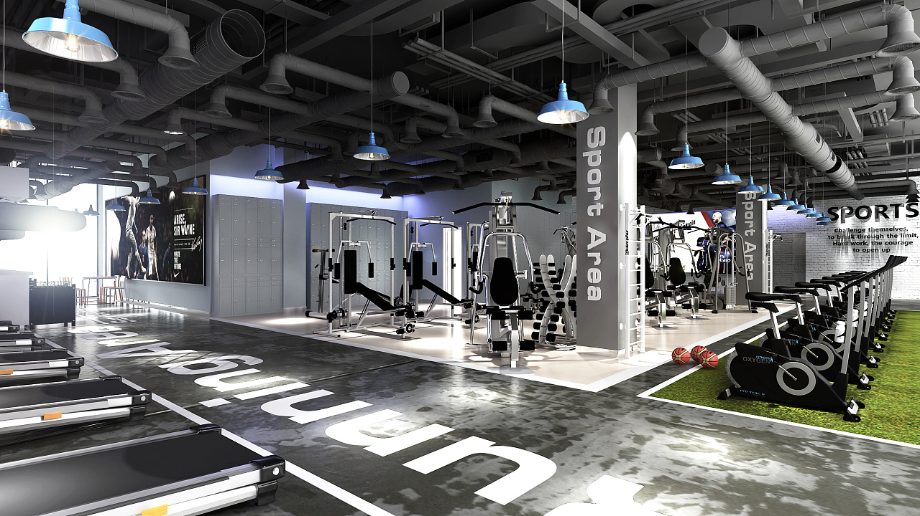
This is Benny
He is a member of
the Get Fit Club
Is his lifestyle healthy?

Slide 16
Listen and choose
1.How often do you exercise?
A less than three times a week
B three to six times a week
C every day
You
Benny
LIFESTYLE
Questionnaire
2.How long do you sleep every night?
A. less than 7 hours
B. more than 9 hours
C. about 8 hours
问卷调查
3.How long do you watch TV every day?
A more than 2 hours
B 1-2 hours
C less than 1 hour
4.How often do you eat cake, chocolate or sweets?
A. every day B. often C. seldom
5.How often do you eat fruit and vegetables?
A. never B. seldom C. often
6.How often do you take a walk?
A. never B. sometimes C. every day

Slide 17
How healthy are you and Benny
Overall(总体上说),
He is a very healthy person.
 | You | Benny
Total number of ‘a’s
Total number of ‘b’s
Total number of ‘c’s
0
Scores:
a = 1 point
b = 2 points
c = 3 points
1
5
17
Your score: Benny’s score:
6-9 points:
You r lifestyle is not healthy. You need to exercise more, and eat more healthy food.
10-13 points:
Not bad, but your lifestyle is not very healthy. You need to exercise more.
14-18 points:
Your lifestyle is healthy. Very good!

Slide 18
Benny likes exercising. He exercises ____ ____ . He usually sleeps for _____________.He watches TV for _____ ____ an hour.He _____ ____ cakes, chocolate and sweets. He ____ eats ____ and ________ . He often ____ _____ _____ after dinner. His score is __. So he is a very ______ person. Congratulations(祝贺) to him!
every day
about ten hours
less than
seldom
eats
often
fruit
vegetables
takes a walk
17
healthy

Slide 19
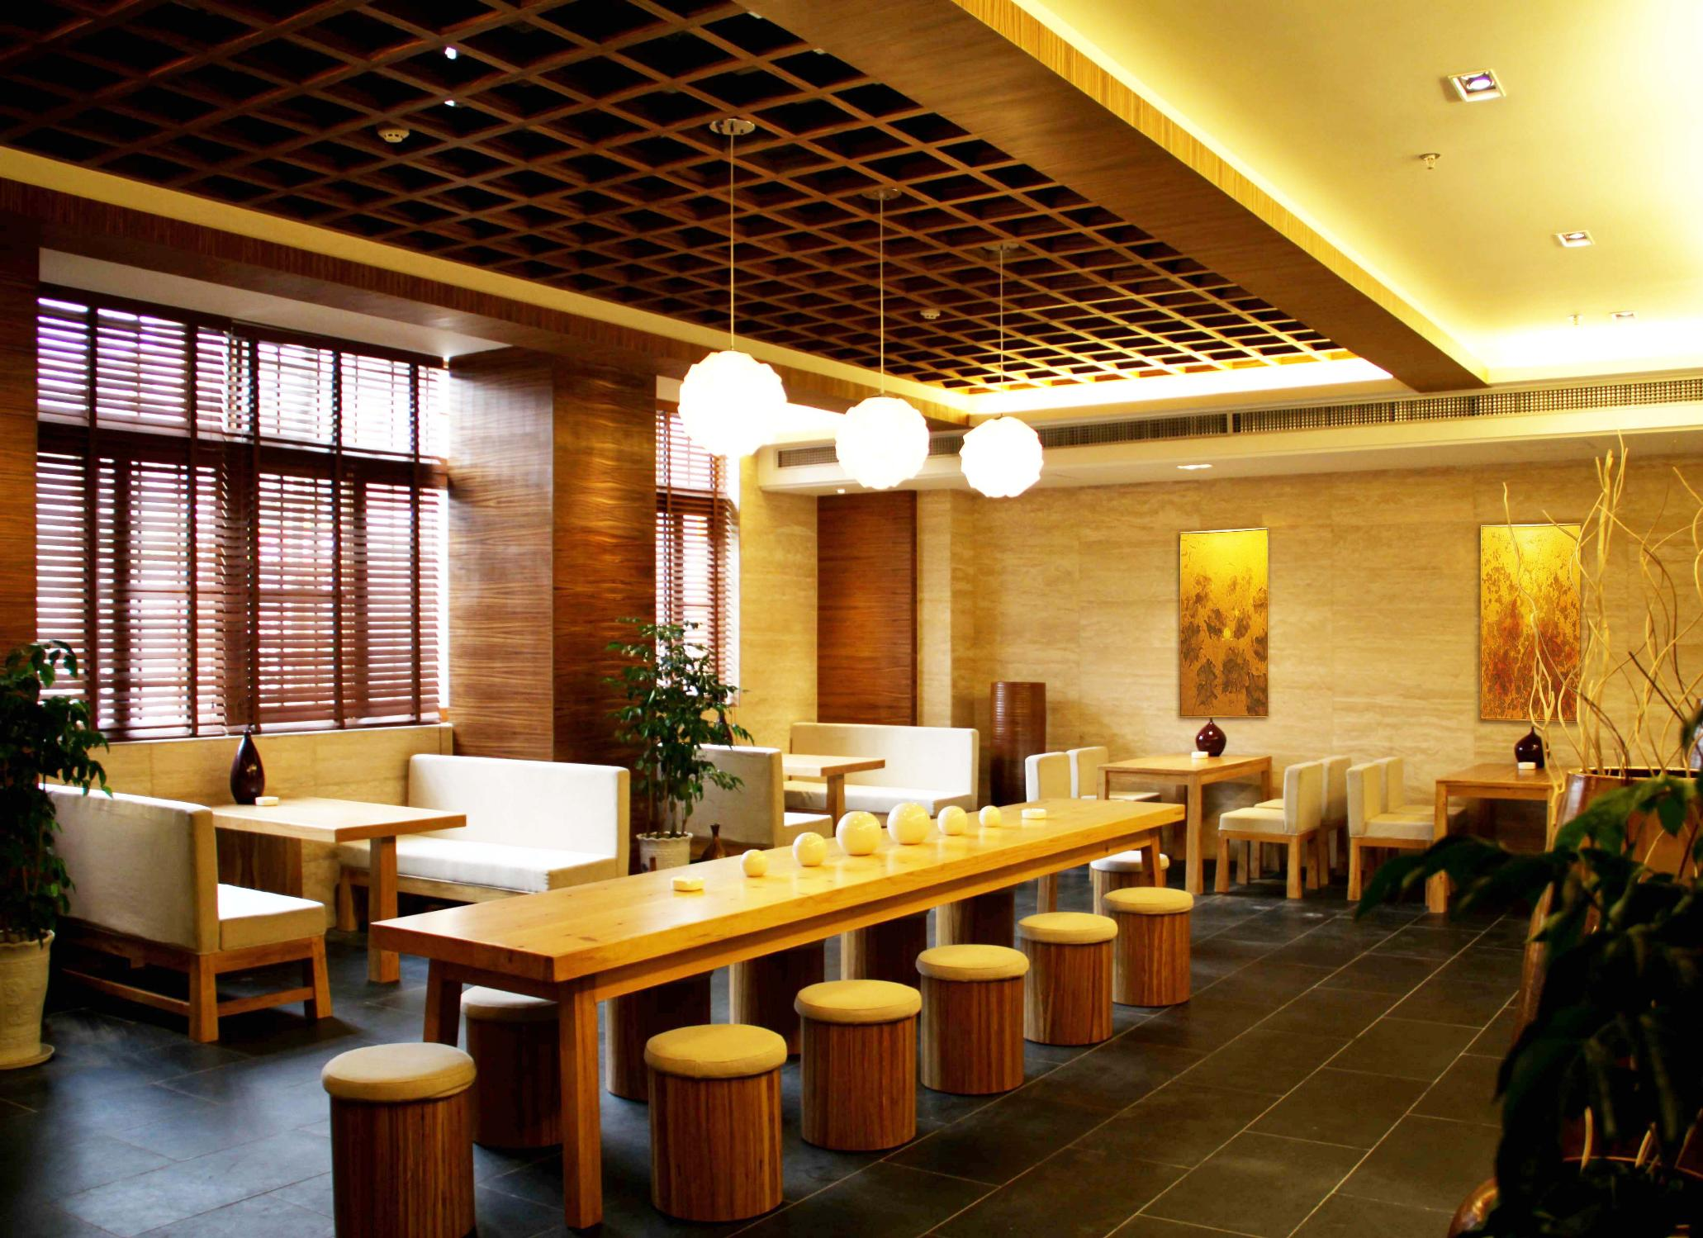
At a restaurant

Slide 20
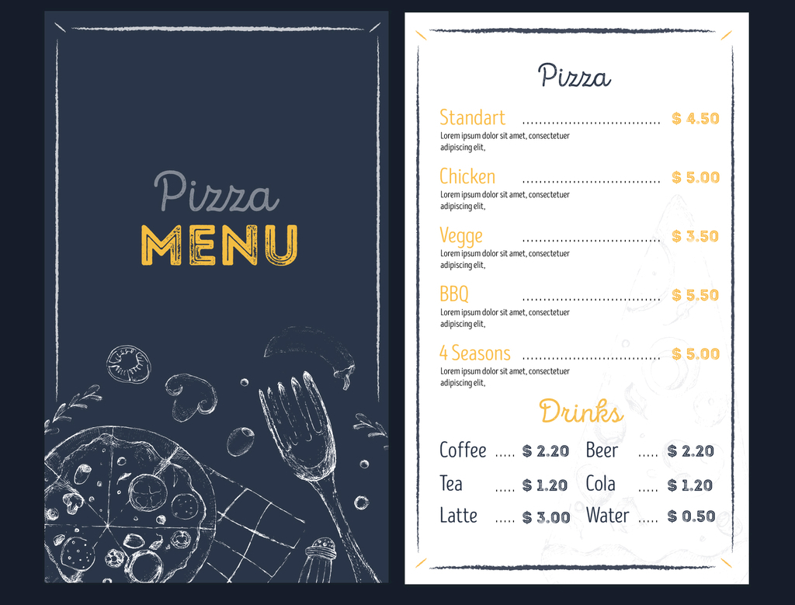
menu
n.菜单
/'menju:/

Slide 21
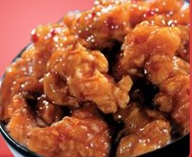
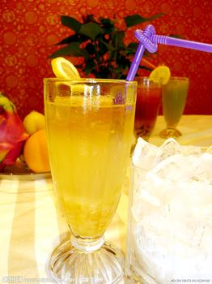
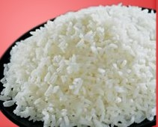
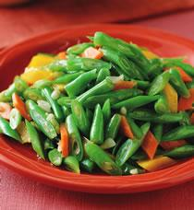
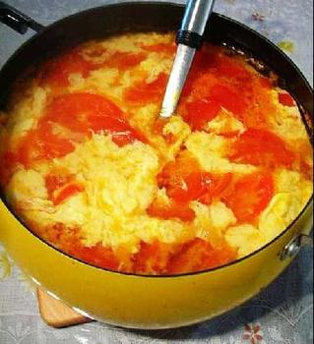
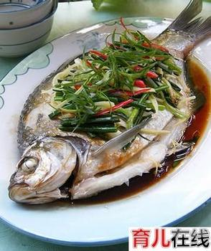
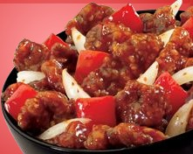
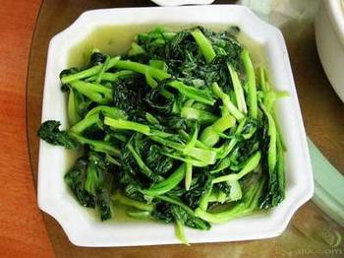
What would you like to order?
/'ɔ:də(r)/
vt.&vi.点（菜）
Orange
juice
Chicken
Green
beans
Rice
/bi:n/
n.豆，豆科植物
Tomato and
egg soup
Fish
Green
vegetables
Beef

Slide 22
What do Millie and Andy
have for dinner?
Beef
fish
green beans
apple juice
some rice.

Slide 23
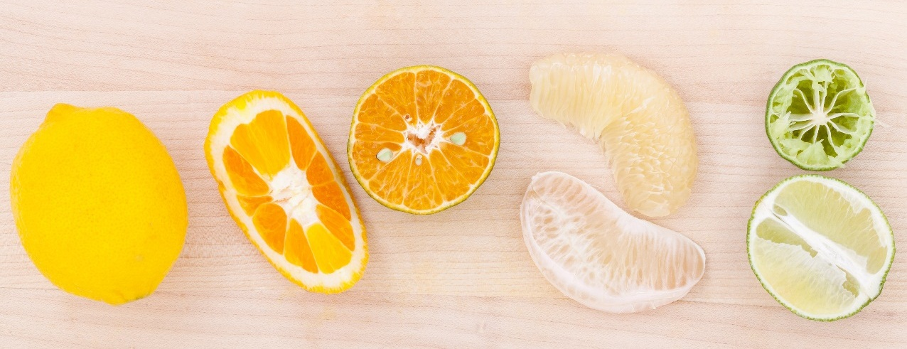
Make up a dialogue
A: What would you like to order?
B: Let me have a look at the menu, please
How about...
A: OK, I’ll have...
Would you like...
B: Yes/ No. I’d like...
A: What about some...?
B: OK,...
A: Any drinks?
B: Can I have a bottle of...?
A: ...is (not) healthy./What about... juice?
B: That’s fine!

Slide 24
Group work
Give a talk on how to keep fit
Group members say the beginning and ending together
Each member should say at least 1 point
I will give you 3 minutes

Slide 25
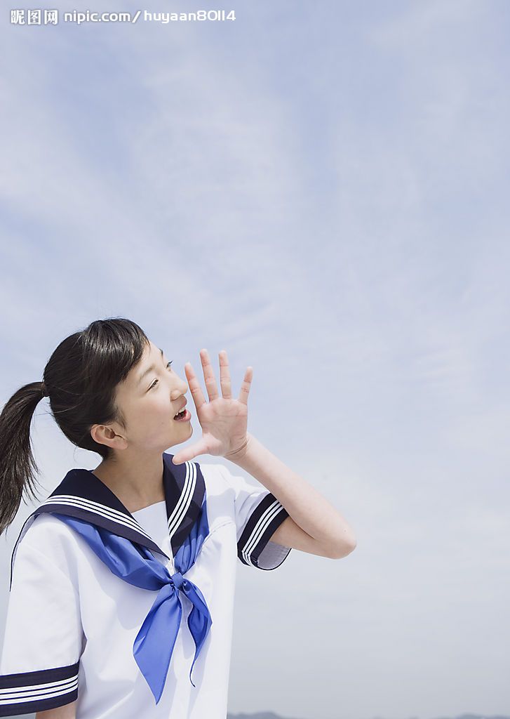
Give a talk on how to keep fit
Hello , boys and girls . Today , We’re very happy to tell you about how to keep fit.
Good luck with your new diet and lifestyle, Thank you , goodbye.
First…
Second …
Then…
Finally…

Slide 26
1. How often do you take a walk?
How often表示“多久一次”，用来询问频率。
Practise
你多久去一次图书馆？
你多久去看你的祖父母一次？
How often do you go to the library?
How often do you visit your grandparents?

Slide 27
take a walk意为“散步”。其中，walk是名词，此短语还可直接用动词walk来代替。
walk作动词时，后常与to连用，意为“步行去……”，相当于go … on foot 。
Practise
His uncle walks to the factory every day.
The old woman takes a walk with her husband (丈夫) every morning.
他的叔叔每天步行去工厂。
这位老妇人每天早上都跟她的丈夫一起散步。

Slide 28
2. more than 2 hours
more than的意思是“比……多”，more是many和much的比较级。其反义短语为less than，意为“不到……”，less是little 和few的比较级。
Practise
There are less than forty students in our
class.
His brother watches TV for more than two hours every day.
我们班有不到40个学生。
他弟弟每天看两个多小时的电视。

Slide 29
3. How long do you sleep every night?
How long意思是“多长”，可以用来询问事物、时间等的长度。
Practise
How long is this river?
How long do you practise English every day?
这条河有多长？
你每天练多长时间英语？

Slide 30
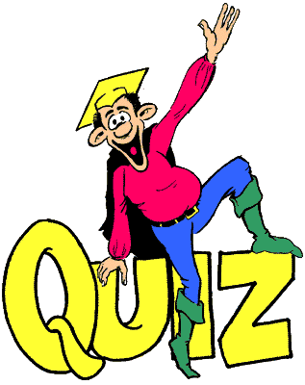

Slide 31
I. 根据首字母或汉语提示完成句子。
1. It’s bad for our health to sleep l____
than six hours a day.
2. The n______ of the students in the class
is 53.
3. — What do you want to o_____, Sir?
— Fish and rice.
4. The beef is very nice. I want m______.
5. The s______ of the match is 60-52. Our
school team wins the basketball match.
ess
umber
rder
ore
core

Slide 32
6. The chocolate ______ (尝起来) too
sweet. I don’t like it.
7. Are green _____ (豆子) your favourite
food?
8. How _____ (多久一次) do you play
computer games?
9. Do you know the _____ (总共的)
population (人口) of China?
10. Please give me the _____ (菜单). I’d
like to have a look first.
tastes
beans
often
total
menu

Slide 33
II. 选择短语并用其适当形式填空。
healthy lifestyle, every day, take a walk,
all right, for lunch, more than, keep fit, how long, a bag of, what about
1. It’s good for us to __________ after
dinner.
2. I’m busy now. ___________ calling me
two hours later (之后)?
3. Toby likes cars. He has __________ 30
model cars.
take a walk
What about
more than

Slide 34
healthy lifestyle, every day, take a walk,
all right, for lunch, more than, keep fit, how long, a bag of, what about
4. — The bus is so crowded (拥挤的). Let’s
wait for the next one.
— ________.
5. Sun Wei seldom gets ill, because he often
exercises and has a ______________.
6. — ________ do they play volleyball
every afternoon?
— For two to three hours.
All right
healthy lifestyle
How long

Slide 35
healthy lifestyle, every day, take a walk,
all right, for lunch, more than, keep fit, how long, a bag of, what about
a bag of
7. I can’t carry ________ apples. It’s too
heavy.
8. The News Report begins at 7:00 p.m.
_________.
9. My grandpa does taiji in the morning to
_________.
10. _________, people from Shanxi always
eat noodles.
every day
keep fit
For lunch

Slide 36
( )1.---________do you visit your grandparents, Daniel？
---Twice a month.
A. How long B.How often
C.What time D.When
( )2.---_______do you watch TV every day?
---For less than half an hour.
A. When B.How long
C.How far D.How often
( )3.---I'm hungry,Mum.May I have ________?
---OK.There is some in the fridge.
A. a carton of milk B.some bread
C.some cola D.some apple juice
( )4.---What should I do, doctor?
---You must eat_____an do_____exercise.
A. much; little B.more;less
C.less;more D.much;less
( )5.How many ________ can you see in the kitchen.
A. bottles of juices B.bottles of juice
C.bottle of juices D.bottle of juice
( )6.There are ________42 students in our classroom.
A. more B. more than C. less than D. less

Slide 37
Proverbs about health
Wealth is nothing without health.
失去健康，钱再多也没用。
There is no medicine against death.
没有长生不老药。
Reading is to the mind while exercise to the body. 读书健脑，运动强身。
Health is better than wealth.
健康胜过财富。
Eat a mouthful less. Take a walk after dinner.
吃饭少一口，饭后走一走。

Slide 38
Homework
Write a short report on your health as well as your health score, and what should you do to keep fit.

